Slide 1
FutureMobility
Accelerate2Move

Slide 2
What is Accelerate2Move?​
a thematic accelerator focusing on Artificial Intelligence, Blockchain, 5G, Vehicle -to-everything, Internet-of-Things connectivity and Web 3.0 in the context of their contribution to sustainable urban mobility​
one of seven thematic EIT Urban Mobility Accelerators​
operating from 2023 - 2025

Slide 3
Who is behind Accelerate2Move?​

Slide 4
Call for applications timeline​​
04.02.-21.04. Open call for applications
July 2025
Bootcamp in Riga
June – December 2025
Execution of the accelerator programme
04.-06.11. Tomorrow Mobility, Barcelona

Slide 5
What does Accelerate2Move offer?
6 months of tailor-made acceleration programme developed with the start-ups​
80 hours of online mentoring and thematic workshops ​
5-day face-to-face bootcamp in Latvia (costs fully covered)​
€2500 grant and tickets to Tomorrow.Mobility 2025​
Mentoring from the most suitable mentors from our database of 200 experts​
Opportunity to test your solutions in testbeds and pilot cities​
Opportunity to get your start-up recommended for investment to EIT Urban Mobility – Impact Ventures division

Slide 6
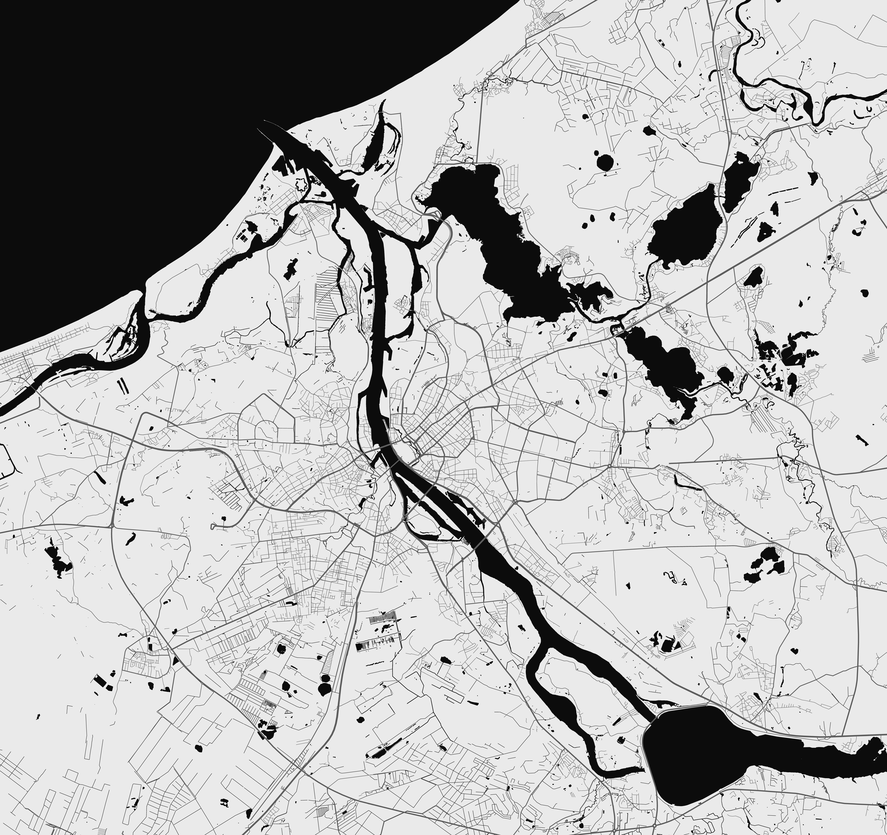
5G at Sea
LMT testbeds
Ķīšezers Lake Drone corridor
VEFRESH
Smart City
5G EMC Lab
Health tech
Biķernieki
5G mobility
333 Drone testbed
IoT, AI, 5G/6G
Quantum technologies, big data

Slide 7
Who are we looking for?
Start-ups consisting of a team with at least 2 FTE. NOT a single founder. Not necessarily connected to monetary compensation;​
Start-ups incorporated in EU or EU associated countries according to the official list of countries by the European Union and third countries associated to Horizon Europe.​
Start-up incorporation date posterior to 31/12/2012. The certificate must be available at the latest 5 calendar days after the selected start-up receives notification of acceptance.

Slide 8
Who are we looking for?
A clear, scalable business idea​
Founders and employees should still own more than 50% of shares​
No more than 10% of your shares are held outside of the eligible countries
Duly justified, preferred TRL 4 – 7
Fit with thematic scope.

Slide 9
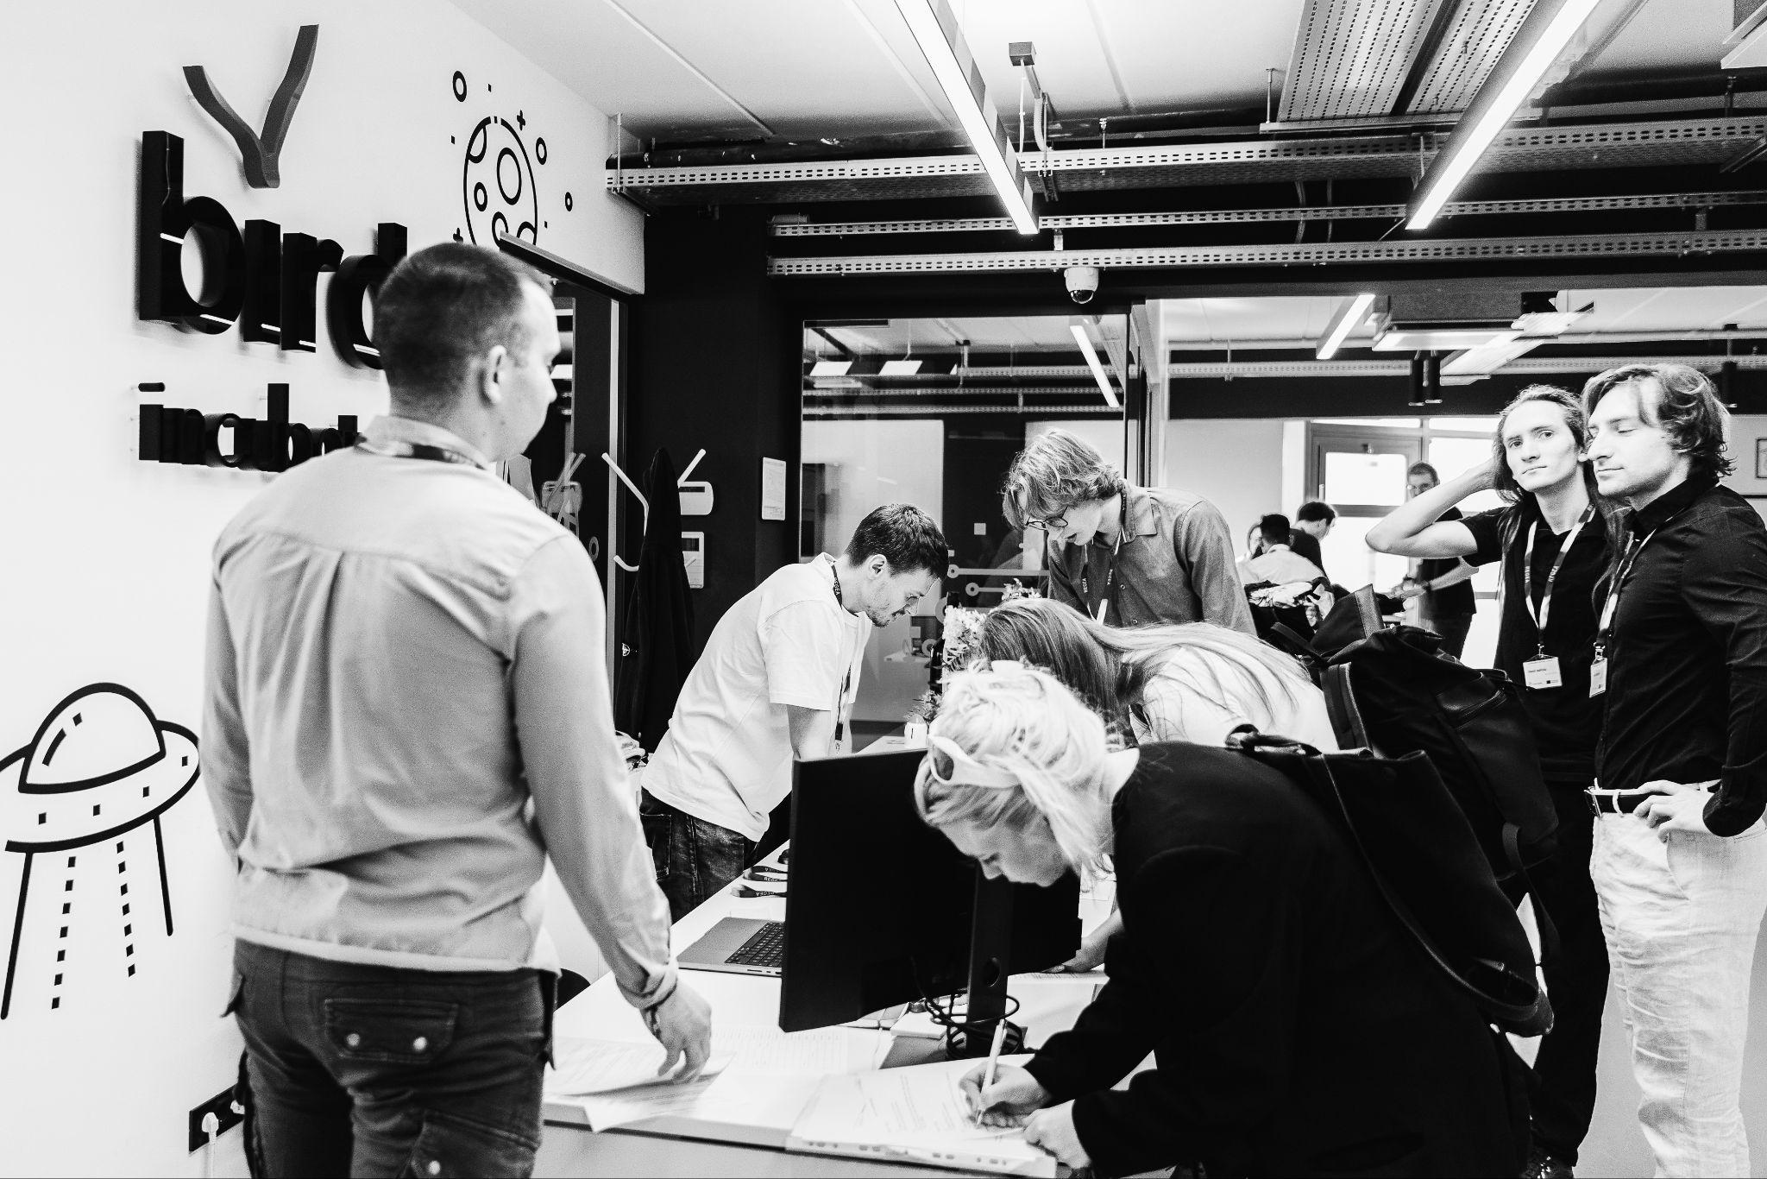
You know what
to do!

