Slide 1
Digitālās inovācijas: “Apvārsnis Eiropa”
4. klastera iespējas
Ingrīda Lavrinoviča, Dr.sc.ing.
Apvārsnis Eiropa
Nacionālā kontaktpunkta
Vecākā eksperte(CL3, CL4)
ingrida.lavrinovica@lzp.gov.lv

Slide 2
CLUSTER 4: Advancing Digital, Industry and Space
DigitaL
INDUSTRY
Digital and emerging technologies for competitiveness and fit for the Green Deal
leading data and computing technologies
Climate neutral, circular and digitized production
Autonomy in key strategic value chains for resilient industry
Space
Destination 3: Data
Autonomy in developing, deploying and using global space-based infrastructures, services, applications and data
Destination 4: Digital & emerging
Destination 6: Human centric
Cluster 4 Overview
Cluster 4 Work programme

Slide 3
2025. Gada darba programma
January
Q4 2024
Q1 2025
Initial discussions on WP orientations
Finalisation of draft work programme
Procedural steps towards adoption of work programme
2024
March
May
July
November
2025
3rd DRAFT of WP2025
APRIL
Draft WP orientations
1st DRAFT of WP2025
2nd DRAFT of WP2025
Adoption of the work programme 2025

Slide 4
Tematiskās jomas
Global Leadership in Climate-Neutral, Circular, Digital Value Chains
Open Strategic Autonomy in Digital & Emerging Technologies
Manufacturing
Construction
Energy –Intensive Industries (Decarbonization and Energy Efficiency)
Circularity and Zero Pollution
Social Circular enterprises
Quantum and high-performance computing
Photonics
AI, GenAI/Data/Robotics
Artificial Intelligence in Science
Open Strategic Autonomy in Global Space Infrastructure & Data
Tech Leadership for Europe’s Strategic Autonomy in Raw & Innovative Materials
Work programme 2025
Accessing Space
Acting in Space
Using Space on Earth (Telecommunications)
Earth Observation
Satellite navigation
Monitoring Space
Boosting Space
Raw materials
Innovative Advanced Materials
Safe and Sustainable by Design
Textiles
Agile, Secure Data & AI Services in a Single Market
Human-Centric Innovation in Digital & Industiral Tech
Connected Collaborative Computing Networks (3C Networks)
AI-GenAI, Data and Robotics
Virtual Worlds
AI, Data, and Robotics
Standardisation and Knowledge Valorisation
International cooperation

Slide 5
Darba programmas melnraksta versija
Konfidenciāls dokuments!
Satur oficiāli nepublicēto informāciju!
Provizoriskie dati par nākamo Apvārsnis Eiropa konkursu virzieniem, tematikām, un budžetu
Programmas galīgajā versijā var būt izmaiņas un labojumi
Noder kā atsauce, lai izvēlētos piemērotāko jomu atbilstoši savām interesēm un profesionālai darbībai
Apvārsnis Eiropa Nacionālā kontaktpunkta eksperti piedāvā konsultācijas, lai palīdzētu izvēlēties atbilstošāko tematiku, kā arī sagatavot one-pager un pitch prezentācijas.

Slide 6
DATA (WP2025 melnraksts)
Destination 3: Developing an agile and secure single market and infrastructure for data-services and trustworthy artificial intelligence services
Connected Collaborative Computing Networks (3C networks)
Topic | Title |  | Type of action | EU contribution per project (EUR million) | Number of projects to be funded
HORIZON-CL4-2025-03-DATA | 08 | Large-scale pilots for supply end-to-end infrastructures integrating device, network computing and communication capabilities for Telco Edge Cloud deployments, as a basis for Connected Collaborative Computing Networks (3C networks) | RIA | 75 | 1
 | 09 | Alignment of stakeholders towards the supply-side large-scale pilot of end-to-end infrastructures integrating device, network computing and communication capabilities | CSA | 2.5 | 1
 | 10 | Roadmap for next generation computing technologies from IoT device level to edge to cloud to HPC | CSA | 2.5 | 1
 | 11 | Open Internet Stack: development of technological commons/open-source 3C building blocks | RIA | 10 | 1
 | 12 | Preparing the Advancement of the state of the art of submarine cable infrastructures | CSA | 2.1 | 1

Slide 7
DATA (WP2025 melnraksts)
Destination 3: Developing an agile and secure single market and infrastructure for data-services and trustworthy artificial intelligence services
AI-GenAI / Data / Robotics
Topic | Title |  | Type of action | EU contribution per project (EUR million) | Number of projects to be funded
HORIZON-CL4-2025-03-DATA | 13 | Fostering Innovative and Compliant Data Ecosystems | IA | 7 to 9 | 5 or 6
HORIZON-CL4-2025-04-DATA | 02 | Empowering AI/generative AI along the Cognitive Computing continuum | RIA | 6 to 8 | 4 or 5
HORIZON-CL4-2025-04-DATA | 03 | Software Engineering for AI and generative AI | RIA | 4 to 6 | 2 or 3

Slide 8
DATA (WP2025 melnraksts)
Destination 4: Achieving open strategic autonomy in digital and emerging enabling technologies
Quantum and High-performance Computing
Topic | Title |  | Type of action | EU contribution per project (EUR million) | Number of projects to be funded
HORIZON-CL4-2025-03-DIGITAL-EMERGING | 01 | Continuation of the Quantum Technologies Flagship | CSA | 4.5 | 1
 | 02 | Quantum Computing – complementing the quantum computing FPAs with the development of a technology agnostic software stack | RIA | 5 | 2
 | 03 | International cooperation: joint research and development with the Republic of Korea | RIA | 2.5 and 2.7 | 3
 | 04 | Post-exascale HPC | CSA | 2.5 | 1

Slide 9
DATA (WP2025 melnraksts)
Destination 4: Achieving open strategic autonomy in digital and emerging enabling technologies
AI-GenAI / Data / Robotics
Topic | Title |  | Type of action | EU contribution per project (EUR million) | Number of projects to be funded
HORIZON-CL4-2025-03-DIGITAL-EMERGING | 07 | Robust and trustworthy GenerativeAI for Robotics and industrial automation | RIA | 40 to 45 | 2
HORIZON-CL4-2025-04-DIGITAL-EMERGING | 04 | Assessment methodologies for General Purpose AI capabilities and risks | RIA | 3 to 4 | 2
 | 05 | Soft Robotics for Advanced physical capabilities | IA | 10 | 2
 | 06 | Challenge-Driven GenAI4EU Booster | RIA | 15 | 4
 | 07 | Enhanced Learning Strategies for General Purpose AI: Advancing GenAI4EU | RIA | 15 | 2

Slide 10
DIGITAL EMERGING (WP2025 melnraksts)
Destination 4: Achieving open strategic autonomy in digital and emerging enabling technologies
Artificial Intelligence in Science
Topic | Title |  | Type of action | EU contribution per project (EUR million) | Number of projects to be funded
HORIZON-CL4-INDUSTRY-2025-01-DIGITAL | 61 | AI Foundation models in science | RIA | 4 to 6 | 2 or 3
HORIZON-CL4-INDUSTRY-2025-01-DIGITAL | 62 | Facilitated cooperation for AI in Science | CSA | 3 | 1

Slide 11
HUMAN-CENTRIc INNOVATION (WP2025 melnraksts)
Destination 6: Digital and industrial technologies driving human-centric innovation
Virtual Worlds
Topic | Title |  | Type of action | EU contribution per project (EUR million) | Number of projects to be funded
HORIZON-CL4-2025-03-HUMAN | 14 | Core technologies for virtual worlds | RIA | 5 to 6 | 7
 | 15 | Generative AI for Virtual Worlds: Advanced technologies for better performance and hyper personalised and immersive experience | IA | 4 to 5 | 4 or 5
 | 16 | Drive the evolution of the internet towards open and interoperable Web 4.0 and Virtual Worlds: building blocks in priority areas | RIA | 3 | 5
 | 17 | Specific support for the Virtual Worlds Partnership and the Web 4.0 initiative | CSA | 2.5 | 1

Slide 12
HUMAN-CENTRIc INNOVATION (WP2025 melnraksts)
Destination 6: Digital and industrial technologies driving human-centric innovation
AI-GenAI / Data / Robotics
Topic | Title |  | Type of action | EU contribution per project (EUR million) | Number of projects to be funded
HORIZON-CL4-2025-03-HUMAN | 18 | GenAI4EU central Hub | CSA | 3 | 1
Standardisation and Knowledge Valorisation
Topic | Title |  | Type of action | EU contribution per project (EUR million) | Number of projects to be funded
HORIZON-CL4-INDUSTRY-2025-01-HUMAN | 60 | Horizon Standardisation Booster | CSA | 1.5 | 1
 | 61 | Standardisation landscape analyses tool | CSA | 1 | 1
 | 62 | Artificial Intelligence for knowledge valorisation | CSA | 2 | 1

Slide 13
HUMAN-CENTRIc INNOVATION (WP2025 melnraksts)
Destination 6: Digital and industrial technologies driving human-centric innovation
Standardisation and Knowledge Valorisation (cont.)
Topic | Title |  | Type of action | EU contribution per project (EUR million) | Number of projects to be funded
HORIZON-CL4-INDUSTRY-2025-01-HUMAN | 63 | Value creation pilots for scaling up innovative solutions | CSA | 2 | 1
 | 64 | Pilot initiatives on Technology Infrastructures | CSA | 0.5 to 1 | 5 to 10
 | 65 | Network of Industry 5.0 system innovation hubs in connected Regional Innovation Valleys | IA | 3 | 1
 | 66 | Assessment of Technology Infrastructure needs in Ukraine | CSA | 1.5 | 1

Slide 14
HUMAN-CENTRIc INNOVATION (WP2025 melnraksts)
Destination 6: Digital and industrial technologies driving human-centric innovation
International Cooperation
Topic | Title |  | Type of action | EU contribution per project (EUR million) | Number of projects to be funded
HORIZON-CL4-2025-03-HUMAN | 19 | International cooperation in semiconductors | CSA | 3 | 1
HORIZON-CL4-2025-04-HUMAN | 08 | GenAI for Africa | RIA | 1 to 2 | 4 or 5

Slide 15
partnerības
European Partnerships
Co-Programmed European Partnerships
Institutionalized European Partnerships
Unite the European Commission with private and public partners
Address collaborative research and innovation
Horizon Europe main implementation tool
Strengthen EU priorities
Commission and private (sometimes public) partners
Specify the objectives
EUR 8 billion budget
Runs from 2021-2030
Research and innovation field
The Union, EU member states and/or industry
Co-funded European Partnerships
EU countries, with research funders and other public authorities at the core of the consortium

Slide 16
ChipsJU: Driving advancements in semiconductor technologies
Established in 2023
Tri-partite European partnership
31 member countries
Uniting Innovation
Resources
Strategic Vision
Driving Force
Support research and development in semiconductor technologies
Facilitate collaboration between public and private sectors
Promote the standardization and adoption of new solutions
Foster innovation in critical digital infrastructure.
3 Industrial associations
More information

Slide 17
SNS JU: European Smart Networks and Services Joint Undertaking
Technological Leadership and Excellence
Strategic Alignment and Industry Collaboration
Digital Infrastructure and Innovation
Public-private partnership
Enhance technological and scientific excellence
Aligned strategies across ICT sectors
Coordination with EU digital programs
Boost infrastructure
Drive Innovations
Support EU policies
2 main missions
Fostering Europe’s technology sovereignty in 6G
Boosting 5G deployment in Europe
EUR 1.8 billion budget
More information
2021-2027

Slide 18
HPC JU: THE EUROPEAN HIGH PERFORMANCE COMPUTING JOINT UNDERTAKING
Individuals
Business
Science
Leading the Way in European Supercomputing
Enhance digital transformation
Solve complex chllenges
Boost productivity
Established in 2018
Located in Luxembourg
Legal and funding entity
35 member countries
3 Private partners
EUR 7 billion budget
More information
2021-2027

Slide 19
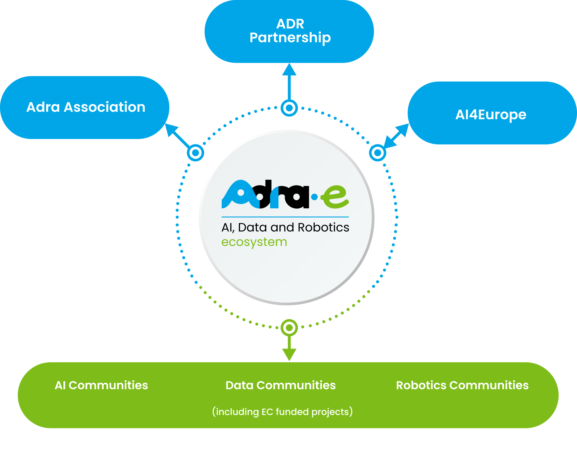
ADRA: AI, Data and Robotics Association
Started on July 1st 2022
CSA action under Horizon Horizon Europe
15 organizations
Support, update and implement the AI, Data, and Robotics Strategic Agenda
Map AI, Data, and Robotics landscape and infrastructures
Increase innovation capacity
Support the development of standards and regulations
More information

Slide 20
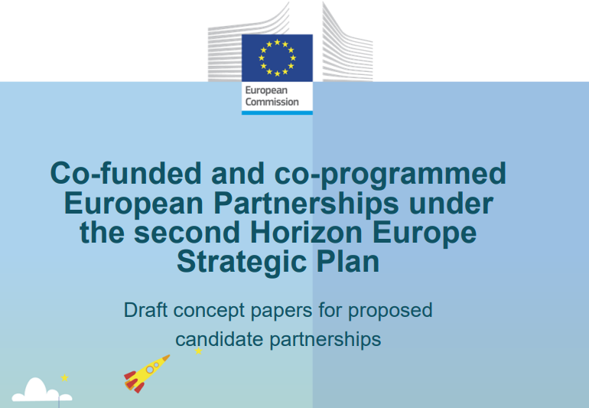
Jauna partnerība
VIRTUAL WORLDS:
Co-programmed European Partnership
Starting year: 2025
The partnership will involve industry and sectoral entities, academia and end-users as well as policy makers and regulators
The Partnership will support:
Research and innovation in Technology building blocks
Policies, human and ethical aspects
Applications – ecosystem
Open Standards
More information

Slide 21
statistika
Parāda iepriekš finansēto projektu sekmību
Palīdz identificēt perspektīvākās tematikas un pētniecības virzienus
Atsauce pieteicējiem, lai provizoriski novērtētu konkurenci savā nozarē

Slide 22
Statistika
D3: World Leading Data and Computing Technologies
Call | Topic |  | Type of action | Proposals | Projects Funded | Scores | Success ratio, %
HORIZON-CL4-2023-DATA-01 | 02 | Integration of data life cycle, architectures and standards for complex data cycles and/or human factors, language (AI, data and robotics partnership) | RIA | 29 | 5 | 12.5 to 14.5 | 17.2
 | 07 | Collaboration with NSF on fundamental research on new concepts for distributed computing and swarm intelligence | CSA | 1 | 1 | 11 | 100.0
 | 04 | Cognitive Computing Continuum: Intelligence and automation for more efficient data processing (AI, data and robotics partnership) | RIA | 66 | 5 | 13.5 to 15.0 | 7.6
 | 06 | Coordination and Support of Cognitive Computing Continuum research and policy | CSA | 3 | 1 | 14 | 33.3

Slide 23
Statistika
D4: Digital and Emerging Technologies for Competitiveness and Fit for the Green Deal (1/2)
Call | Topic |  | Type of action | Proposals | Projects Funded | Scores | Success ratio, %
HORIZON-CL4-2023-DIGITAL-EMERGING-01 | 01 | Novel paradigms and approaches, towards AI-driven autonomous robots (AI, data and robotics partnership) | RIA | 51 | 4 | 13.5 to 14.0 | 7.8
 | 12 | Adaptive multi-scale modelling and characterisation suites from lab to production | RIA | 35 | 4 | 14.0 to 14.5 | 11.4
 | 51 | Pervasive photonics - multi- technology integration for digital infrastructure, sensors and internet of things (Photonics partnership) | RIA | 30 | 4 | 14.5 to 15.0 | 13.3
 | 53 | Versatile light sources and systems as tools for manufacturing and medical application (Photonics Partnership) | RIA | 23 | 4 | 14.5 | 17.4
 | 57 | Advanced imaging and sensing technologies (IA)(Photonics Partnership) | IA | 14 | 4 | 12.5 to 14.0 | 28.6

Slide 24
Statistika
D4: Digital and Emerging Technologies for Competitiveness and Fit for the Green Deal (2/2)
Call | Topic |  | Type of action | Proposals | Projects Funded | Scores | Success ratio, %
HORIZON-CL4-2023-DIGITAL-EMERGING-01-CNECT | 02 | Industrial leadership in AI, Data and Robotics – advanced human robot interaction (AI Data and Robotics Partnership) | IA | 11 | 3 | 10.5 to 12.5 | 27.3
 | 11 | Low TRL research in micro- electronics and integration technologies for industrial solutions | RIA | 36 | 9 | 14.0 to 15.0 | 25.0
 | 32 | Sustainable safe-by-design 2D materials technology | RIA | 4 | 1 | 13.5 | 25.0
 | 33 | 2D materials of tomorrow | RIA | 16 | 3 | 13.5 to 14.5 | 18.8
 | 40 | Quantum Photonic Integrated Circuit technologies | RIA | 9 | 3 | 15 | 33.3
 | 41 | Investing in alternative quantum computation and simulation platform technologies | RIA | 4 | 2 | 14.0 to 14.5 | 50.0
 | 50 | Next generation quantum sensing and metrology technologies | RIA | 10 | 3 | 15 | 30.0
 | 56 | Photonic Strategies and Skills Development (Photonics Partnership) | CSA | 4 | 2 | 12.0 to 13.5 | 50.0

Slide 25
Statistika
D6: A human-centred and ethical development and industrial technologies (1/5)
Calls | Topic |  | Type of action | Proposals | Projects Funded | Scores | Success ratio, %
HORIZON-CL4-2023-HUMAN-01 | 31 | Toolbox for efficient IP licensing for market uptake and societal value creation | CSA | 5 | 1 | 12.5 | 20.0
 | 32 | Piloting communities of expert facilitators to improve industry- academia-public sector co-creation | CSA | 6 | 1 | 13.5 | 16.7
 | 33 | Fostering knowledge valorisation through societal and cultural interactions | CSA | 4 | 2 | 10.0 to 12.0 | 50.0
 | 51 | Pilots for an innovative human-centric industry | RIA | 7 | 1 | 12.0 | 14.3
 | 52 | Drivers and success factors for progress towards Industry 5.0 | RIA | 5 | 1 | 15.0 | 20.0
 | 53 | Localised and Urban Manufacturing, supporting creativity and the New European Bauhaus | RIA | 8 | 4 | 13.0 to 14.5 | 50.0

Slide 26
Statistika
D6: A human-centred and ethical development and industrial technologies (2/5)
Calls | Topic |  | Type of action | Proposals | Projects Funded | Scores | Success ratio, %
HORIZON-CL4-2023-HUMAN-01 | 54 | Green and digital skills and training needs for a just transition | CSA | 9 | 3 | 10.0 to 12.5 | 33.3
 | 62 | Boosting industrial symbiosis by standardization | CSA | 2 | 1 | 11.5 | 50.0
 | 63 | Provide for a strong and sustainable pool of experts for European Standardization: attract the students of university/HEI | CSA | 3 | 1 | 13.0 | 33.3
 | 64 | Pre-normative research and standardization in industrial ecosystems | CSA | 3 | 2 | 10.5 to 11.5 | 66.7
 | 91 | International Hub for Digital Partnerships in the Indo-Pacific | CSA | 5 | 1 | 14.5 | 20.0
 | 92 | R&I cooperation with Sub-Saharan Africa | CSA | 7 | 1 | 10.5 | 14.3
 | 93 | R&I cooperation with Latin America (Mexico, Brazil, Argentina, and other countries in the BELLA network or members of RedClara) | CSA | 6 | 1 | 15.0 | 16.7

Slide 27
Statistika
D6: A human-centred and ethical development and industrial technologies (3/5)
Calls | Topic |  | Type of action | Proposals | Projects Funded | Scores | Success ratio, %
HORIZON-CL4-2023-HUMAN-01-CNECT | 01 | Efficient trustworthy AI - making the best of data (AI, Data and Robotics Partnership) | RIA | 48 | 4 | 14.5 to 15.0 | 8.3
 | 02 | Large Scale pilots on trustworthy AI data and robotics addressing key societal challenges (AI Data and Robotics Partnership) | IA | 7 | 3 | 10.5 to 13.5 | 42.9
 | 03 | Natural Language Understanding and Interaction in Advanced Language Technologies (AI Data and Robotics Partnership) | RIA | 25 | 3 | 13.5 to 14.5 | 12.0
 | 04 | Open innovation: Addressing Grand challenges in AI (AI Data and Robotics Partnership) | CSA | 5 | 1 | 13.5 | 20.0
 | 05 | Through AI from Disinformation to Trust | IA | 9 | 2 | 11.0 to 14.0 | 22.2
 | 11 | Next Generation Internet Fund | RIA | 3 | 1 | 14.5 | 33.3
 | 12 | Pilots for the Next Generation Internet | IA | 4 | 4 | 10.0 to 13.0 | 100.0

Slide 28
Statistika
D6: A human-centred and ethical development and industrial technologies (4/5)
Calls | Topic |  | Type of action | Proposals | Projects Funded | Scores | Success ratio, %
HORIZON-CL4-2023-HUMAN-01-CNECT | 13 | Next Generation Internet International Collaboration - USA | RIA | 2 | 1 | 13 | 50.0
 | 14 | Next Generation Internet Commons Policy | CSA | 1 | 1 | 11.5 | 100.0
 | 21 | Next Generation eXtended Reality | RIA | 55 | 4 | 14.0 to 15.0 | 7.3
 | 22 | eXtended Reality for Industry 5.0 | IA | 17 | 3 | 12.5 to 14.0 | 17.6
 | 23 | Supporting the emergence of an open human- centric Metaverse | CSA | 7 | 1 | 14.5 | 14.3
 | 65 | Support facility for digital standardisation and international cooperation in digital partnerships | CSA | 2 | 1 | 11 | 50.0
 | 66 | Promoting EU standards globally | CSA | 1 | 1 | 12 | 100.0
 | 82 | Art-driven digital innovation: Towards human compatible and ecologically conscious technology | CSA | 1 | 1 | 13.5 | 100.0

Slide 29
Statistika
D6: A human-centred and ethical development and industrial technologies (5/5)
Calls | Topic |  | Type of action | Proposals | Projects Funded | Scores | Success ratio, %
HORIZON-CL4-2024-HUMAN-02 | 34 | Support for transnational activities of National Contact Points in the thematic areas of Digital, Industry and Space | CSA | 3 | 3 | 11.00 to 13.00 | 100.0
 | 35 | Intellectual asset management support for public research organisations, academic institutions and their spin-offs | CSA | 10 | 1 | 14.50 | 10.0
 | 36 | Synergy with national and regional initiatives in Europe on Innovative Materials | CSA | 1 | 1 | 11.00 | 100.0

Slide 30
ES R&I prioritātes viedo materiālu jomā
ENERGY
ELECTRONICS
Renewable and low carbon energy conversion and generation
Energy storage systems
Energy distribution and the transmission grid
Renewable fuels
Sensors
Novel computing and memory concepts
Power electronics
5G/6G communication and beyond
Optoelectronics
Photonics
Quantum components
New chip production
R & I
MOBILITY
CONSTRUCTION
Advanced batteries (e.g. solid-state)
Fuel cells systems
Advanced lighter materials
Advanced composite materials and structures
Coatings and paints
Hybrid manufacturing proceses
Safe and sustainable use components
Resilient transport infrastructure
Cost-efficient maintenance and repair
Enhanced energy efficiency in buildings (composite foams, thermal insulation
Robust and long-lasting building structures
Grater wellbeing in buildings
Materials for circularity improvement and environmental performance
Advanced Materials for Industrial Leadership

Slide 31
SPACE NEWS: advances IOD/IOV Evolution Strategy
"Space Gateway" Initiative → Linking IOD/IOV with ESA & national programs
New destinations → Expanding to Moon, GEO/GTO orbits
Innovation Testing → Supporting biotech, manufacturing, and other experiments
Advanced services → TRL 5 testing, support for “non-standalone” components
Strategic Mission Link → Integrating with the ISOS4I pilot mission
Long-Term Access → Pre-booking spare capacity on institutional launches and platforms
Re-entry demonstrations → Testing technologies on re-entry vehicles
WP2026-2027

Slide 32
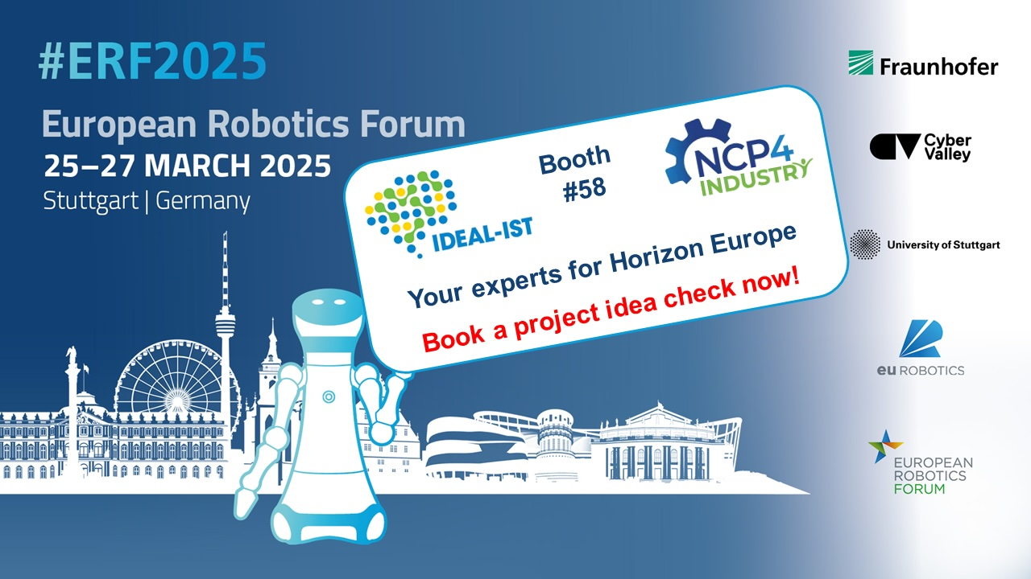
Tuvākie pasākumi
Horizon Europe Cluster 4 Digital Brokerage Event (March 19)
EuroTech 2025: Engineering the Clean Industrial Deal
EuroHPC Summit
European Robotics Forum
Horizon Europe Cluster 4 Info Days (May 13-14)
ERF2025: Project Idea Check

Slide 33
Digitālā joma, rūpniecība un kosmoss
Kontaktpersonas
4. klasterim
Jūlija Asmuss
Koordinatore, CL4
Ingrīda Lavrinoviča
CL3, CL4

Slide 34
Paldies!
1.1.1. specifiskā atbalsta mērķa “Pētniecības un inovāciju kapacitātes stiprināšana un progresīvu tehnoloģiju ieviešana kopējā P&A sistēmā” 1.1.1.5. pasākuma “Latvijas pilnvērtīga dalība Apvārsnis Eiropa programmā, tajā skaitā nodrošinot kompleksu atbalsta instrumentu klāstu un sasaisti ar RIS3 specializācijas jomu attīstīšanu” projekts “Atbalsts Latvijas dalībai starptautiskās pētniecības un inovācijas programmās”. ietvaros

