Slide 1

Apvārsnis Eiropa 2. klastera «Kultūra, jaunrade un iekļaujoša sabiedrība» darba programma un aktuālie konkursi.
Darja Aksjonova
Nacionālā kontaktpunkta
vecākā eksperte
darja.aksjonova@lzp.gov.lv
1.1.1. specifiskā atbalsta mērķa "Palielināt Latvijas zinātnisko institūciju pētniecisko un inovatīvo kapacitāti un spēju piesaistīt ārējo finansējumu, ieguldot cilvēkresursos un infrastruktūrā" 1.1.1.5. pasākuma "Atbalsts starptautiskās sadarbības projektiem pētniecībā un inovācijās" 1.kārtas, projekta Nr.1.1.1.5/17/I/001 “Atbalsts starptautiskās sadarbības projektu izstrādei un īstenošanai” ietvaros

Slide 2
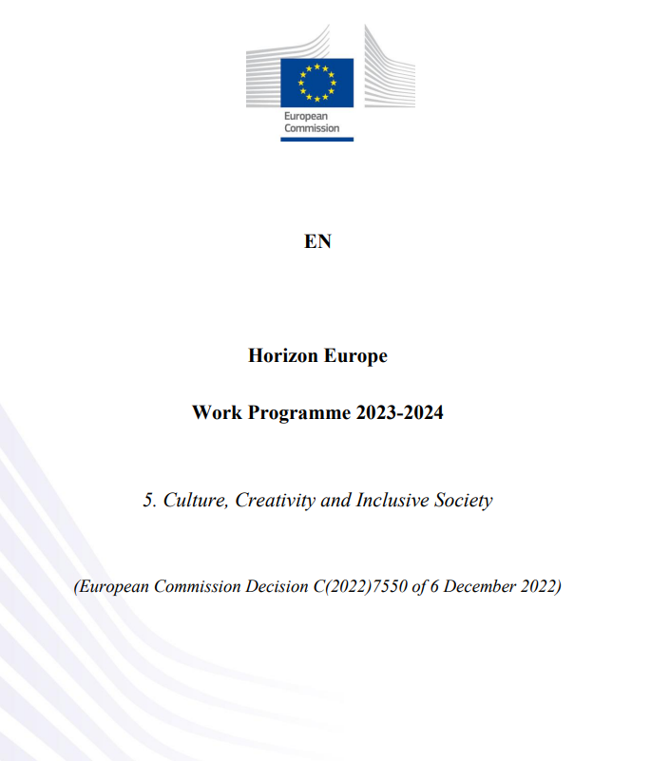

Apvārsnis Eiropa 2. klastera darba programma
infoday: Events | The research and innovation community platform (europa.eu)
darba programma: wp-5-culture-creativity-and-inclusive-society_horizon-2023-2024_en.pdf (europa.eu)

Slide 3
DESTINATION 1
DESTINATION: INNOVATIVE RESEARCH ON DEMOCRACY AND GOVERNANCE
DESTINATION 2 INNOVATIVE RESEARCH ON EUROPEAN CULTURAL HERITAGE AND CULTURAL AND CREATIVE INDUSTRIES - BUILDING OUR FUTURE FROM THE PAST
DESTINATION 3 INNOVATIVE RESEARCH on SOCIAL and ECONOMIC TRANSFORMATIONS
DESTINATION 4
DIGITAL AND EMERGING TECHNOLOGIES FOR COMPETITIVENESS AND FIT FOR THE GREEN DEAL

Slide 4
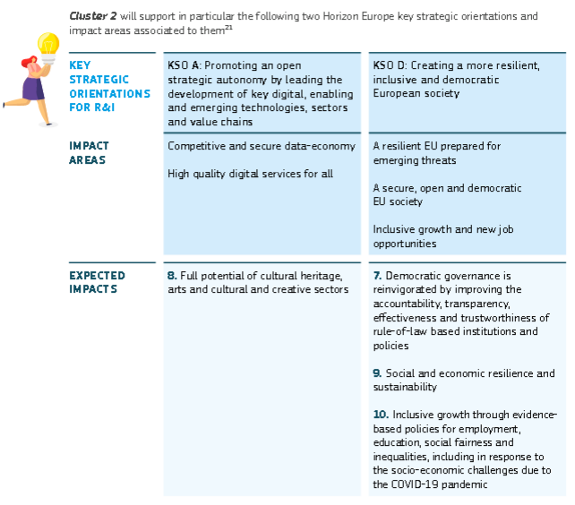
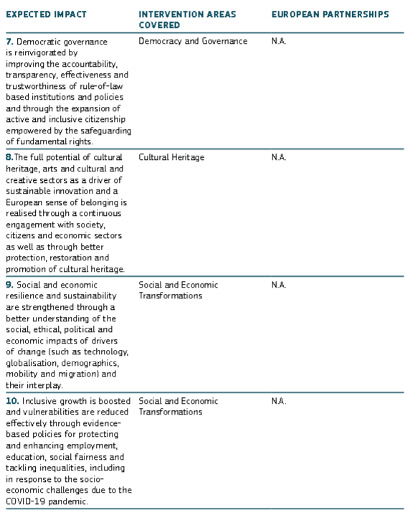
Strategic Plan: https://ec.europa.eu/info/sites/info/files/research_and_innovation/funding/documents/ec_rtd_horizon-europe-strategic-plan-2021-24.pdf

Slide 5

Projektu tipi
Type | Activities | Financing rate
RIA (Research and Innovation Actions) | Activities to establish new knowledge or to explore the feasibility of a new or improved technology, product, process, service or solution. | Up to 100%
IA (Innovation Actions) | Activities to produce plans and arrangements or designs for new, altered or improved products, processes or services. | *Up to 70%
CSA (Coordination and Support Actions) | Activities that contribute to the objectives of Horizon Europe. This excludes R&I activities, except for ‘Widening participation and spreading excellence’. | Up to 100%
* the rate is 70 percent for profit-making legal entities and 100 percent for non-profit legal entities

Slide 6
Projektu tipi
Research & Innovation Actions | Innovation Actions
Basic & applied research | Limited R&D activities
Testing / validation on small-scale prototype (in lab or simulated environment) | Prototyping, testing, large-scale product validation & market replication
Limited demo or pilot activities (to show tech feasibility in a near to operational environment) | Demo or pilot activities (to show tech feasibility in operational environment)
Developing innovations meeting needs of markets | Developing innovations meeting needs of markets & their delivery to market
Exploitation activities
Innovation management

Slide 7
Technology Readiness Level
Technology Readiness Levels (TRLs) are indicators of the maturity level of particular technologies.
TRL 1 – basic principles observed
TRL 2 – technology concept formulated
TRL 3 – experimental proof of concept
TRL 4 – technology validated in lab
TRL 5 – technology validated in relevant environment (industrially relevant environment in the case of key enabling technologies)
TRL 6 – technology demonstrated in relevant environment (industrially relevant environment in the case of key enabling technologies)
TRL 7 – system prototype demonstration in operational environment
TRL 8 – system complete and qualified
TRL 9 – actual system proven in operational environment (competitive manufacturing in the case of key enabling technologies; or in space)

Slide 8
Technology Readiness Level
TRL 1-3/4: basic research
TRL 4-6: applied research
TRL 6-9: demonstration
N.B! Research and Innovation Actions Technology levels starts at 3 and is expected to achieve 5
For IA it is usually between 4-7, in some cases up to 8

Slide 9
Destination: Innovative research on democracy and governance
Opening date: 14 December 2022
Deadline: 14 March 2023
Topic | Type of action, TRL | EU contribution per project (EUR million) | Number of projects to be funded
HORIZON-CL2-2023-DEMOCRACY-01-01: Detecting, analysing and countering foreign information manipulation and interference | RIA | 2.00 to 3.00 | 3
HORIZON-CL2-2023-DEMOCRACY-01-02: Developing a better understanding of information suppression by state authorities as an example of foreign information manipulation and interference | RIA | 2.00 to 3.00 | 3
HORIZON-CL2-2023-DEMOCRACY-01-03: New approaches for combatting corruption and other undue influences on political decision-making | RIA | 5.00 to 6.00 | 2
HORIZON-CL2-2023-DEMOCRACY-01-04: The emotional politics of democracies | RIA | 2.00 to 3.00 | 3
HORIZON-CL2-2023-DEMOCRACY-01-05: The climate imperative and its impact on democratic governance | RIA | 2.00 to 3.00 | 3
HORIZON-CL2-2023-DEMOCRACY-01-06: Democratic governance for times of disruptive changes to the social contract | RIA | 2.00 to 3.00 | 3
HORIZON-CL2-2023-DEMOCRACY-01-07: Intersectionality and equality in deliberative and participatory democratic spaces | RIA | 2.00 to 3.00 | 3
HORIZON-CL2-2023-DEMOCRACY-01-08: Political perspectives for the Eastern Neighbourhood and the Western Balkans | RIA | 2.00 to 3.00 | 3

Slide 10
Destination: Innovative research on European cultural heritage and cultural and creative industries – building our future from the past
Opening date: 14 December 2022
Deadline: 14 March 2023
Topic | Type of action, TRL | EU contribution per project (EUR million) | Number of projects to be funded
HORIZON-CL2-2023-HERITAGE-01-01: Advanced technologies for remote monitoring of heritage monuments and artefacts | RIA | 3.00 to 4.00 | 3
HORIZON-CL2-2023-HERITAGE-01-02: Cultural and creative industries for a sustainable climate transition | RIA | 3.00 to 4.00 | 3
HORIZON-CL2-2023-HERITAGE-01-03: Re-visiting the digitisation of cultural heritage: What, how and why? | RIA | 3.00 to 4.00 | 3
HORIZON-CL2-2023-HERITAGE-01-04: Cultural heritage in transformation – facing change with confidence | RIA | 2.00 to 3.00 | 3
HORIZON-CL2-2023-HERITAGE-01-05: Fostering socio-economic development and job creation in rural and remote areas through cultural tourism | RIA | 2.00 to 3.00 | 3
HORIZON-CL2-2023-HERITAGE-01-06: A world leading European video game innovation system | RIA | 3.00 to 4.00 | 3
HORIZON-CL2-2023-HERITAGE-01-07: Promoting cultural literacy through arts education to foster social inclusion | RIA | 2.00 to 3.00 | 3
HORIZON-CL2-2023-HERITAGE-01-08: Cultural and creative approaches for genderresponsive STEAM education | CSA | 2.00 to 3.00 | 1

Slide 11
A European Collaborative Cloud for Cultural Heritage - 2023
https://op.europa.eu/en/publication-detail/-/publication/90f1ee85-ca88-11ec-b6f4-01aa75ed71a1/language-en
Opening date: 10 January 2023
Deadline: 21 September 2023
Topic | Type of action, TRL | EU contribution per project (EUR million) | Number of projects to be funded
HORIZON-CL2-2023-HERITAGE-ECCCH-01-01: A European Collaborative Cloud for Cultural Heritage | IA | 25.00 | 1
HORIZON-CL2-2023-HERITAGE-ECCCH-01-02: A European Collaborative Cloud for Cultural Heritage – Innovative tools for digitising cultural heritage objects | RIA | 4.00 to 5.00 | 2

Slide 12
Destination: Innovative research on social and economic transformations
Opening date: 14 December 2022
Deadline: 14 March 2023
Topic | Type of action, TRL | EU contribution per project (EUR million) | Number of projects to be funded
HORIZON-CL2-2023-TRANSFORMATIONS-01-01: Remote working arrangements and their economic, social and spatial effects | RIA | 2.00 to 3.00 | 3
HORIZON-CL2-2023-TRANSFORMATIONS-01-02: Towards sustainable economic policy paradigms | CSA | 2.00 to 3.00 | 1
HORIZON-CL2-2023-TRANSFORMATIONS-01-03: Global Shortages and Skill Partnerships | RIA | 2.00 to 3.00 | 3
HORIZON-CL2-2023-TRANSFORMATIONS-01-04: Bridging the migration research to policy gap | CSA | 2.00 to 3.00 | 1
HORIZON-CL2-2023-TRANSFORMATIONS-01-05: Efficiency and effectiveness of investment in high-quality education and training | RIA | 2.00 to 3.00 | 3
HORIZON-CL2-2023-TRANSFORMATIONS-01-06: Mapping of longitudinal data and assessment of inequalities in education, training and learning achievements | RIA | 2.00 to 3.00 | 3
HORIZON-CL2-2023-TRANSFORMATIONS-01-07: Tackling European skills and labour shortages | RIA | 2.00 to 3.00 | 3

Slide 13
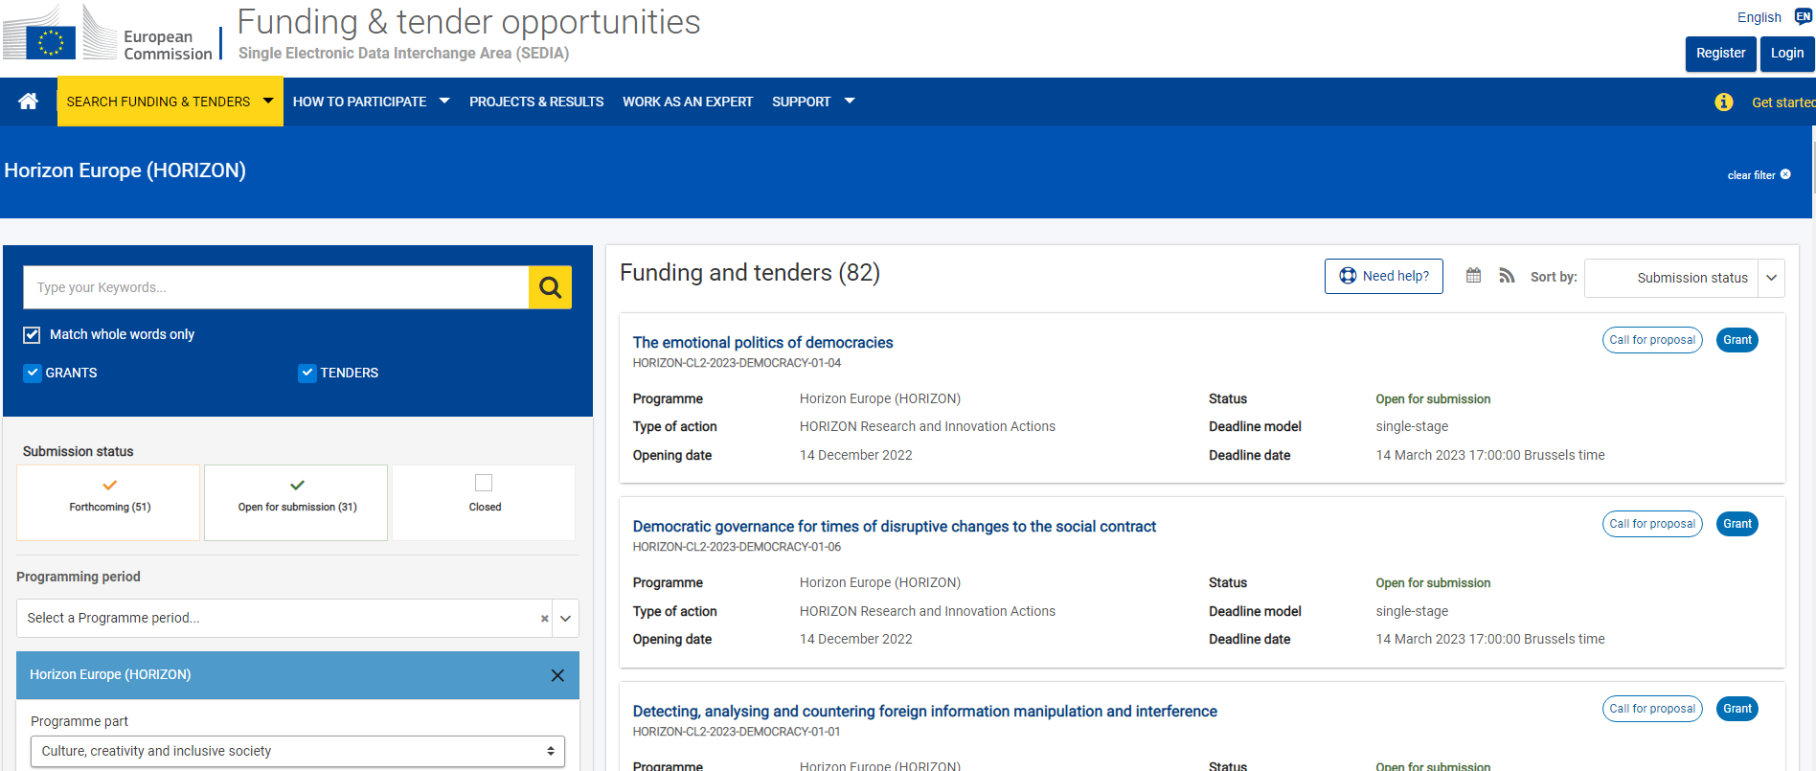
Funding&tender opportunities

Slide 14
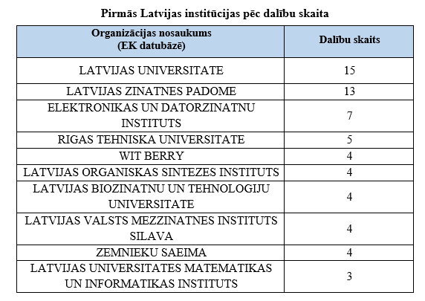
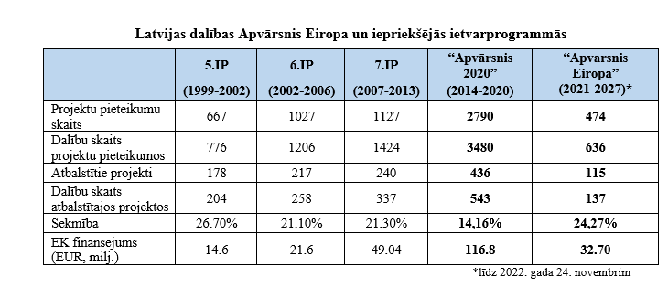
Statistika

Slide 15
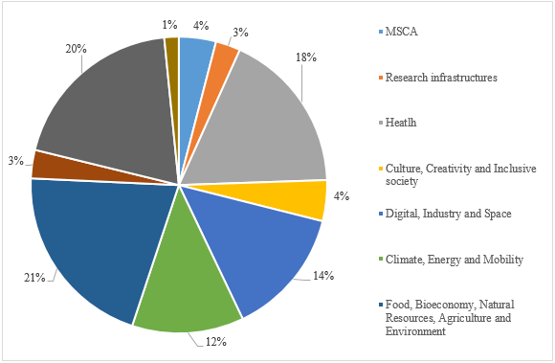
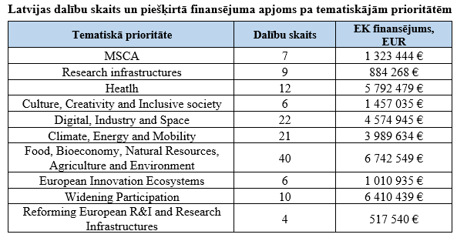
Statistika

Slide 16
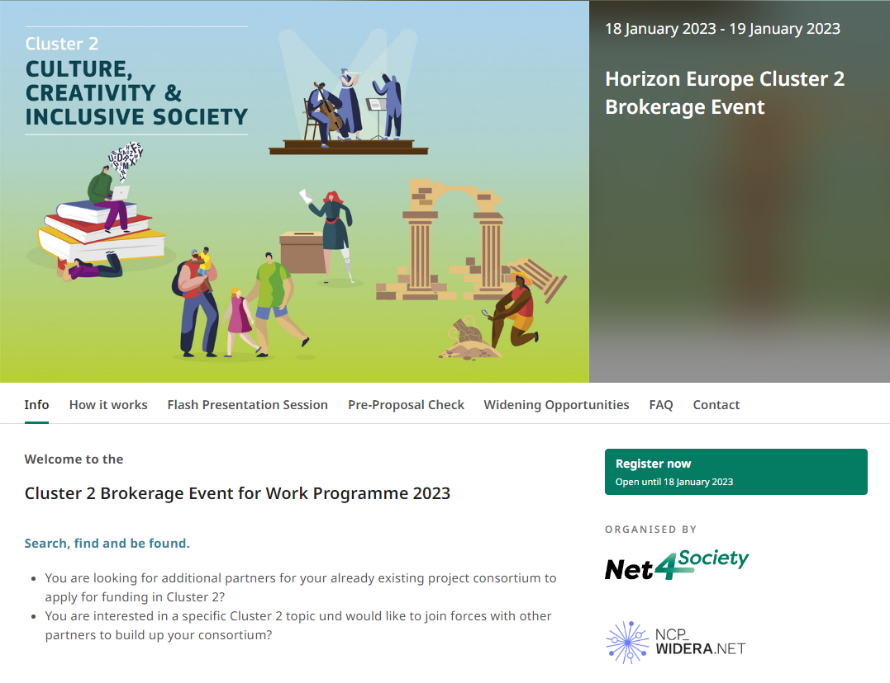

Slide 17

Infodiena:
https://research-innovation-community.ec.europa.eu/events/6wpb8q0qb5i1CN0VaWS5BF/overview
17 January 2023, pl. 10:00 (GMT+02:00)
Brokerage event:
https://cluster-2-brokerage-event.b2match.io/
Jan 18 2023 | 10am - 5pm (11am - 6pm)
Jan 19 2023 | 10am - 1pm (11am - 2pm)

Slide 18
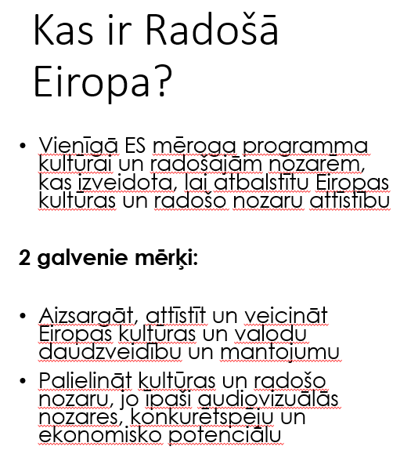
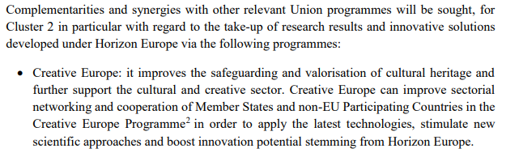
Sadarbība ar citām programmām

Slide 19

Kas ir Radošā Eiropa?
3 programmas atzari:
MEDIA: audiovizuālo darbu izstrāde, izplatīšana un piekļuve tiem
Culture: starptautiskā sadarbība un radošo un kultūras sektoru attīstība
Cross-sectoral: Pētījumi un novērtējumi, Creative Europe Desks, politikas izstrāde; mediju un inovāciju uzsaukumi u.c.

Slide 20

Eiropas sadarbības projekti
Maza mēroga: max. €200.000, līdzfinansējums 80%, 3 partneri no 3 dažādām valstīm
Vidēja mēroga: max. €1.000.000, līdzfinansējums 70%, 5 partneri no 5 dažādām valstīm
Liela mēroga: max. €2.000.000, līdzfinansējums 60%, 10 partneri no 10 dažādām valstīm
Max 48 mēneši
Budžets: 61 miljoni eiro
Launch of call: 2022. gada 17. novembris
Deadline: 2023. gada 23. februārī

Slide 21

Culture Moves Europe
Individuālās mobilitātes granti
Individuāliem māksliniekiem un kultūras profesionāļiem, kas ceļo no 7 līdz 60 dienām, vai personu grupām (līdz 5 personām, kas ceļo no 7 līdz 21 dienai).Katru gadu no rudens līdz pavasarim būs pieejami konkursi visās nozarēs.
Rezidentu granti
īstermiņa rezidences no 1 līdz 3 mēnešiem, vai ilgtermiņa uzturēšanās no 3 līdz 6 mēnešiem, vai pagarinātās rezidences līdz 10 mēnešiem.
Uzaicinājumi uz katru sektoru tiks atvērti divas reizes shēmas darbības laikā.

Slide 22




Paldies!
Darja Aksjonova
Latvijas Zinātnes padomes
Starptautiskās sadarbības programmu projektu departamenta
Apvārsnis Eiropa Nacionālā kontaktpunkta vecākā eksperte
E-pasts: darja.aksjonova@lzp.gov.lv
Telefons: +371 29812647
@apvarsnis
@Apvārsnis EU Latvijas Nacionālais kontaktpunkts - HE NCP LV
https://lzp.gov.lv/starptautiskas-sadarbibas-programmas/apvarsnis-eiropa/

