Slide 1

French Research and Innovation landscape

Slide 2
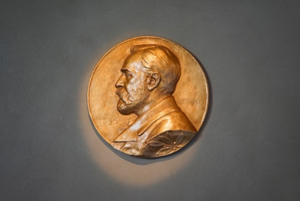

7 good reasons to choose France for your research :
Excellent research : France takes 2nd world place for the number of Fields medals (11) and 2nd world place for Nobel prizes (65). It is the 3rd nation in Shanghai ranking (2021) and it takes the 4th world place for the impact of its scientific publications (H-index)
A country of innovation : France is the 2nd EU country for the number of patents
Attracting researchers from all over the world : with 42% of foreigners among its PhD students, France is the 3rd host country in EU for young researchers
A global network : French R&I institutions are set in more than 250 destinations in the world, and more than 63% of French publications are made in collaboration with foreign rearchers
At the heart of international research projects : French research is involved in large european and international research projects : particle physics with CERN, Arianespace, ITER project on nuclear fusion etc.
Dynamic R&I ecosystem : 2/3 of French research is operated by the non-academic sector. 600 000 people work for R&I in entreprises.
Top level research infrastructures : 108 RI, including large research infrastructures are listed in the national roadmap 2021, in different areas : astronomy and astrophysics, health and life sciences, human and social sciences, physics and engineering sciences etc.

Slide 3


Organisation of Research and Innovation in France
Academic sector
Non-academic sector
Large
enterprises
National research centers
Grandes Ecoles
Universities
SMEs
NGOs
Hospitals
Public
Agencies
UMR
UPR
UMR
UMR
UMR
UMR
UMR
Museums
Etc.
Research Units - Laboratories

Slide 4
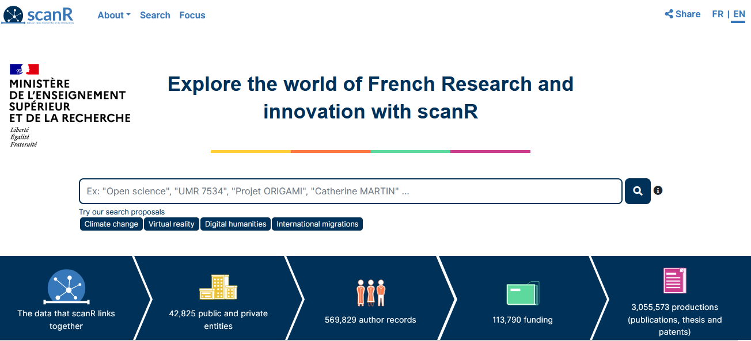
ScanR : search engine for
French research and Innovation
https://scanr.enseignementsup-recherche.gouv.fr/
Search by keywords, publications, authors’ names, projects’ names, types of entity, sectors, location etc.

Slide 5
I have identified a possible host – what now?
Contact them
Send a short e-mail explaining who you are, your motivations and why you want to work with them and why this institution
Specify that you want to apply with them to the MSCA Postdoctoral Fellowships (include a link to the call page)
Attach your CV and a short summary of your project (one-page-proposal)
Make sure you are clear in what you are asking from them
Make sure you are visible
Make sure your research pages/web site are up-to-date
  What you have done – current CV
  Include all activities : demonstrate that you are the right candidate for a Postdoctoral Fellowship
  Research interests – what you would like to work on in the future
Social media – personal vs professional

