Slide 1
Apvārsnis Eiropa 4. klastera «Digitālā joma, rūpniecība un kosmoss» informācijas diena
Pasākuma programma:
10:00-10:40 prezentācija par Apvārsnis Eiropa 2024. gada 4. klastera “Digitālā joma, rūpniecība un kosmoss” darba programmas konkursiem
Jūlija Asmuss, Latvijas zinātnes padomes NKP vadītāja
10:40-11:00 prezentācija "Sadarbības ar Eiropas Kosmosa Aģentūru (EKA) Latvijas uzņēmumiem un akadēmijai"
Dāvids Štēbelis, Eiropas Kosmosa aģentūras industriālais koordinators Latvijā
11:00-11:25 prezentācija par Apvārsnis Eiropa finanšu un juridiskajiem jautājumiem
Inga Šīrante, Latvijas zinātnes padomes NKP vecākā eksperte
11:25-11:30 jautājumi un atbildes

Slide 2
Apvārsnis Eiropa 4. klastera «Digitālā joma, rūpniecība un kosmoss» aktualitātes
Jūlija Asmuss, Dr.sc.ing.
Nacionālā kontaktpunkta
vadītāja
julija.asmuss@lzp.gov.lv
1.1.1. specifiskā atbalsta mērķa "Palielināt Latvijas zinātnisko institūciju pētniecisko un inovatīvo kapacitāti un spēju piesaistīt ārējo finansējumu, ieguldot cilvēkresursos un infrastruktūrā" 1.1.1.5. pasākuma "Atbalsts starptautiskās sadarbības projektiem pētniecībā un inovācijās" 1.kārtas, projekta Nr.1.1.1.5/17/I/001 “Atbalsts starptautiskās sadarbības projektu izstrādei un īstenošanai” ietvaros

Slide 3
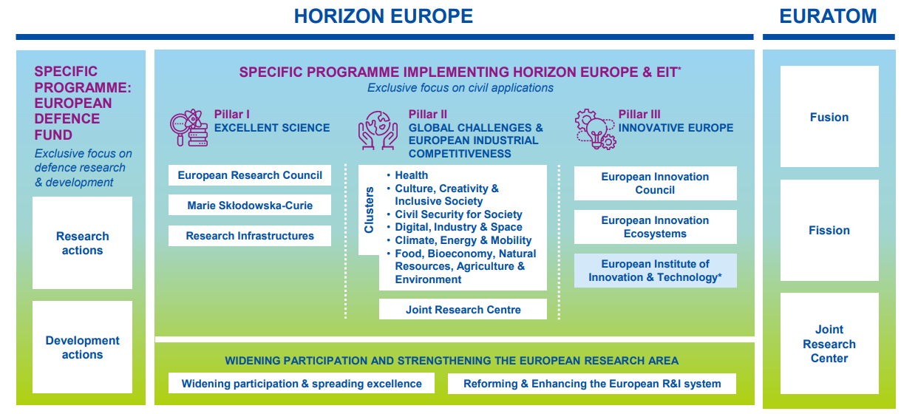
APVĀRSNIS EIROPA
WORK PROGRAMMES 2023-2024

Slide 4
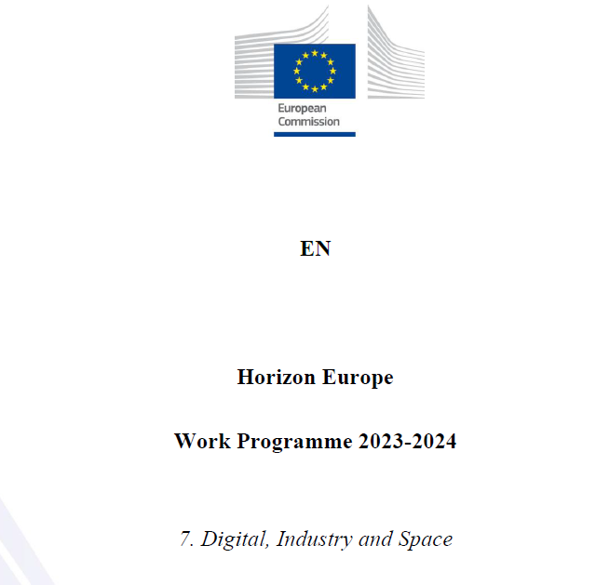
Apvārsnis Eiropa 4. klastera darba programma
informācija: https://ec.europa.eu/info/horizon-europe/cluster-4-digital-industry-and-space_en
darba programma: https://ec.europa.eu/info/funding-tenders/opportunities/docs/2021-2027/horizon/wp-call/2023-2024/wp-7-digital-industry-and-space_horizon-2023-2024_en.pdf
programmas ceļvedis:
https://ec.europa.eu/info/funding-tenders/opportunities/docs/2021-2027/horizon/guidance/programme-guide_horizon_en.pdf

Slide 5
DESTINATION 1
CLIMATE NEUTRAL, CIRCULAR AND DIGITISED PRODUCTION
DESTINATION 2
INCREASED AUTONOMY IN KEY STRATEGIC VALUE CHAINS FOR RESILIENT INDUSTRY
DESTINATION 3
WORLD LEADING DATA AND COMPUTING TECHNOLOGIES
DESTINATION 4
DIGITAL AND EMERGING TECHNOLOGIES FOR COMPETITIVENESS AND FIT FOR THE GREEN DEAL
DESTINATION 5
OPEN STRATEGIC AUTONOMY IN DEVELOPING, DEPLOYING AND USING GLOBAL SPACE-BASED INFRASTRUCTURE, SERVICES, APPLICATIONS AND DATA
DESTINATION 6
A HUMAN-CENTRED AND ETHICAL DEVELOPMENT OF DIGITAL AND INDUSTRIAL TECHNOLOGIES

Slide 6
Projektu tipi
Type | Activities | Financing rate
RIA (Research and Innovation Actions) | Activities to establish new knowledge or to explore the feasibility of a new or improved technology, product, process, service or solution. | Up to 100%
IA (Innovation Actions) | Activities to produce plans and arrangements or designs for new, altered or improved products, processes or services. | *Up to 70%
CSA (Coordination and Support Actions) | Activities that contribute to the objectives of Horizon Europe. This excludes R&I activities, except for ‘Widening participation and spreading excellence’. | Up to 100%
* the rate is 70 percent for profit-making legal entities and 100 percent for non-profit legal entities

Slide 7
Tehnoloģiju gatavības līmenis
Technology Readiness Levels (TRLs) are indicators of the maturity level of particular technologies.
TRL 1 – basic principles observed
TRL 2 – technology concept formulated
TRL 3 – experimental proof of concept
TRL 4 – technology validated in lab
TRL 5 – technology validated in relevant environment (industrially relevant environment in the case of key enabling technologies)
TRL 6 – technology demonstrated in relevant environment (industrially relevant environment in the case of key enabling technologies)
TRL 7 – system prototype demonstration in operational environment
TRL 8 – system complete and qualified
TRL 9 – actual system proven in operational environment (competitive manufacturing in the case of key enabling technologies; or in space)

Slide 8
D3: World Leading Data and Computing Technologies
https://www.youtube.com/watch?v=tCMzmVa3QcA
Opening date: 15 November 2023
Deadline: 19 March 2024
Topic | Type of action, TRL | EU contribution per project (EUR million) | Number of projects to be funded
HORIZON-CL4-2024-DATA-01-01: AI-driven data operations and compliance technologies (AI, data and robotics partnership) | IA TRL 4-5/TRL 6-7 | 8-10 | 4
HORIZON-CL4-2024-DATA-01-03: Piloting emerging Smart IoT Platforms and decentralized intelligence | IA TRL 3-4/TRL 6-7 | 20-25 | 2
HORIZON-CL4-2024-DATA-01-05: Platform Building, standardization and Up-scaling of the ‘Cloud-Edge-IoT’ Solutions | CSA | 2 | 1

Slide 9
HORIZON-CL4-2024-DATA-01-01
What are we looking for?
Developing, piloting and integrating compliance tools and data economy enablers into compliant systems and solutions for creating value on data, especially in the AI context
Addressing compliance in the broad sense (legal, ethical, environmental, fairness/trustworthiness)
Addressing compliance in a holistic way – employing inherently compliant architectures and design principles (“compliance by design”)
What we do NOT want?
Stand-alone or add-on compliance tools, not integrated in systems/solutions
Low-maturity science-fiction (this a practical IA topic)
Research-oriented proposals (this is an IA topic)
Legal entities established in China are not eligible in any capacity (p. 178 of WP, p. 13 of General Annexes to WP)
Topic evolution and links to other topics
Proposals should build on results of:
H2020-ICT-13-2019-20 data platforms
HORIZON-CL4-2021-DATA-01-01 privacy-preserving technologies
HORIZON-CL4-2023-HUMAN-01-01 data for trustworthy AI
… and liaise with Digital Europe projects on:
Common European Data Spaces
European Digital Innovation Hubs

Slide 10
HORIZON-CL4-2024-DATA-01-01
Current project portfolios
ICT-13-2018-2019 - Supporting the emergence of data markets and the data economy
HORIZON-CL4-2021-DATA-01-01 - Technologies and solutions for compliance, privacy preservation, green and responsible data operations
Key group of actors driving this
AI, data and robotics partnership (Adra)
Big Data Value Association (BDVA)
Background documents
A European Strategy for Data (COM/2020/66 final)
Events
European Big Data Value Forum 25-27 Oct 2023
AI, Data and Robotics Forum 8-9 Nov 2023

Slide 11
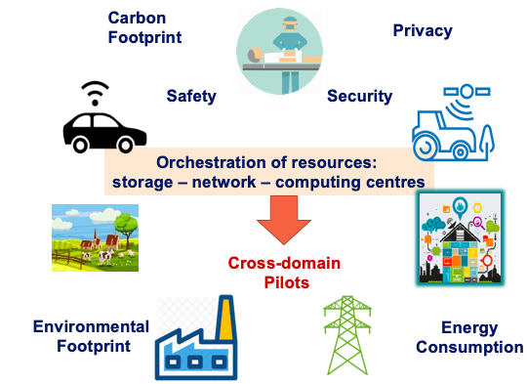
HORIZON-CL4-2024-DATA-01-03
A Platform Approach to share hardware and foster an Open Ecosystem
What we do NOT want?
Pure technology push → need to consider validation in selected application context
Low profile projects → looking for strategic projects to pave the way for a European Strategic Agenda
Proprietary technology development → need to consider open interfaces and standards, where applicable build on open source projects
Narrowly focused scope → need to connect different dots IoT, ADRA, cloud, ARTEMIS, KDT , SNS..
Static work plan execution → build an open ecosystem and make strategic use of Cascading funds
Simplistic dissemination activities: non-targeted, academic communication
A key group of actors driving this
Alliance AIOTI, GAIA-X, Alliance of Industrial Data & Cloud, BDVA, 5G PPP, ARTEMIS IA

Slide 12
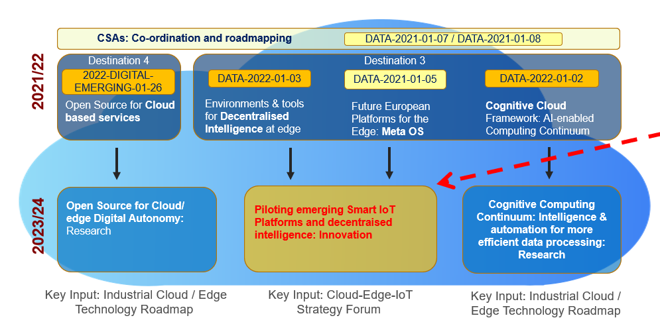
HORIZON-CL4-2024-DATA-01-03
Topic evolution and links to other topics
HE-CL4-2021-DATA-01-05 (MetaOS),
HE-CL4-2022-DATA-01-02 (Cognitive Cloud),
HE-CL4-2022-DATA-01-03 (Swarms),
HECL4-2023-DATA-01-04 (computing continuum),
the projects to be selected under topic HE-CL4-2024-DIGITAL-EMERGING-01-21. → coordinated by the CSAs OpenContinuum + UnlockCEI
Direct follow-up of the European Data Strategy → create links to Data Space projects //TEFs under DIGITAL EUROPE → bridge to related SRIAs in Chips JU, INSIDE, SNS JU, Alliance AIOTI, Cloud Alliance
Main stakeholders that are addressed
Industrial IoT: Data, AI technology providers, sensor-IoT device manufacturers, distributed computation experts, connectivity, standardisation
Existing digital platforms (Cloud, Edge, IoT, ..) , relevant open source communities like ECLIPSE, Linux, Apache, …
Academia, key industrial demand side, system integrators SMEs, start-ups,…

Slide 13
HORIZON-CL4-2024-DATA-01-05
Background documents
European Data Strategy, Digital Decade → Cloud Edge Cluster: Communication Materials/brochures → Alliance AIOTI SRIA: Advancing IoT and Edge Compuyting Research & Innovation → Concertation & Consultation Meeting May 2023: Future Outlook → Market / position papers by CSAs: Industry Spotlight → IDC Spotlight: Benefits of an Open Edge → Roadmap published by the Alliance on Industrial Data and Cloud
HIPEAC Vision https://www.hipeac.net/vision/#/latest/
What we do NOT want?
No generic knowledge: → need Sector Knowledge, Business analytics
Carrying out R&D, scientific papers as outcome // tons of deliverables
Newcomers in CSA actions → track record in community buildings and stakeholder mobilisation
Large consortia: → need of a powerful but lean consortium
Simplistic, standard dissemination activities: need professional approach
Closed club → need to open up target communities to interdisciplinary topics
Future Outlook:
Portal for projects, open calls and events: www.EUCloudEdgeIoT.eu
Study Economic Potential of Far Edge Computing in the Future Smart IoT launched on 06/07/2021 → Portal Shaping Europe’s Digital Future

Slide 14
D4: Digital and Emerging Technologies for Competitiveness and Fit for the Green Deal
https://www.youtube.com/live/PEmPitl3cLU
Opening date: 15 November 2023
Deadline: 19 March 2024
Topic | Type of action, TRL | EU contribution per project (EUR million) | Number of projects to be funded
HORIZON-CL4-2024-DIGITAL-EMERGING-01-03: Novel paradigms and approaches, towards AI-driven autonomous robots (AI, data and robotics partnership) | RIA TRL 2-3/TRL 4-5 | 8 | 4
HORIZON-CL4-2024-DIGITAL-EMERGING-01-04: Industrial leadership in AI, Data and Robotics boosting competitiveness and the green transition (AI, data and robotics partnership) | IA TRL 3-5/TRL 6-7 | 10 | 5
HORIZON-CL4-2024-DIGITAL-EMERGING-01-21: Open Source for Cloud/Edge to support European Digital Autonomy | RIA TRL 4/TRL 6 | 4-6 | 4
HORIZON-CL4-2024-DIGITAL-EMERGING-01-22: Fundamentals of Software Engineering | RIA TRL 2/TRL 5 | 4-6 | 4
HORIZON-CL4-2024-DIGITAL-EMERGING-01-23: Public recognition scheme for Open Source | CSA | 2 | 1
HORIZON-CL4-2024-DIGITAL-EMERGING-01-31: Pilot line(s) for 2D materials-based devices | RIA TRL 3-4/TRL 5-6 | 33 | 1

Slide 15
D4: Digital and Emerging Technologies for Competitiveness and Fit for the Green Deal
https://www.youtube.com/live/PEmPitl3cLU
Opening date: 15 November 2023
Deadline: 19 March 2024
Topic | Type of action, TRL | EU contribution per project (EUR million) | Number of projects to be funded
HORIZON-CL4-2024-DIGITAL-EMERGING-01-34*: Synergy with national and regional initiatives in Europe | CSA | 3 | 1
HORIZON-CL4-2024-DIGITAL-EMERGING-01-42*: Stimulating transnational research and development of next generation quantum technologies, including basic theories and components | RIA TRL 1-4/TRL 6 | 15 | 1
HORIZON-CL4-2024-DIGITAL-EMERGING-01-45: Fundamentals of Software Engineering | IA TRL 4-5/TRL 6-7 | 4-5 | 3
HORIZON-CL4-2024-DIGITAL-EMERGING-01-54: Public recognition scheme for Open Source | RIA TRL 2/TRL 5 | 3-5 | 4
HORIZON-CL4-2024-DIGITAL-EMERGING-01-55: Photonics Innovation Factory for Europe (Photonics Partnership) | IA TRL 2-5/TRL 4-7 | 15 | 1

Slide 16
*Call HORIZON-CL4-2024-DIGITAL-EMERGING-01
The Commission intends to cancel 2 topics included in Call HORIZON-CL4-2024-DIGITAL-EMERGING-01 (Digital and emerging technologies for competitiveness and fit for the Green Deal), with planned opening date 15 November 2023 and Deadline date 19 March 2024.
The topics to be cancelled are:
HORIZON-CL4-2024-DIGITAL-EMERGING-01-34: Synergy with national and regional initiatives in Europe (CSA), EUR 3.00 million.
The Commission is considering a new topic in a new call with a broader scope that would support the coordination of national and regional initiatives for both two-dimensional and advanced materials.
HORIZON-CL4-2024-DIGITAL-EMERGING-01-42: Stimulating transnational research and development of next generation quantum technologies, including basic theories and components (Cascading grant with FSTP) (RIA), EUR 15.00 million. This topic is postponed, unchanged, to the new call for a better coordination with the national funding agencies. The new Call would be opened around April 2024.

Slide 17
HORIZON-CL4-2023-DIGITAL-EMERGING-01-03
What are we looking for?
Substantial next step in the ability of robots to perform non-repetitive functional tasks in realistic settings (e.g. guidance, navigation, manipulation, interaction, etc.), demonstrated in key high impact sectors to deliver significant economic and/or societal benefits.
Step change in the enabling conditions for the diffusion of robots in various industries, sectors and services.
Major advances in science and technology to maintain Europe’s scientific excellence in robotics.
What we do NOT want?
Proposals with limited ambition on AI-powered robotics delivering only incremental progress over the state of the art.
Non-realistic settings disconnected from actual needs of key industries, sectors and services (end-users involvement is key)
Focus on low impact sectors with little potential to deliver economic or societal benefits.
Project portfolio
SPEAR
S.W.A.G.
PRIMI
MANiBOT
INVERSE
IRE
ARISE
ROBOSAPIENS
AI, Data and Robotics Partnership https://adr-association.eu/
Topic evolution and links to other topics
HORIZON-CL4-2021-DIGITAL-EMERGING-01-11 HORIZON-CL4-2021-DIGITAL-EMERGING-01-12 HORIZON-CL4-2022-DIGITAL-EMERGING-02-06 HORIZON-CL4-2023-DIGITAL-EMERGING-01-01

Slide 18
HORIZON-CL4-2023-DIGITAL-EMERGING-01-04
Topic evolution and links to other topics
HORIZON-CL4-2021-DIGITAL-EMERGING-01-11 HORIZON-CL4-2021-DIGITAL-EMERGING-01-12 HORIZON-CL4-2022-DIGITAL-EMERGING-02-05 HORIZON-CL4-2022-DIGITAL-EMERGING-02-07
HORIZON-CL4-2023-DIGITAL-EMERGING-01-02
What we do NOT want?
Proposals loosely connected with the green transition.
Academic exercises with limited potential for commercial exploitation of the results after the end of the project.
Non-realistic settings disconnected from actual needs.
Focus on low impact sectors or applications with little potential to deliver economic or societal benefits.
Project portfolio
SoliDAIR
FORTIS
EMERALD
ARISE
COROB
JARVIS
SeConRob
PERKS
AUTOASSESS
SOPRANO
MAGICIAN
TALOS
AI, Data and Robotics Partnership https://adr-association.eu/
Types of stakeholders that are addressed:
Robot system manufacturers and integrators
Tech-transfer institutions (e.g. DIHs, competence centers…)
Academy and research organizations
End users
Pay attention to requirements on multidisciplinarity + SSH (if human interaction)

Slide 19
HORIZON-CL4-2023-DIGITAL-EMERGING-01-21
What are we looking for?
Prototypes of cloud and edge servers demonstrated in relevant centralized and distributed environments
Full computing infrastructure deployments based on European processor technology
A full Open Computing Architecture stack, which supports emerging processing architectures (e.g. RISC-V).
Standards and best practices
What we do NOT want?
Developments at the upper layers of the cloud computing that do not take into account the underlying processor architecture
Orchestration systems
IaaS, PaaS, SaaS unless linked to emulation or design of Data servers.
Topic evolution and links to other topics
Upgrade of HORIZON-CL4-2022-DIGITAL-EMERGING-01-26 Open source for cloud-based services (RIA)
From theoretical prototype to actual demonstrator in real production
Not linked to other topic sin this WP
Project portfolio
AERO
RISER
VITAMIN-V
OpenCUBE

Slide 20
HORIZON-CL4-2023-DIGITAL-EMERGING-01-22
What are we looking for?
Responsible software engineering methods and tools
Best practices leveraging, among others, novel AI and data technologies to accelerate the development and maintenance of software
Methods and tools for multi-architecture systems
Efficient and agile modelling, verification and validation, vulnerability assessment and mitigation.
What we do NOT want?
Specific Application development
Software for specific usage, but we want at least three use cases
Project portfolio
PHYSICS
DATACLOUD
CHARITY
SERRANO
Ai-SPRINT
COSMOS
ELEGANT
FOCETA
PIACERE
VeriDevOps
XANDAR
Was it called before?
Software Engineering as a recurrent topic for at least the past three framework programmes
Focus on methods and tools but advances with the state of the art of other technologies
Current key subjects: cybersecurity, AI

Slide 21
HORIZON-CL4-2023-DIGITAL-EMERGING-01-23
What are we looking for?
Establishment of a system of European annual awards that acts as a spotlight stirring up contributions to Open Source Software and Hardware projects.
Increased interest for the contribution to, integration of and exploitation of Open Source assets
Development of a scheme including a list of fields related to Open Source
Elaboration of an adequate process to:
scrutinize different fields of action relevant to open source
select appropriate candidates for being recognized
implement adequate award ceremonies.
What we do NOT want?
Coordination and Support actions to organize software projects
Coordination of portfolio of projects
Limitation to the research framework programme
A world-wide impact is sought
Who are the types of main stakeholders that are addressed?
No specific group of addressees, but consortia including relevant SMEs with focus on ICT communication are expected

Slide 22
HORIZON-CL4-2023-DIGITAL-EMERGING-01-31
Was it called before?
Continuation of the Graphene Flagship,
Continuation of the 2D experimental Pilot Line, build on the IP developed therein
Significant change in implementation: FPA/SGAs + ERANET vs RIAs/IA and one CSA
Future outlook
Technology and Innovation roadmap:
https://graphene-flagship.eu/innovation/industrialisation/roadmap/
Background information
Graphene Flagship https://graphene-flagship.eu/
Annual reports: https://graphene-flagship.eu/research/annual-report/
2D Experimental Pilot Line https://graphene-flagship.eu/innovation/pilot-line/
2D Experimental Pilot Line https://www.flagera.eu
Key group of actors driving this
The Graphene Flagship consortium is a key group: https://graphene-flagship.eu/collaboration/our-partners/

Slide 23
HORIZON-CL4-2023-DIGITAL-EMERGING-01-45
What are we looking for?
Build on Flagship ramp-up success stories
Move the technologies up the TRL scale
Lab to infrastructures, fab, market
Build EU quantum ecosystem
What we do NOT want?
Topic 01-45 (Q sensing): Lack of industrialization focus
Pure academic consortia
Splitting competences, incoherent approaches
Non-addressed supply-chain weaknesses
Was it called before?
Continuation of activities of the Quantum Flagship ramp-up phase, WP21-22, WP23
Technology demonstration phase → support deployment activities
In line with Strategic Research and Industry Agenda
Key group of actors driving this
The Quantum Flagship Community​
Quantum Community Network
European Quantum Industry Consortium The Quantum Flagship Governance​
Strategic Advisory Board (SAB)​
Quantum Coordination Board (QCB) (former SEB)​
CSA: QUCATS
Background documents
qt.eu – Resources​
Quantum (europa.eu)​
Strategic Research and Industry Agenda​
Project portfolio
https://qt.eu/projects/

Slide 24
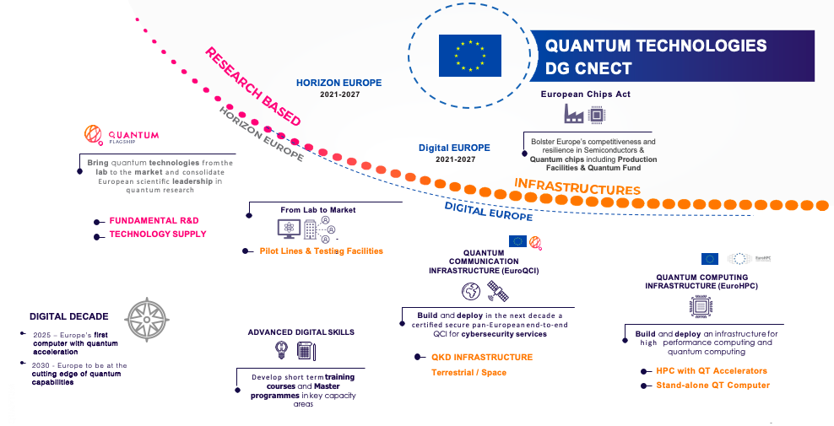
Flagship on Quantum Technologies: a Paradigm Shift

Slide 25
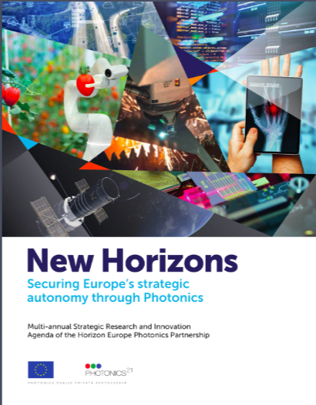
HORIZON-CL4-2023-DIGITAL-EMERGING-01-54
What are we looking for?
Contribution to:
Sensors/probes to monitor the quality of the communication network and of photonic signals transported in the communication network
Methods to use the network as large-scale distributed sensor
Development of foundational optical technologies, systems and networks that provide the future access infrastructure
Photonics21 Strategic Research and Innovation Agenda 2023-2030
https://www.flipsnack.com/photonics21/photonics21-strategic-research-and-innovation-agenda-2023-2030/full-view.html
Key group of actors driving this
Photonics21 https://www.photonics21.org/
Events
https://www.photonics21.org/events-workshops/

Slide 26
HORIZON-CL4-2023-DIGITAL-EMERGING-01-55
Is this new or has it been called before?
The call is about an innovation hub operating in the photonics area.
There have been predecessors starting in Horizon2020 (the ACTPHAST projects)
What we do NOT want?
Geographic concentration of activities in one region
Activities without connection to use in industry
Future outlook
The Photonics Partnership cooperates with the Chips Joint Undertaking to facilitate activities on photonic chips
The partnership also plans to cooperate with the virtual worlds initiative
Key group of actors driving this
Photonics21 https://www.photonics21.org/
Events
https://www.photonics21.org/events-workshops/

Slide 27
D6: A human-centred and ethical development and industrial technologies
https://www.youtube.com/live/IVdN1FhwA7U
Opening date: 15 November 2023
Deadline: 19 March 2024
Topic | Type of action, TRL | EU contribution per project (EUR million) | Number of projects to be funded
HORIZON-CL4-2024-HUMAN-01-06*: Explainable and Robust AI (AI Data and Robotics Partnership) | RIA TRL 2-3/TRL 4-5 | 9-10 | 3
HORIZON-CL4-2024-HUMAN-01-07*: Collaborative intelligence – combining the best of machine and human (AI Data and Robotics Partnership) | RIA TRL 2-3/TRL 4-5 | 5 | 4
HORIZON-CL4-2024-HUMAN-01-61*: Facilitate the engagement in global ICT standardisation development | CSA | 6 | 1

Slide 28
*Call HORIZON-CL4-2024-HUMAN-01
The Commission intends to cancel the 3 topics included in Call HORIZON-CL4-2024-HUMAN-01 (A human-centred and ethical development of digital and industrial technologies) with planned opening date 15 November 2023 and Deadline date 19 March 2024
HORIZON-CL4-2024-HUMAN-01-06: Explainable and Robust AI (AI Data and Robotics Partnership) (RIA), EUR 30.00 million
HORIZON-CL4-2024-HUMAN-01-07: Collaborative intelligence – combining the best of machine and human (AI Data and Robotics Partnership) (RIA), EUR 20.00 million
The Commission is considering the need to introduce a new call for projects that would better support the policy needs emerging from the fast evolving trend on Artificial Intelligence, in particular around generative Artificial Intelligence. This strategy also aims to secure sovereignty over AI technology, requiring projects with sufficient critical mass.
HORIZON-CL4-2024-HUMAN-01-61: Facilitate the engagement in global ICT standardisation development (CSA), EUR 6.00 million. This topic is postponed, unchanged, to the new call. The new Call would be opened around April 2024.

Slide 29
D1: Climate neutral, circular and digitised production
https://www.youtube.com/live/Ip4Bu2oW_Aw
Opening date: 19 September 2023
Deadline: 7 February 2024
Topic | Type of action, TRL | EU contribution per project (EUR million) | Number of projects to be funded
HORIZON-CL4-2024-TWIN-TRANSITION-01-01: Bio-intelligent manufacturing industries (Made in Europe Partnership) | RIA TRL 4/TRL 6 | 4-5 | 5
HORIZON-CL4-2024-TWIN-TRANSITION-01-03: Manufacturing as a Service: Technologies for customized, flexible, and decentralized production on demand (Made in Europe Partnership) | RIA TRL 4/TRL 6 | 5-7 | 5
HORIZON-CL4-2024-TWIN-TRANSITION-01-05: Technologies/solutions to support circularity for manufacturing (Made in Europe Partnership) | RIA TRL 4/TRL 6 | 4-6 | 6
HORIZON-CL4-2024-TWIN-TRANSITION-01-12: Enhanced assessment, intervention and repair of civil engineering infrastructure | RIA /TRL 6 | 5-6 | 2

Slide 30
D1: Climate neutral, circular and digitised production
https://www.youtube.com/live/Ip4Bu2oW_Aw
Opening date: 19 September 2023
Deadline: 7 February 2024
Topic | Type of action, TRL | EU contribution per project (EUR million) | Number of projects to be funded
HORIZON-CL4-2024-TWIN-TRANSITION-01-32: Optimisation of thermal energy flows in the process industry (Processes4Planet partnership) | IA TRL 5/TRL 7 | 10-15 | 2
HORIZON-CL4-2024-TWIN-TRANSITION-01-34: Renewable hydrogen used as feedstock in innovative production routes (Processes4Planet Partnership) | RIA TRL 4/TRL 6 | 8-10 | 2
HORIZON-CL4-2024-TWIN-TRANSITION-01-35: Turning CO2 emissions from the process industry to feedstock (Processes4Planet partnership) | IA TRL 5-6/TRL 7 | 10-15 | 2
HORIZON-CL4-2024-TWIN-TRANSITION-01-38: Hubs for circularity for industrialised urban peripheral areas (Processes4Planet partnership) | IA TRL 5/TRL 7 | 15-20 | 2

Slide 31
D1: Climate neutral, circular and digitised production
https://www.youtube.com/live/Ip4Bu2oW_Aw
Opening date: 19 September 2023
Deadline: 7 February 2024
Topic | Type of action, TRL | EU contribution per project (EUR million) | Number of projects to be funded
HORIZON-CL4-2024-TWIN-TRANSITION-01-41: Breakthroughs to improve process industry resource efficiency (Processes4Planet partnership) | RIA TRL 4/TRL 6 | 10-12 | 3
HORIZON-CL4-2024-TWIN-TRANSITION-01-44: Digital transformation and ensuring a better use of industrial data, which can optimise steel supply chains (Clean Steel partnership) | IA TRL 5/TRL 6-7 | 8-10 | 2
HORIZON-CL4-2024-TWIN-TRANSITION-01-46: CO2-neutral steel production with hydrogen, secondary carbon carriers and electricity OR innovative steel applications for low CO2 emissions (Clean Steel Partnership) | RIA TRL 4/TRL 5-6 | 3-5 | 4

Slide 32
HORIZON-CL4-2024-TWIN-TRANSITION-01-01
https://cloud.effra.eu/index.php/s/bRrlW4F79uVpeiv
The focus of this topic is on manufacturing.
The development of materials beyond the manufacturing context is excluded.
Proposals should address either advanced manufacturing techniques (e.g. additive manufacturing, extrusion, moulding etc.) to process bio-materials or bio-intelligent components for upscaled production; or bio-intelligent production technologies; or combinations of these two approaches.
Proposals submitted under this topic should include a business case and exploitation strategy, as outlined in the introduction to this Destination.
Proposals need to demonstrate the development of digital and green technologies that facilitate the upscaled manufacturing of bio-based or bio-intelligent products in one manufacturing value chain. In addition, sustainable business models need to be developed for production and recycling of the products.
Turning FAIR into reality: https://ec.europa.eu/info/sites/default/files/turning_fair_into_reality_1.pdf
All projects should build on or seek collaboration with existing projects and develop synergies with other relevant European, national or regional initiatives, funding programmes and platforms, for example with Horizon Europe Cluster 6 and its Destination on Circular Economy and Bioeconomy sectors and/or its Partnership Circular Bio-based Europe (CBE).

Slide 33
HORIZON-CL4-2024-TWIN-TRANSITION-01-03
Interoperability is a core requirement for MaaS; for this reason, research will build on existing standards or contribute to standardization where relevant, taking also into account the contributions of upcoming EU initiatives like the Digital Product Passport or the Manufacturing Data Spaces.
Proposals should explain how the proposed approach contributes to the competitiveness of industry and the sustainability and circularity of production and logistics, through measurable targets.
Proposals submitted under this topic should include a business case and exploitation strategy, as outlined in the introduction to this Destination.
https://cloud.effra.eu/index.php/s/bRrlW4F79uVpeiv
Turning FAIR into reality: https://ec.europa.eu/info/sites/default/files/turning_fair_into_reality_1.pdf

Slide 34
HORIZON-CL4-2024-TWIN-TRANSITION-01-05
Links may be established with relevant cases emerging from the CSA project HORIZON-CL4-2023-RESILIENCE-01-39.
International cooperation is encouraged, especially with Japan, S. Korea, US, Canada, and Australia.
Proposals submitted under this topic should include a business case and exploitation strategy, as outlined in the introduction to this Destination.
Proposals should take into account relevant international standards and activities supported under the Digital Europe programme, e.g. in the area of Manufacturing Data Spaces.
Turning FAIR into reality: https://ec.europa.eu/info/sites/default/files/turning_fair_into_reality_1.pdf
Research must build on existing standards or contribute to standardisation. Interoperability for data sharing should be addressed, leveraging on existing ontologies and metadata and though the implementation of the FAIR data principles.
All projects should build on or seek collaboration with existing projects and develop synergies with other relevant European, national or regional initiatives, funding programmes and platforms. Collaboration with EIT Manufacturing is encouraged, in particular on the development of skills.
Proposal for Ecodesign for Sustainable Products Regulation

Slide 35
HORIZON-CL4-2024-TWIN-TRANSITION-01-32
HORIZON-CL4-2024-TWIN-TRANSITION-01-34
Proposals submitted under this topic should include a sound business case and strong exploitation strategy, as outlined in the introduction to this Destination. As a project output a more elaborated exploitation plan should be developed including preliminary plans for scalability, commercialisation and deployment. This should also include the assessment of possible societal and environmental impact and implications for the workplace.
Research must build on existing standards or contribute to standardisation. Where relevant, interoperability for data sharing should be addressed.
Proposals should build on or seek collaboration with existing projects and develop synergies with other relevant European, national, or regional initiatives, funding programmes and platforms
Proposals should build on or seek collaboration with existing projects and develop synergies with other relevant European, national, or regional initiatives and funding programmes and platforms. Where relevant, proposals could liaise with the Clean Hydrogen Joint Undertaking and are encouraged to contribute and participate to the activities of the TRUST database and the hydrogen observatory.
Processes4Planet SRIA 2050
https://www.aspire2050.eu/sites/default/files/users/user85/p4planet_07.06.2022._final.pdf
Technology Reporting Using Structured Templates (TRUST) tool https://www.clean-hydrogen.europa.eu/knowledge-management/annual-data-collection_en#trust

Slide 36
HORIZON-CL4-2024-TWIN-TRANSITION-01-35
HORIZON-CL4-2024-TWIN-TRANSITION-01-38
Where synergies are possible with projects from topic HORIZON-CL5-2024-D3-02-11, cooperation activities are encouraged.
Proposals should build on or seek collaboration with existing projects and develop synergies with other relevant European, national or regional initiatives, funding programmes and platforms and are encouraged to consider the use of their expected outcomes in a wider approach that might benefit the establishment of Hubs for Circularity.
Clustering and cooperation with other selected projects under this topic and other relevant topics in Horizon Europe (e.g., HORIZON-CL4-2023-TWIN-TRANSITION-01-42 or HORIZON-CL4-2023-RESILIENCE-01-05), with European initiatives (as for example: Circular Cities and Regions Initiative (CCRI) and European Circular Economy Stakeholder Panel (ECESP)), as well as building on existing projects is strongly encouraged (see also Industrial Symbiosis Report of March 2020).
This topic aims to support the goals of the smart cities mission by contributing to a healthier urban industrial symbiosis through waste reduction.
This topic implements the co-programmed European partnership Processes4Planet.
Hubs for Circularity
https://www.h4c-community.eu/

Slide 37
D2: Increased autonomy in key strategic value chains for resilient industry
https://www.youtube.com/watch?v=9G5n2QuzdSo
Opening date: 19 September 2023
Deadline: 7 February 2024
Topic | Type of action, TRL | EU contribution per project (EUR million) | Number of projects to be funded
HORIZON-CL4-2024-RESILIENCE-01-01: Exploration of critical raw materials in deep land deposits | RIA /TRL 3-5 | 5 | 4
HORIZON-CL4-2024-RESILIENCE-01-04: Piloting emerging Smart IoT Platforms and decentralized intelligence | IA /TRL 6-7 | 7,3 | 3
HORIZON-CL4-2024-RESILIENCE-01-08: Rare Earth and magnets innovation hubs | IA /TRL 6-7 | 16 | 2
HORIZON-CL4-2024-RESILIENCE-01-10: Addressing due diligence requirements in raw materials supply chains | CSA | 2,2 | 1

Slide 38
D2: Increased autonomy in key strategic value chains for resilient industry
https://www.youtube.com/watch?v=9G5n2QuzdSo
Opening date: 19 September 2023
Deadline: 7 February 2024
Topic | Type of action, TRL | EU contribution per project (EUR million) | Number of projects to be funded
HORIZON-CL4-2024-RESILIENCE-01-11: Technologies for extraction and processing of critical raw materials | IA /TRL 6-7 | 7,5 | 2
HORIZON-CL4-2024-RESILIENCE-01-24: Development of safe and sustainable by design alternatives | IA TRL 4-5/TRL 6-7 | 12-15 | 4
HORIZON-CL4-2024-RESILIENCE-01-35: Biodegradable polymers for sustainable packaging materials | IA TRL 4/TRL 6-7 | 6-8 | 4
HORIZON-CL4-2024-RESILIENCE-01-36: Advanced biomaterials for the Health Care | IA TRL 3-4/TRL 5-6 | 6-8 | 4
HORIZON-CL4-2024-RESILIENCE-01-41: 'Innovate to transform' support for SME's sustainability transition | CSA | 5 | 2

Slide 39
HORIZON-CL4-2024-RESILIENCE-01

Slide 40
HORIZON-CL4-2024-RESILIENCE-01
Participation in this topic is limited to legal entities established in Member States, associated countries, OECD countries, African Union Member States*, MERCOSUR, CARIFORUM, Andean Community and countries with which the EU has concluded strategic partnerships on raw materials (Argentina, Canada, Chile, Kazakhstan, Namibia, Ukraine).
The choice of these countries was made taking into consideration the development of strategic international partnerships on raw materials and avoidance of reinforcing existing over-dependencies, as well as the importance of involving partners committed to pursuing open trade in such materials. Proposals including legal entities which are not established in the countries that fall under the criteria above will be ineligible
Argentina
Canada
Chile
Kazakhstan
Namibia
Ukraine

Slide 41
HORIZON-CL4-2024-RESILIENCE-01
Project portfolio
FutuRaM https://futuram.eu/
AfricaMaVal https://africamaval.eu
NewWave https://www.newwave-horizon.eu/
HAlMan https://halman-project.eu/
SEMACRET https://semacret.eu/
VECTOR https://vectorproject.eu/
METALLICO https://metallico-project.eu/

Slide 42
HORIZON-CL4-2024-RESILIENCE
EU action plan on Critical Raw Materials
https://ec.europa.eu/docsroom/documents/42852/attachments/2/translations/en/renditions/native
Directive on single-use plastics
https://eur-lex.europa.eu/eli/dir/2019/904/oj
United Nations Framework Classification for Resources (UNFC)
https://unece.org/sustainable-energy/sustainable-resource-management/united-nations-framework-classification
Circular economy action plan
https://environment.ec.europa.eu/strategy/circular-economy-action-plan_en
Rare Earth Magnets and Motors from the European Raw Materials Alliance https://eitrawmaterials.eu/wp-content/uploads/2021/09/ERMA-Action-Plan-2021-A-European-Call-for-Action.pdf
United Nations Resource Management System
https://unece.org/sustainable-energy/unfc-and-sustainable-resource-management/unrms

Slide 43
D5: Open strategic autonomy in developing, deploying and using global space-based infrastructures, services, applications and data
Opening date: 21 November 2023
Deadline: 20 February 2024
https://www.youtube.com/live/Y7sDJJlyYSE
Topic | Type of action, TRL | EU contribution per project (EUR million) | Number of projects to be funded
HORIZON-CL4-2024-SPACE-01-35: Copernicus for Land and Water | RIA /TRL 5-6 | 1,5-2 | 4
HORIZON-CL4-2024-SPACE-01-36: Copernicus for Security | RIA /TRL 5-6 | 4 | 2
HORIZON-CL4-2024-SPACE-01-64: Quantum Space Gravimetry Phase-B study & Technology Maturation | RIA /TRL 6-7 | 14 | 1
HORIZON-CL4-2024-SPACE-01-73: Space technologies for European non-dependence and competitiveness | RIA /TRL 5-8 | 2-3 | 7

Slide 44
HORIZON-CL4-2024-SPACE-01-35/36
https://www.copernicus.eu/en
Through Earth Observation (EO) satellites the status of and changes in Earth’s systems can be monitored and assessed
Copernicus serves as an independent and powerful European EO solution with services to benefit all European citizens
Its own fleet of Earth observation satellites (Sentinels) provides global data free of charge
Additionally, the commercial market demand for EO products is expected to grow quickly in the next years with a focus on
Advanced, very high-resolution satellite imagery and
Affordable, high-resolution, high-revisit products
6 Sentinel Expansion missions are being studied
CHIME: Copernicus Hyperspectral Imaging Mission for the Environment
CIMR: Copernicus Imaging Microwave Radiometer
C02M: Copernicus Anthropogenic Carbon Dioxide Monitoring
CRISTAL: Copernicus Polar Ice and Snow Topography Altimeter
LSTM: Copernicus Land Surface Temperature Monitoring
ROSE-L: Copernicus L-band Synthetic Aperture Radar
https://www.copernicus.eu/en/copernicus-services

Slide 45
HORIZON-CL4-2024-SPACE-01-35/36
HI-SIDE aims to develop & demonstrate satellite data-chain technologies. To advance onboard data handling & support high-speed data transfer https://www.hi-side.space/
LEMON developed a Lidar emitter for space applications. To monitor greenhouse gases and water vapour https://lemon-dial-project.eu/
REDDCopernicus assessed a future Copernicus EO service. To support sustainable forest monitoring https://www.reddcopernicus
https://www.copernicus.eu/en/accessing-data-where-and-how/copernicus-services-catalogue

Slide 46
HORIZON-CL4-2024-SPACE-01-64
Quantum Space Gravimetry
Satellite gravity missions provide unique observations not covered by other Earth observation missions
Quantum technology can be a game-changer for space applications and a key enabler for the evolution of Copernicus for applications in Earth science: climatology, geodesy, oceanography, hydrology, glaciology, etc)
HE project CARIOQA develops an engineering model of the quantum accelerometer for a future mission
Quantum Key Distribution
Technology used to deliver crypto material to end-users
Satellites used to overcome the limitations of ground-based segments
Objective is to mature the new quantum technologies (such as entanglement) and perform the qualification for space and ground segments

Slide 47
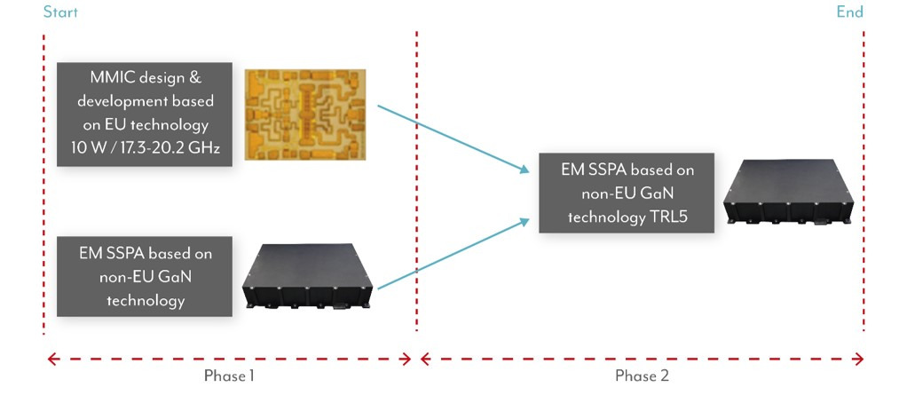
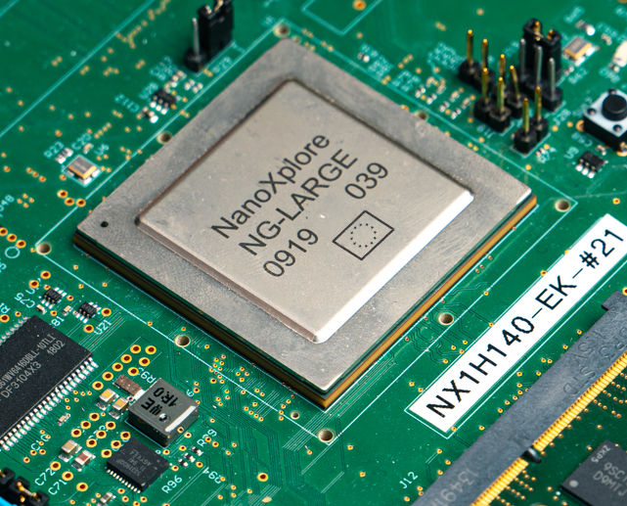
HORIZON-CL4-2024-SPACE-01-73
Examples of recent achievements in the area of EU technological non-dependence
The first radiation hard fully European FPGA NG-MEDIUM (Field Programmable Gate Array)
Development of a supply chain covering different families of FPGAs in the EU
Funded projects cover the design, manufacturing, validation and space qualification
Used in multiple space missions, including Galileo
GaN power technology for space applications
Development of EU based GaN technology for power applications, covering both low voltages (<50V) and high voltages of up to 650V
Funded projects aimed at developing and space qualify the GaN foundry process leading to GaN devices space compatible

Slide 48
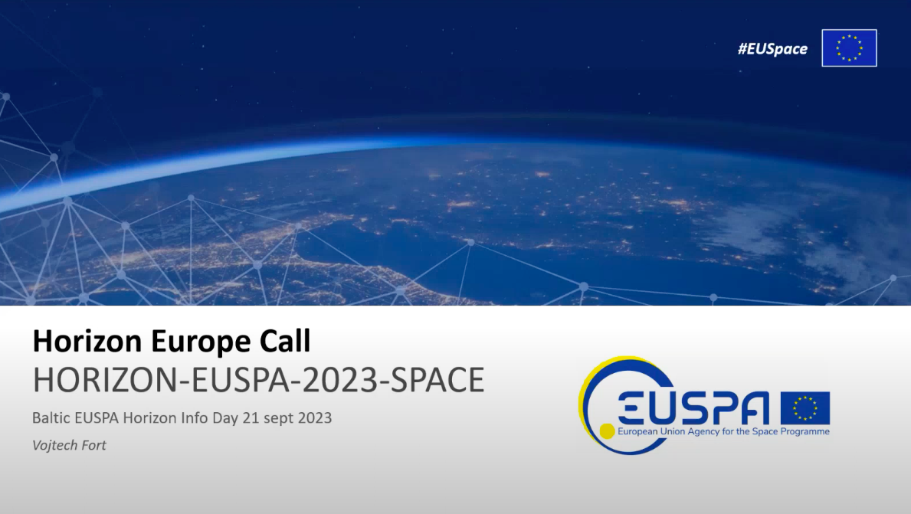
EUSPA CALLS
https://www.euspa.europa.eu/opportunities/horizon-europe
HORIZON-EUSPA-2023-SPACE-01-41
HORIZON-EUSPA-2023-SPACE-01-42
HORIZON-EUSPA-2023-SPACE-01-43
HORIZON-EUSPA-2023-SPACE-01-46
HORIZON-EUSPA-2023-SPACE-01-61
https://www.euspa.europa.eu/
https://www.youtube.com/watch?v=dTg2bayyiBM
https://www.lzp.gov.lv/lv/jaunums/oktobri-tiks-atverts-tresais-eiropas-savienibas-kosmosa-programmas-agenturas-euspa-projektu-konkurss

Slide 49
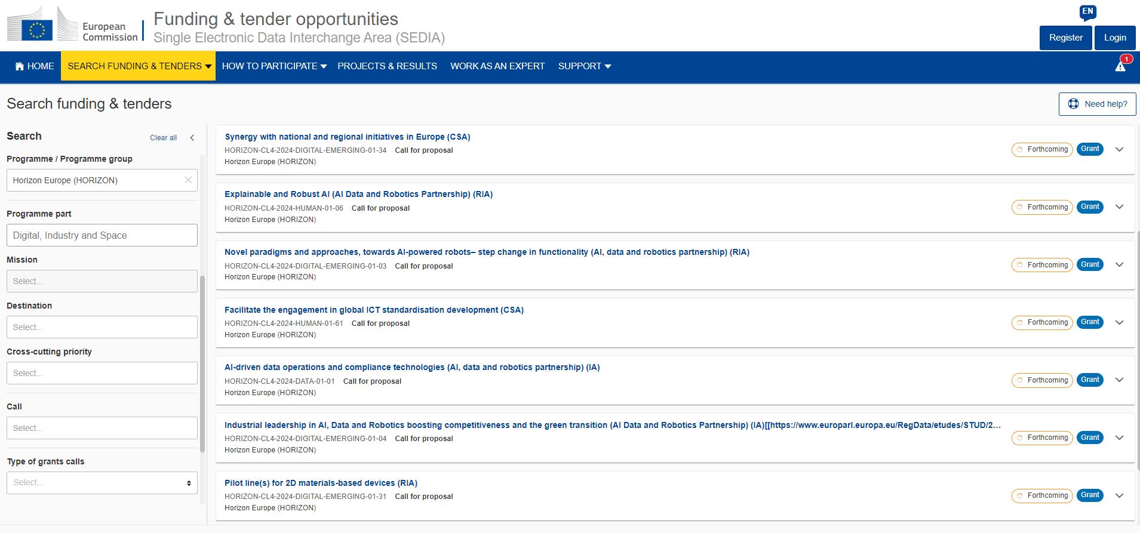
Funding&tender opportunities

Slide 50
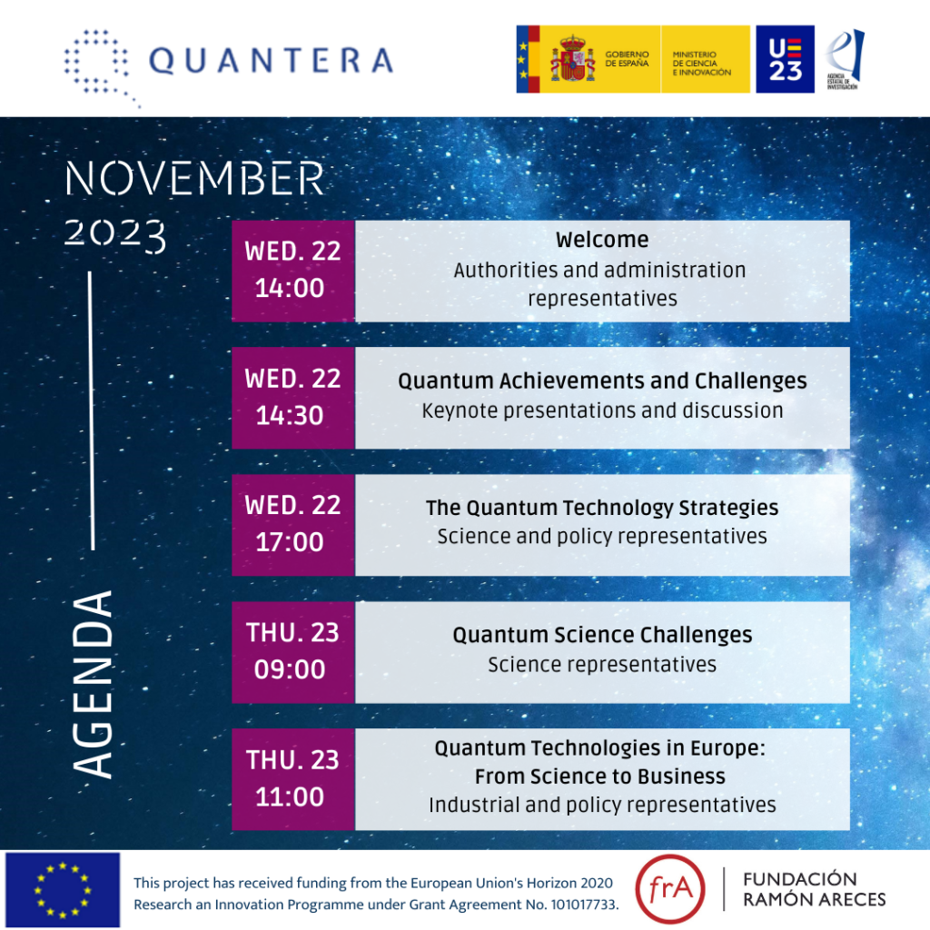
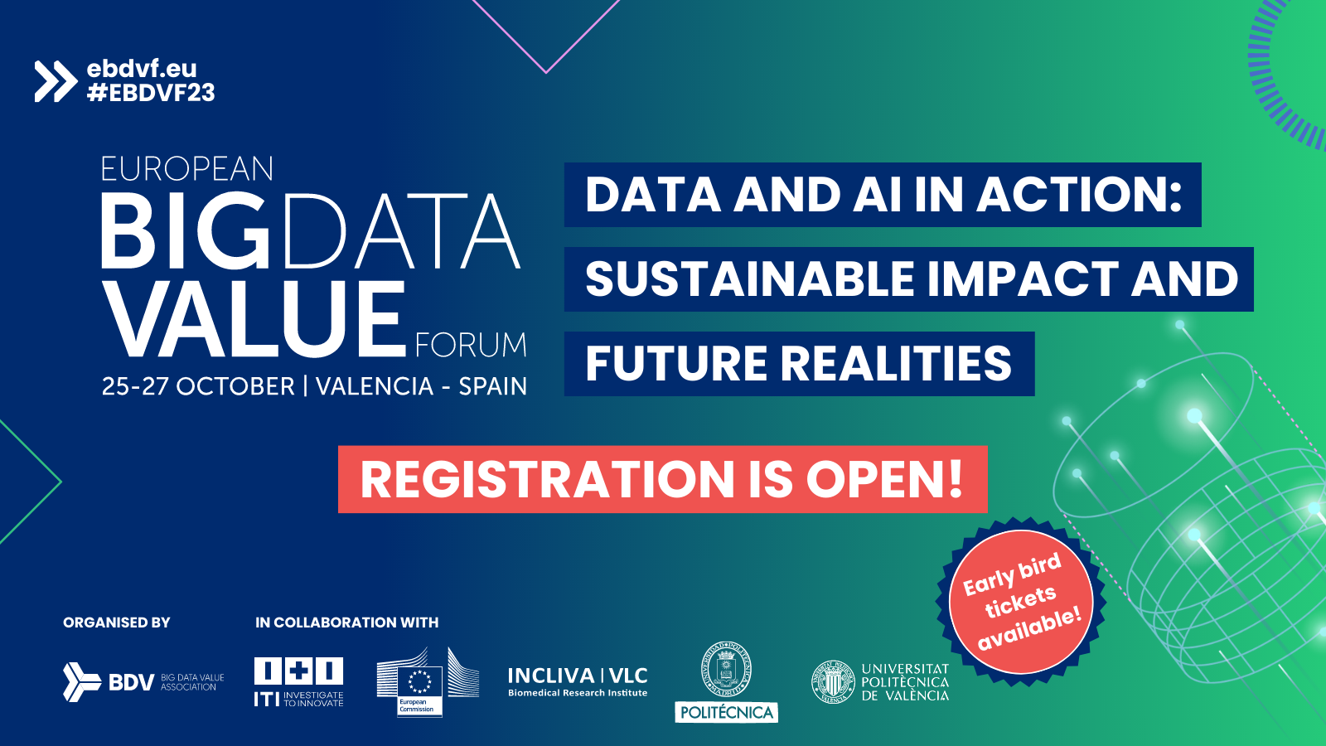
Pasākumi
https://adr-association.eu/blog/announcing-the-european-ai-data-robotics-forum-08-09-11-2023-versailles/
https://quantera.eu/save-the-date-quantum-technologies-in-europe/
https://european-big-data-value-forum.eu/
https://www.euspaceweek.eu/
https://kets2023.b2match.io/

Slide 51
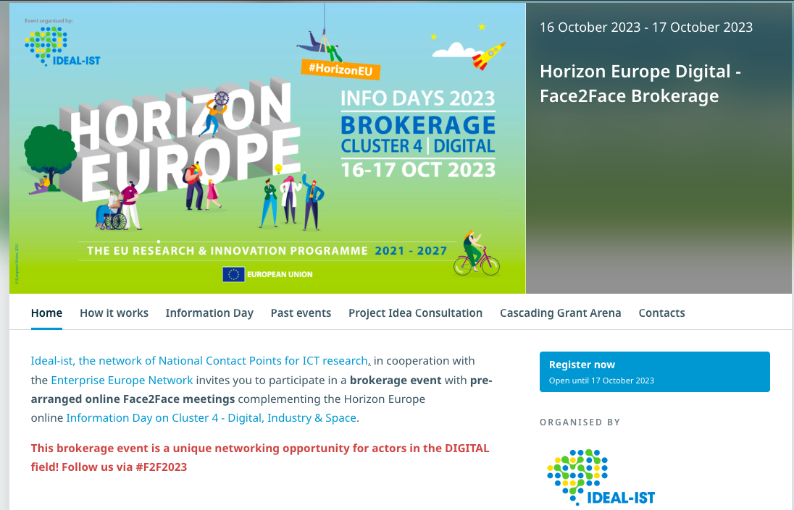
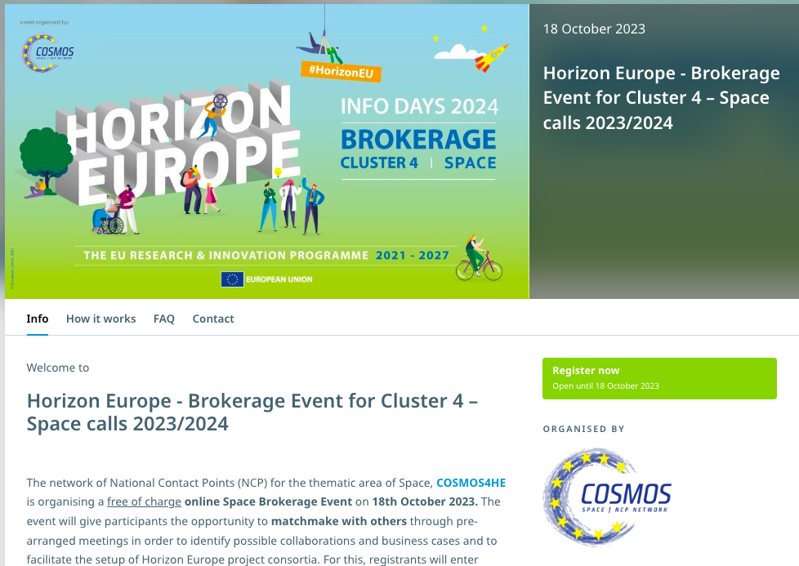
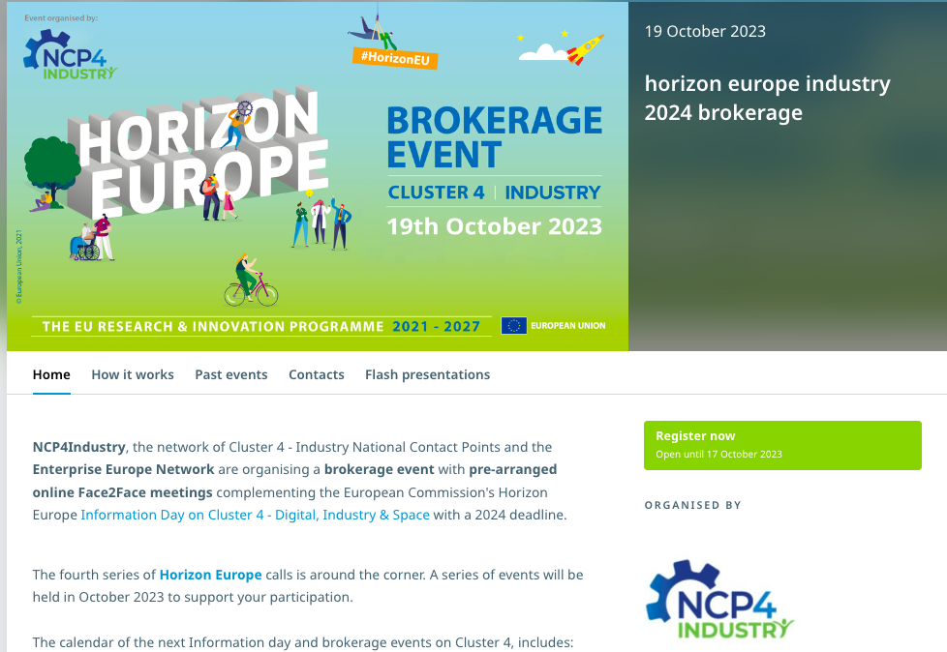
Kontakt biržas
Digital brokerage event
Destinations 3, 4, 6
Space brokerage event
Destination 5
https://www.ideal-ist.eu
https://www.ncp-space.net
Industry brokerage event
Destinations 1, 2
https://ncp4industry.eu

Slide 52
Atbalsts ceļošanas izdevumu segšanai
Apvārsnis Eiropa Nacionālais kontaktpunkts aicina pieteikties saņemt atbalstu ceļošanas izdevumu segšanai uz Apvārsnis Eiropa 2.pilāra tīklošanas pasākumiem.
Atbalsts ceļošanas izdevumu segšanai pieejams visiem Zinātniskajā reģistrā reģistrētiem dalībniekiem, kuri vēlas atrast partnerus un/vai prezentēt sava projekta ideju, piedaloties klātienes tīklošanās pasākumos.
Papildus informācija: https://www.lzp.gov.lv/lv/atbalsts-pieteicejiem

Slide 53
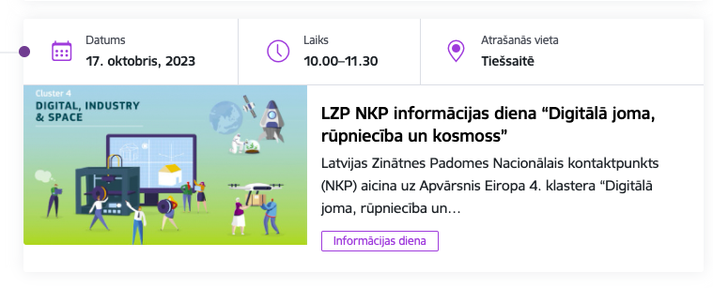
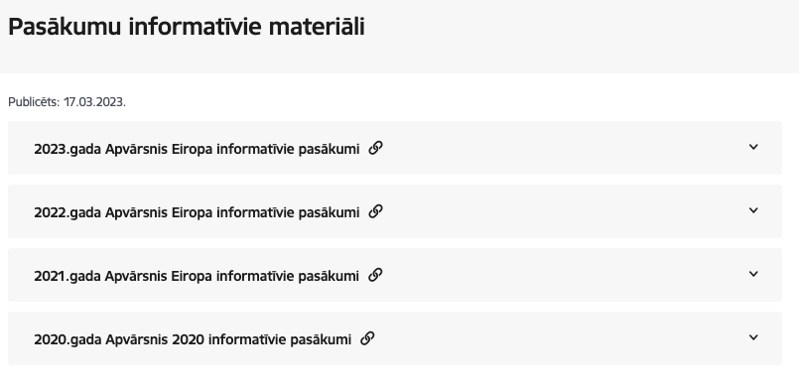
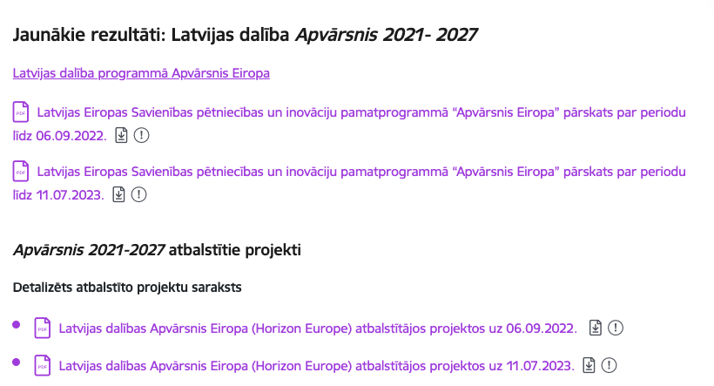
https://www.lzp.gov.lv/lv/notikumu-kalendars
https://www.lzp.gov.lv/lv/pasakumu-informativie-materiali
https://www.lzp.gov.lv/lv/atbalstitie-projekti-2
https://www.lzp.gov.lv/lv/jaunumi?category%5B67%5D=67

Slide 54
Statistika: Apvārsnis Eiropa 4. klasteris
ELEKTRONIKAS UN DATORZINATNU INSTITUTS | 10 | 2 321 972,53 €
LATVIJAS UNIVERSITATES CIETVIELU FIZIKAS INSTITUTS | 2 | 936 594,50 €
WIT BERRY | 4 | 433 443,25 €
LATVIJAS VALSTS KOKSNES KIMIJAS INSTITUTS | 1 | 421 375,00 €
TILDE SIA | 1 | 408 537,50 €
ZALA BRIVIBA BIEDRIBA | 1 | 305 000,00 €
SMARTSOL SIA | 2 | 297 583,13 €
GRUPA93 | 1 | 295 250,00 €
EXPONENTIAL TECHNOLOGIES | 1 | 278 043,75 €
SIA LIGHTSPACE TECHNOLOGIES | 1 | 223 750,00 €
VALSTS AKCIJU SABIEDRIBA ELEKTRONISKIE SAKARI | 1 | 208 125,00 €
VALMIERAS TEHNIKUMS | 1 | 199 522,00 €
LATVIJAS UNIVERSITATES MATEMATIKAS UN INFORMATIKAS INSTITUTS | 1 | 154 234,85 €
RIGAS PLANOSANAS REGIONS | 1 | 143 750,00 €
SIA RIGAS MEZI | 1 | 140 857,50 €
SABIEDRIBA AR IEROBEZOTU ATBILDIBU SUNGIS | 1 | 101 733,60 €
RIGA MUNICIPAL AGENCY "RIGA ENERGY AGENCY" | 1 | 101 250,00 €
RIGAS TEHNISKA UNIVERSITATE | 1 | 88 593,75 €

Slide 55
APVĀRSNIS EIROPA NACIONĀLAIS KONTAKTPUNKTS
Jānis Ancāns
CL1
Marija Plotniece
EIC, EIT, EIE, RI
Inga Šīrante
Legal and Financial issues
Sarmīte Mickeviča
Widening, CL3
Aiga Salmiņa
CL5, CL6, JRC
Liene Ekša
MSCA, ERC, ERA
Jūlija Asmuss
Coordinator, CL4
Darja Aksjonova,
CL2, EURAXESS, Widening
Lāsma Brenča
CL5, CL6
https://www.lzp.gov.lv/lv/apvarsnis-eiropa-2021-2027

Slide 56
Paldies!
@apvarsnis
@Apvārsnis EU Latvijas Nacionālais kontaktpunkts - HE NCP LV
https://www.lzp.gov.lv/lv/apvarsnis-eiropa
Informācijas avots:

