Slide 1
Apvārsnis Eiropa paplašināšanās (Widening) konkursu informācijas diena
Pasākuma programma:
10:00-10:20 prezentācija par Apvārsnis Eiropa 2024. gada Paplašināšanās konkursiem (Hop On & Excellence Hubs) darba programmas konkursiem
Sarmīte Mickeviča, Latvijas zinātnes padomes NKP vecākā eksperte
10:20-10:40 prezentācija par Apvārsnis Eiropa 2024. gada Paplašināšanās konkursiem (ERA Chairs & ERA Talents) darba programmas konkursiem
Darja Aksjonova, Latvijas zinātnes padomes NKP vecākā eksperte
10:40-10:50 NCP.WIDERA.NET portāls un Ceļojumu atbalsta pasākumiem (Travel Grants)
10.50 – 11.05 Widening Statistikas Dashboard
11:05-11:15 jautājumi un atbildes

Slide 2

Apvārsnis Eiropa paplašināšanās (Widening) konkursu aktualitātes
Darja Aksjonova
Nacionālā kontaktpunkta
Vecākā eksperte
Darja.aksjonova@lzp.gov.lv
Sarmīte Mickeviča
Nacionālā kontaktpunkta
Vecākā eksperte
Sarmite.mickevica@lzp.gov.lv
1.1.1. specifiskā atbalsta mērķa "Palielināt Latvijas zinātnisko institūciju pētniecisko un inovatīvo kapacitāti un spēju piesaistīt ārējo finansējumu, ieguldot cilvēkresursos un infrastruktūrā" 1.1.1.5. pasākuma "Atbalsts starptautiskās sadarbības projektiem pētniecībā un inovācijās" 1.kārtas, projekta Nr.1.1.1.5/17/I/001 “Atbalsts starptautiskās sadarbības projektu izstrādei un īstenošanai” ietvaros

Slide 3
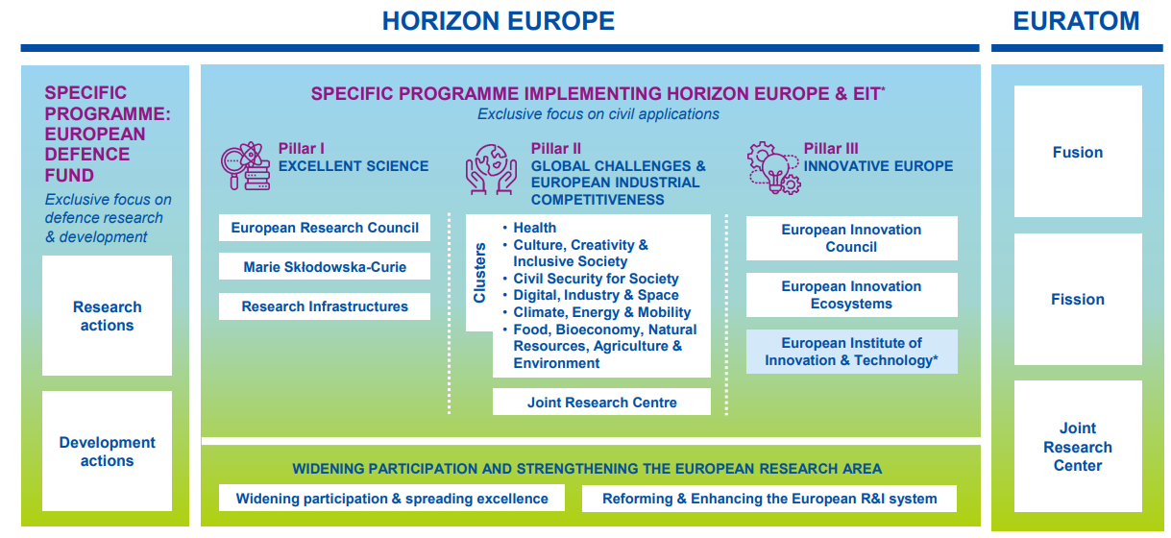
APVĀRSNIS EIROPA
WORK PROGRAMMES 2023-2024

Slide 4


Apvārsnis Eiropa paplašināšanās darba programma
informācija: https://ec.europa.eu/info/horizon-europe/cluster-4-digital-industry-and-space_en
darba programma: https://ec.europa.eu/info/funding-tenders/opportunities/docs/2021-2027/horizon/wp-call/2023-2024/wp-11-widening-participation-and-strengthening-the-european-research-area_horizon-2023-2024_en.pdf
Dokumenti: https://research-and-innovation.ec.europa.eu/funding/funding-opportunities/funding-programmes-and-open-calls/horizon-europe/strategic-plan_en#the-second-horizon-europe-strategic-plan-2025-2027
programmas ceļvedis:
https://ec.europa.eu/info/funding-tenders/opportunities/docs/2021-2027/horizon/guidance/programme-guide_horizon_en.pdf

Slide 5

Projektu tipi
Type | Activities | Financing rate
RIA (Research and Innovation Actions) | Activities to establish new knowledge or to explore the feasibility of a new or improved technology, product, process, service or solution. | Up to 100%
IA (Innovation Actions) | Activities to produce plans and arrangements or designs for new, altered or improved products, processes or services. | *Up to 70%
CSA (Coordination and Support Actions) | Activities that contribute to the objectives of Horizon Europe. This excludes R&I activities, except for ‘Widening participation and spreading excellence’. | Up to 100%
* the rate is 70 percent for profit-making legal entities and 100 percent for non-profit legal entities

Slide 6
DESTINATION 1
Improved access to Excellence
DESTINATION 2
Attracting and mobilising the best talents
DESTINATION 3
Reforming and enhancing the EU research and innovation system
Hop on facility
Excelence hubs

Slide 7
Hop on facility & Excelence hubss
https://www.youtube.com/watch?v=wdK-P91UtSo
Topic | Type of action, TRL | EU contribution per project (EUR million) | Number of projects to be funded
HORIZON-WIDERA-2023-ACCESS-06: Hop on facility Opening date: 10 Jan 2023 Deadline: 26 Sep 2024 | RIA | 0.1 – 0.6 | 160
HORIZON-WIDERA-2023-ACCESS-07: Excellence Hubs Opening date: 28 Sep 2023 Deadline: 7 Mar 2024 | CSA | 2.00 – 6.00 | 12

Slide 8
Hop on facility: Policy objective
Improve Inclusiveness of Horizon Europe by involving additional research institutions from Widening countries in Horizon Europe Pillar 2 and EIC Pathfinder actions.
Contribute to the ‘advancing Europe package’ negotiated in the legislative process for Horizon Europe
Open up closed networks and overcome barriers
Contribute to reducing the participation gap in Horizon Europe and closing the innovation divide in Europe
Notes:
Atvērt slēgtos tīklus

Slide 9
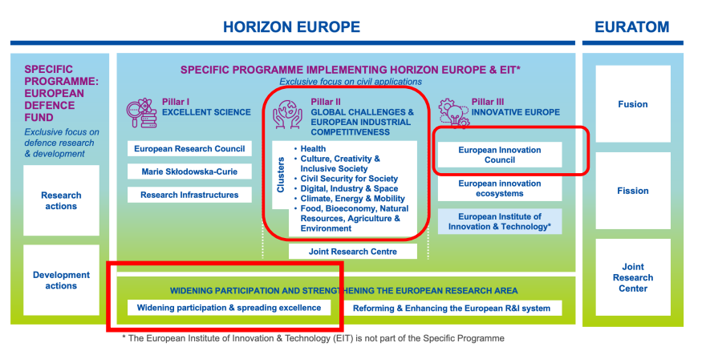
Hop on facility: Who?
A consortium funded under Pillar 2 or the EIC Pathfinder actions of Horizon Europe with a valid grant agreement, but with no partner from a Widening country;
A legal entity from a Widening Country wishing to join this collaborative R&I action.

Slide 10
Hop on facility: EXPECTED IMPACTS
At system level, mobilize excellence and increase visibility of R&I systems of Widening countries, improve knowledge circulation, and reduce participation gap for Widening countries in thematic domains (relates to portfolio of hop on projects not to individual case).
At organisation level, open up silos of established closed networks and improve research excellence of institutions from widening countries in specific fields.
At the level of the beneficiary, acquire new competencies and skills (from working in transnational projects) e.g. on research management, dissemination and exploitation of results.
Notes:
Atvērt slēgtos tīklus

Slide 11
Hop on facility: KEY FEATURES (1)
Who:
A consortium funded under Pillar 2 or the EIC Pathfinder actions of Horizon Europe with a valid grant agreement but with no partner from a Widening country;
A legal entity from a Widening Country wishing to join this collaborative R&I action, typically not an individual but rather a research group
How:
The proposal must be submitted by the coordinator of the consortium funded under Pillar 2 of Horizon Europe.
All consortium partners need to agree on the accession of the new partner.
The proposal should include a detailed description of the profile of the new partner and its role in the existing project and the R&I relevance and complementarity needs to be demonstrated.
The additional partner and task should be described in a dedicated proposal template, Description of Action (DoA) of parent project to be annexed
Notes:
Atvērt slēgtos tīklus

Slide 12
Hop on facility: KEY FEATURES (2)
Implementation:
Selected consortia will be invited to submit an amendment request for accession of a new partner, modification of the description of the action and upgrade of the budget.
Costs:
The budget increase must be exclusively for the benefit of the new partner.
An additional coordination fee of up to 10% of the increased budget can be allocated to the coordinator of the consortium.
Notes:
500 partnerim
10% no 500 jeb 50K var prasīt koordinators – incresed mng effort

Slide 13
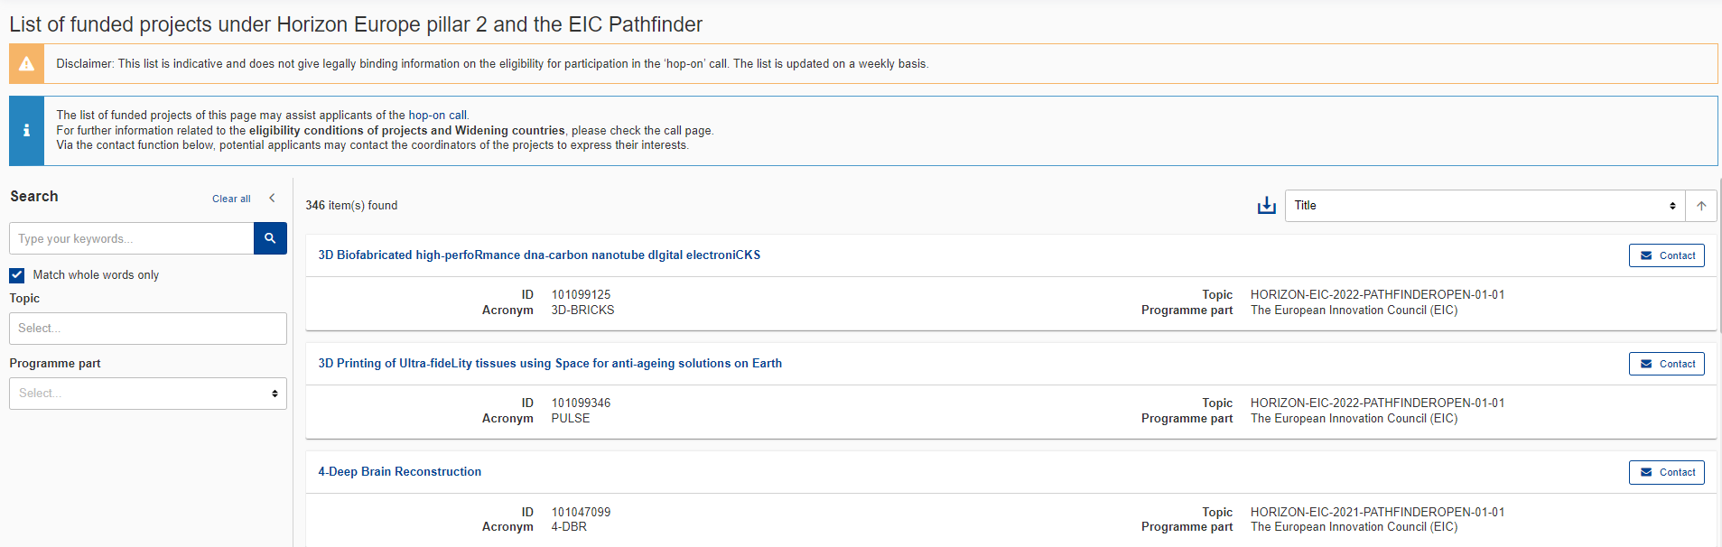
Hop on facility: List of eligible projects
https://ec.europa.eu/info/funding-tenders/opportunities/portal/screen/opportunities/horizon/hop-on
-> Hop-On Facility: page limit is 8 pages
Notes:
500 partnerim
10% no 500 jeb 50K var prasīt koordinators – incresed mng effort
In part A only coordinators and new partner should be mentioned

Slide 14
Excellence Hubs: Rationale
Innovation divide persists in Europe and risks to broaden as a result of the pandemic crisis.
Despite some progress many countries and regions lag behind in terms of their R&I investments.
Strong linkages between science and business are competitive success factors for R&I performance in more advanced regions and countries
Legislators have requested for ‘initiatives for excellence’ in the widening component of Horizon Europe → two complementary actions for excellence in innovation and Higher Education
Place based innovation ecosystems are drivers for development, diffusion and uptake of R&I results in catching up countries and regions
Close collaboration of academia, business, regional government and societal actors based on the quadruple helix principle is instrumental
European added value by cross-border collaboration of eco-systems alongside value adding chains, EU policy priorities and/or regional smart specialization strategies

Slide 15
Excellence Hubs: Policy objectives
Mobilise national investments in R&I capacity in widening countries
Develop innovation excellence in place based ecosystems including research, business, regional government and societal actors (quadruple helix)
Improved science business links and synergies with cohesion funds
Strengthen European co-operation and internationalization of regional ecosystems
Better involvement of regional and societal actors in European R&I activities
Create innovation and entrepreneurial culture in catching up countries and regions
Synergies with the programme parts on European Innovation Ecosystems and the European Institute of Innovation & Technology (EIT).

Slide 16
Excellence Hubs: Key features of placed based innovation ecosystems
Place based innovation ecosystems are interconnected companies, research institutions, governmental bodies and societal actors (quadruple helix) that are mutually reinforcing each other in a territorial context and together raise the level of innovation excellence in their regional fabric.
Quadruple helix ecosystems described in many scientific articles on knowledge economy and innovation and have inspired a number of funding initiatives in Europe and US
Inclusion of societal actors on top of formerly known triple helix adds the culture- and media-based public and civil society
Geographic proximity of actors (place based approach) facilitates stronger and sustainable collaborative links especially between academia and business
Ecosystems are dynamic networks (different from traditional industry clusters) including co-operation as well as competition (‘co-petition’)
Need to upscale from regional context to European and International

Slide 17
Excellence Hubs: Consortium structure
Minimum requirement: Two placed based innovation ecosystems from two different countries, all components of quadruple helix (research institution, business, regional/local government, societal actor) need to be represented
Umbrella organizations may replace individual partners (Cluster organization)
Keep consortium at manageable size i.e. not overly exceeding 20 partners (7 – 21 partners, depends are there umbrella organizations)
No advanced partners, but entities and ecosystems from non-widening countries may participate if justified and center of gravity of the project. Indicative budget share +- 70% remains in widening countries
Define thematic scope of consortium by common denominator in related smart specialization strategies and/or European policy priorities such as green and digital transition

Slide 18
Excellence Hubs: Core components of the project
Coherent and balanced work package of actions with the following content:
Cross-border joint R&I strategy aligned with strategic priorities: detailed strategy and agenda based on sound analysis of demand and opportunities within the scope of common smart specialization or European policy priorities
Joint R&I project consolidating academia business linkages: in the scope of joint strategy, active involvement of business partners envisaging marketable solutions
Action and investment plan for implementation of the strategy: Concrete implementation and finance plan including the mobilization of funds from ERDF, national funds, venture capital etc.
Conceptual design and pre-planning for pilots and demonstrators (if applicable): e.g. specification of R&I infrastructure, feasibility and proof of concept studies
Accompanying measures: e.g. to raise visibility, citizen engagement, technology transfer, entrepreneurship training, staff exchange, mutual learning etc. in view of creating innovation culture.

Slide 19
Excellence Hubs: NEW !! Optional Module - Mentoring
Mentoring of an emerging place-based innovation ecosystem established in rural areas, Western Balkans or Eastern Partnership Countries including Ukraine
Legal entities from such countries and regions are encouraged to join the project as participants in order to benefit from mentoring, training, knowledge transfer
ecosystems without fully developed quadruple helix structure may join via this module
mentoring module does not count for the minimum condition of having at least two fully-fledged quadruple helix innovation ecosystems
Consortia opting for this module may claim up to 1 million € additional budget (on top of the 5 million € for regular projects)
Notes:
How emerging ecosystem can be defined?
-> emerging must not have all 4 components (quadriple helix)
What is pursope of Mentoring module
-> bring in newcamers
-> not yet present quadriple helix structure
-> To support laging regions
Do not support previous excelence hubs, including risk of double financing
What could be ideal number of partners – 7-22 partneri, depends on idividual case
Pure SSH – no
New research institute creation – no

Slide 20
DESTINATION 1
Improved access to Excellence
DESTINATION 2
Attracting and mobilising the best talents
DESTINATION 3
Reforming and enhancing the EU research and innovation system
ERA Chairs
ERA Talents
ERA Fellowships

Slide 21
ERA Chairs & ERA Talents
https://www.youtube.com/watch?v=wdK-P91UtSo
Opening date: 28 Sep 2023
Deadline: 07 Mar 2024
Topic | Type of action, TRL | EU contribution per project (EUR million) | Number of projects to be funded
HORIZON-WIDERA-2023-TALENTS 01-01: ERA Chairs | CSA | 1.50 - 2.50 | 45
HORIZON-WIDERA-2024-TALENTS-03-01: ERA Talents | CSA | 1.00 - 3.00 | 20
Opening date: 11 Apr 2024
Deadline: 26 Sep 2024

Slide 22

ERA Chairs
OSI pieredze ERA Chairs projektā
Latvijai ir 3 projekti:
Natural Products Research at Latvian Institute of Organic Synthesis as a driver for Excellence in Innovation
SWEB - Smart Windows for Zero Energy Buildings

Slide 23
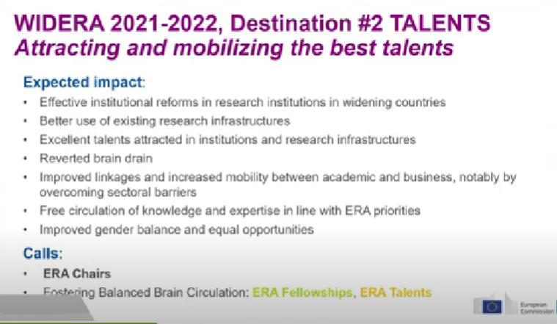

ERA Chairs
Tiek sagaidīts:
Efektīvas institucionālas reformas pētnieciskas organizācijās paplašināšanas valstīs
Labāka esošo pētnieciskas infrastruktūras izmantošanā
Izcilu talantu piesaiste institūcijas un pētniecības infrastruktūras
White And Green Modern Professional Secondary Research Presentation (lzp.gov.lv)

Slide 24
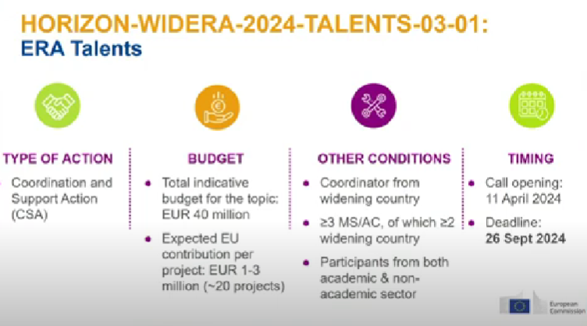
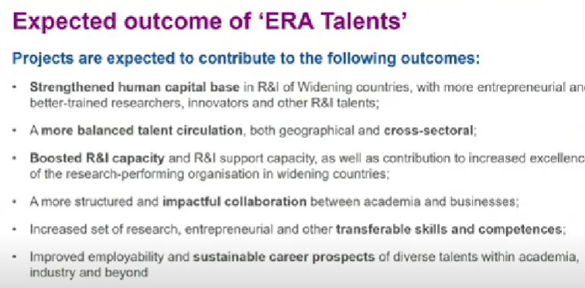
ERA Talents

Slide 25


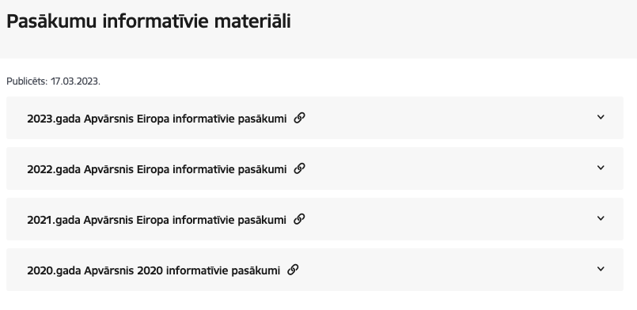
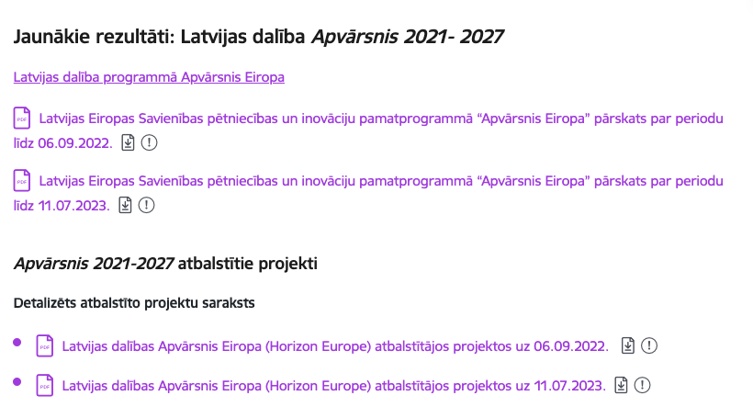
https://www.euraxess.lv
https://www.lzp.gov.lv/lv/pasakumu-informativie-materiali
https://www.lzp.gov.lv/lv/atbalstitie-projekti-2
Horizon Europe info day - WIDERA Work Programme 2023-2024, Morning session - YouTube

Slide 26
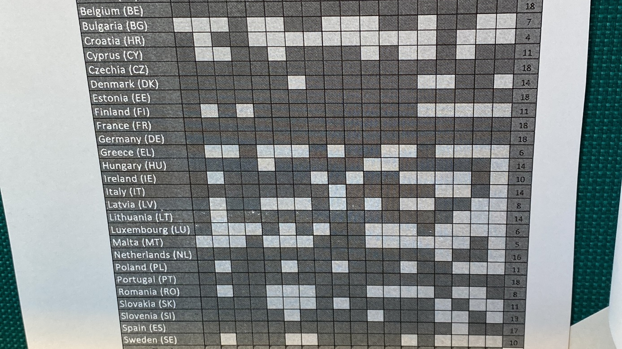

Slide 27



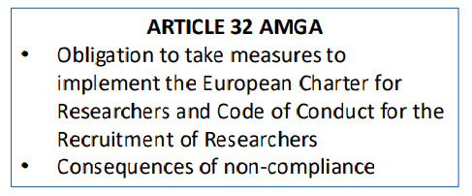
RM ROADMAP Project Home

Slide 28
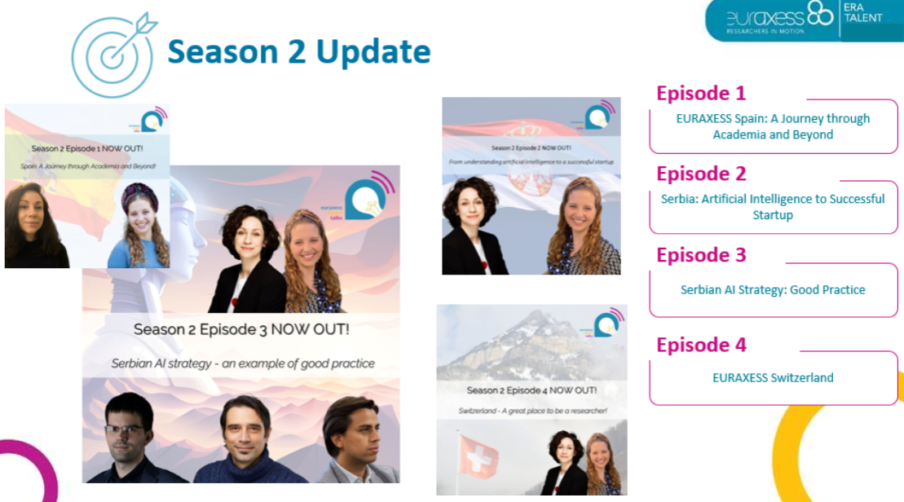
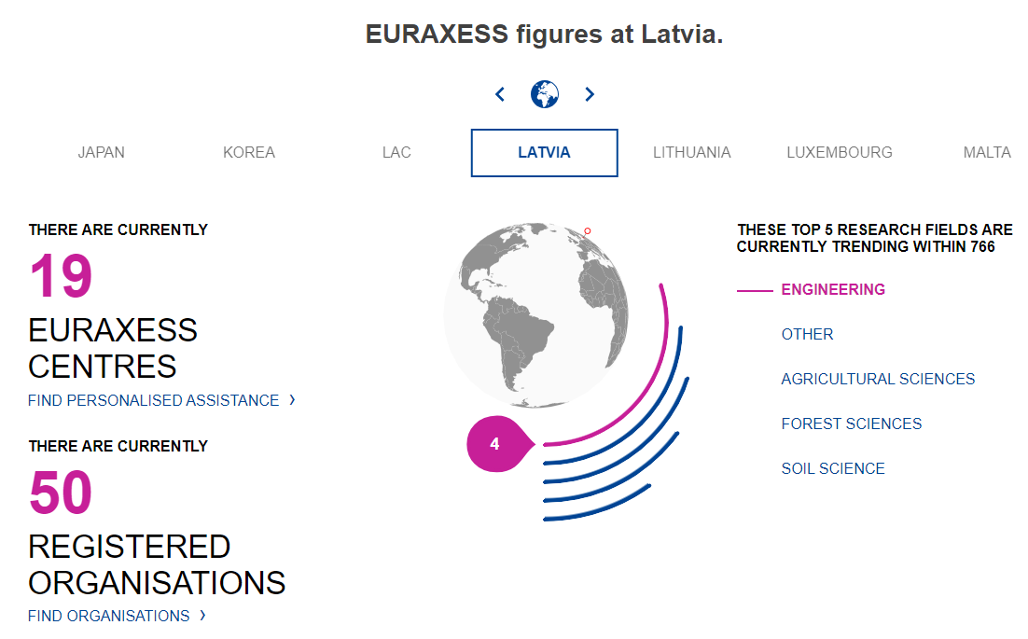


Slide 29


5 Temātiskie habi
Euraxess Startup Hub
Habi tiek definēti kā integrētas platformas tematiskai pārrobežu sadarbībai starp EURAXESS pakalpojumu centriem (ESC) un citām ieinteresētajām personām ārpus EURAXESS tīkla, lai iesaistītu un sniegtu pakalpojumus pētniekiem, pētniecības organizācijām un citiem ESC.
Research Career Beyond Academia
Research Careers in Academia
Supporting Talent Circulation
Euraxess Science 4 Refugees Hub

Slide 30


Pasākumi un kontaktbiržas
Home - NCP_WIDERA.NET (ncpwideranet.eu)
Horizon Europe - ERA 2024 Knowledge Day and Brokerage Event - Home (b2match.io)

Slide 31
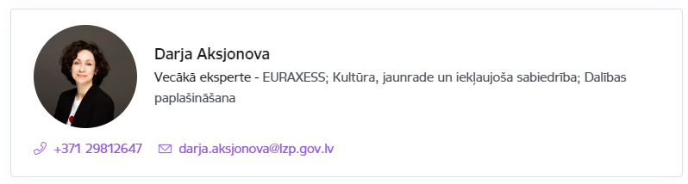

Atbalsts ceļošanas izdevumu segšanai
Apvārsnis Eiropa Nacionālais kontaktpunkts aicina pieteikties saņemt atbalstu ceļošanas izdevumu segšanai uz Apvārsnis Eiropa 2.pilāra tīklošanas pasākumiem.
Atbalsts ceļošanas izdevumu segšanai pieejams visiem Zinātniskajā reģistrā reģistrētiem dalībniekiem, kuri vēlas atrast partnerus un/vai prezentēt sava projekta ideju, piedaloties klātienes tīklošanās pasākumos.
Papildus informācija: https://www.lzp.gov.lv/lv/atbalsts-pieteicejiem

Slide 32

Webinar: Navigating Horizon Europe: social sciences and humanities perspectives from the Baltics and beyond (google.com)

Slide 33
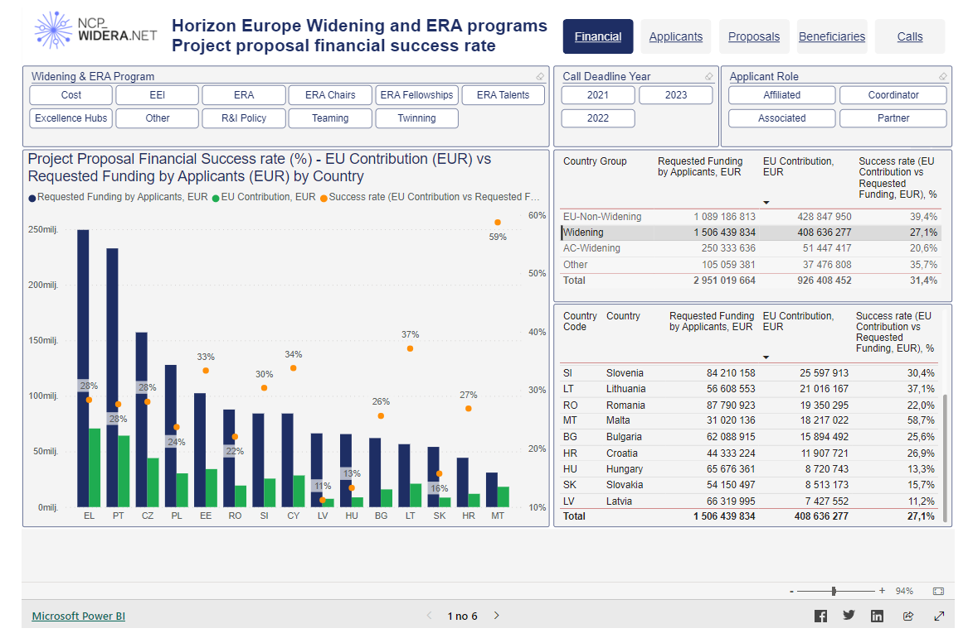
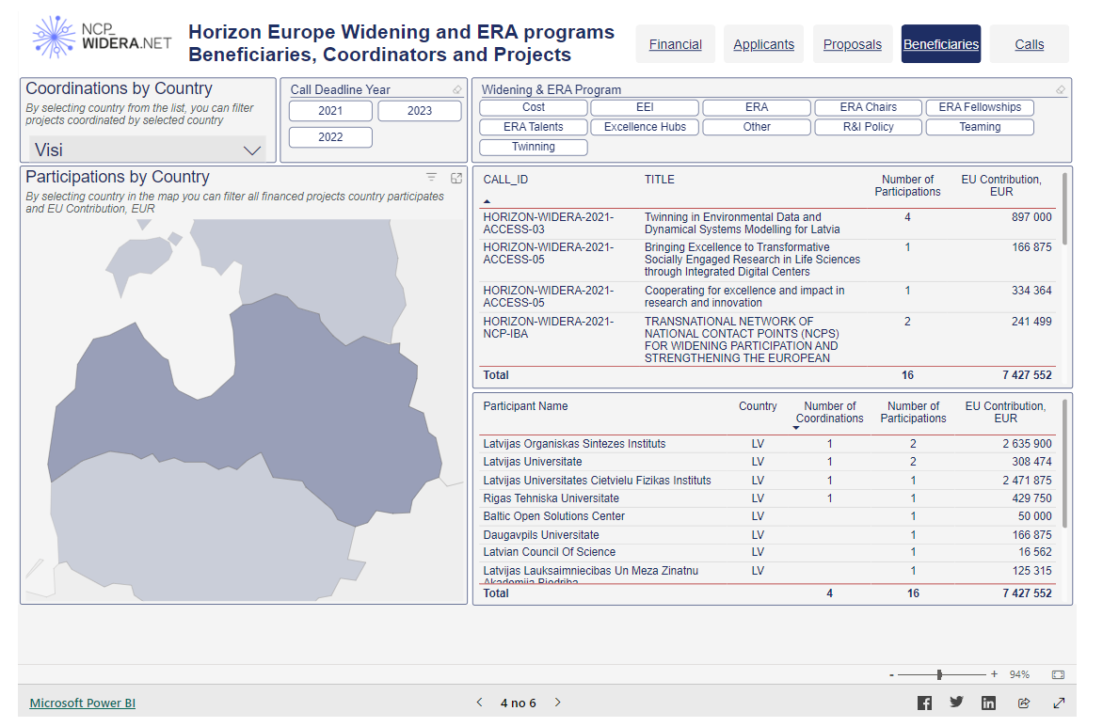
NCP_WIDERA.NET: Statistika
https://www.ncpwideranet.eu/dashboards/

Slide 34
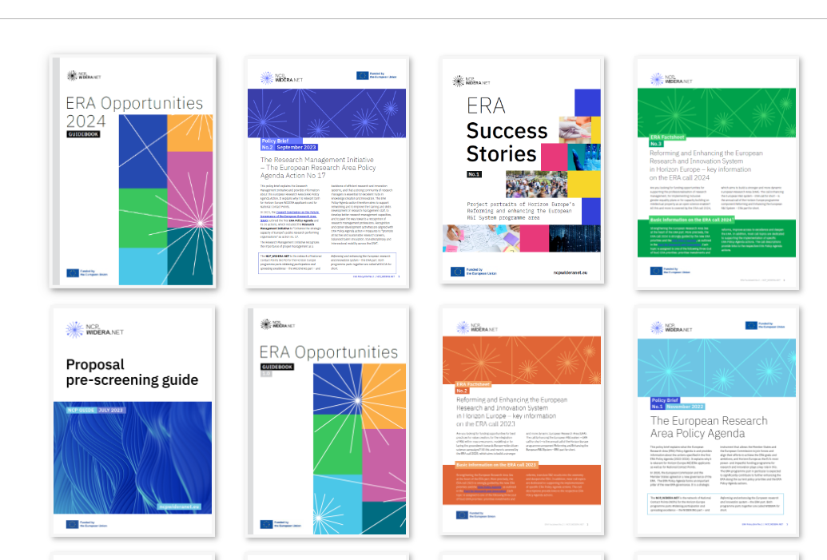
NCP_WIDERA.NET: Materiāli
https://www.ncpwideranet.eu/publications/

Slide 35
APVĀRSNIS EIROPA NACIONĀLAIS KONTAKTPUNKTS
Jānis Ancāns
CL1
Marija Plotniece
EIC, EIT, EIE, RI
Inga Šīrante
Legal and Financial issues
Sarmīte Mickeviča
Widening, CL3
Aiga Salmiņa
CL5, CL6, JRC
Liene Ekša
MSCA, ERC, ERA
Jūlija Asmuss
Coordinator, CL4
Darja Aksjonova,
CL2, EURAXESS, Widening
Lāsma Brenča
CL5, CL6
https://www.lzp.gov.lv/lv/apvarsnis-eiropa-2021-2027

Slide 36





Paldies!
@apvarsnis
@Apvārsnis EU Latvijas Nacionālais kontaktpunkts - HE NCP LV
https://www.lzp.gov.lv/lv/apvarsnis-eiropa
Informācijas avots:

