Slide 1
Apvārsnis Eiropa 2. klastera «Kultūra, jaunrade un iekļaujoša sabiedrība» informācijas diena
Pasākuma programma:
10:00-10:30 prezentācija par Apvārsnis Eiropa 2024. gada 2. klastera “Kultūra, jaunrade un iekļaujoša sabiedrība” darba programmas konkursiem
Darja Aksjonova, Latvijas zinātnes padomes NKP vecāka eksperte
10:30-10:50 prezentācija «CERV aktuālie konkursi»
Zane Meļķe, LR Kultūras Ministrija
10:50-11:00 jautājumi un atbildes
11:00-11:20 prezentācija «Kā pareizi un droši komunicēt savu projektu?» Ieva Treija komunikācijas konsultante
11:20-11:30 jautājumi un atbildes

Slide 2

Apvārsnis Eiropa 2. klastera «Kultūra, jaunrade un iekļaujoša sabiedrība» aktualitātes
Darja Aksjonova
Nacionālā kontaktpunkta
Vecāka eksperte
darja.aksjonova@lzp.gov.lv
1.1.1. specifiskā atbalsta mērķa "Palielināt Latvijas zinātnisko institūciju pētniecisko un inovatīvo kapacitāti un spēju piesaistīt ārējo finansējumu, ieguldot cilvēkresursos un infrastruktūrā" 1.1.1.5. pasākuma "Atbalsts starptautiskās sadarbības projektiem pētniecībā un inovācijās" 1.kārtas, projekta Nr.1.1.1.5/17/I/001 “Atbalsts starptautiskās sadarbības projektu izstrādei un īstenošanai” ietvaros

Slide 3
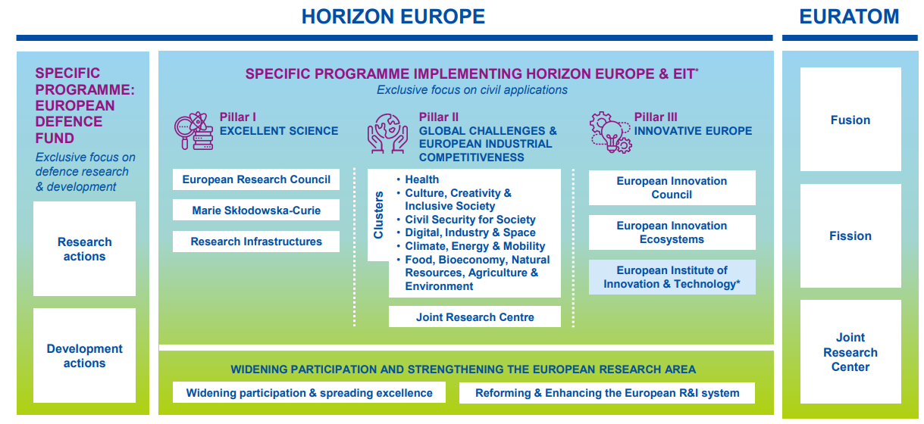
APVĀRSNIS EIROPA
WORK PROGRAMMES 2023-2024

Slide 4
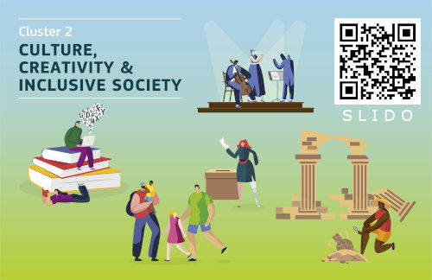

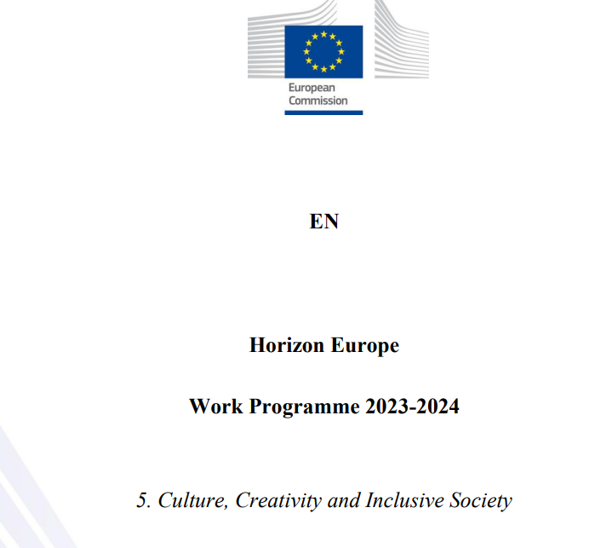
Apvārsnis Eiropa 2. klastera darba programma
informācija: https://research-innovation-community.ec.europa.eu/events/2oQugg5jdh3x8gWvkBREF0/overview
darba programma: https://ec.europa.eu/info/funding-tenders/opportunities/docs/2021-2027/horizon/wp-call/2023-2024/wp-5-culture-creativity-and-inclusive-society_horizon-2023-2024_en.pdf
programmas ceļvedis:
https://ec.europa.eu/info/funding-tenders/opportunities/docs/2021-2027/horizon/guidance/programme-guide_horizon_en.pdf

Slide 5
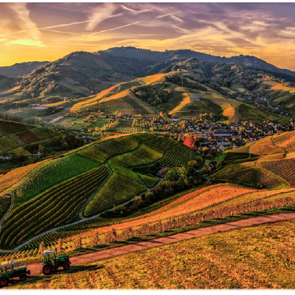
2 klastera īpatnības

Slide 6
DESTINATION 1
Innovative Research on Democracy and Governance
DESTINATION 2
Innovative Research on the European Cultural Heritage and the Cultural and Creative Industries
DESTINATION 3
Innovative Research on Social and Economic Transformations
Partnership 2
Social Transformations and Resilience
Destination New European Bauhaus
2025-2027
Partnership 1
- Resilient Cultural Heritage
- Resilient Cultural Heritage: Coastal Cultural Heritage addition

Slide 7

Projektu tipi
Type | Activities | Financing rate
RIA (Research and Innovation Actions) | Activities to establish new knowledge or to explore the feasibility of a new or improved technology, product, process, service or solution. | Up to 100%
IA (Innovation Actions) | Activities to produce plans and arrangements or designs for new, altered or improved products, processes or services. | *Up to 70%
CSA (Coordination and Support Actions) | Activities that contribute to the objectives of Horizon Europe. This excludes R&I activities, except for ‘Widening participation and spreading excellence’. | Up to 100%
* the rate is 70 percent for profit-making legal entities and 100 percent for non-profit legal entities

Slide 8
Tehnoloģiju gatavības līmenis
Technology Readiness Levels (TRLs) are indicators of the maturity level of particular technologies.
TRL 1 – basic principles observed
TRL 2 – technology concept formulated
TRL 3 – experimental proof of concept
TRL 4 – technology validated in lab
TRL 5 – technology validated in relevant environment (industrially relevant environment in the case of key enabling technologies)
TRL 6 – technology demonstrated in relevant environment (industrially relevant environment in the case of key enabling technologies)
TRL 7 – system prototype demonstration in operational environment
TRL 8 – system complete and qualified
TRL 9 – actual system proven in operational environment (competitive manufacturing in the case of key enabling technologies; or in space)

Slide 9
D1: Innovative Research on Democracy and Governance
https://www.youtube.com/watch?v=MJOsOkmifSo
Opening date: 04 October 2023
Deadline: 07 February 2024
Topic | Type of action | EU contribution per project | Number of projects to be funded
 |  | (EUR million)
HORIZON-CL2-2024-DEMOCRACY-01-01: Protest politics and cultures of opposition in democracy | RIA | 2-3 mln | 3
HORIZON-CL2-2024-DEMOCRACY-01-02: Multilevel governance in times of digital and climate transitions | RIA | 2-3 mln | 3
HORIZON-CL2-2024-DEMOCRACY-01-03: What is the long-term impact of rule of law and other European values on socio-economic outcomes? | RIA | 2-3 mln | 3
HORIZON-CL2-2024-DEMOCRACY-01-04: The interrelation between social, cultural and political identities, as well as the sense of belonging, and democracies | RIA | 2-3 mln | 3
HORIZON-CL2-2024-DEMOCRACY-01-05: Gender-roles in extremist movements and their impact on democracy | RIA | 2-3 mln | 3
HORIZON-CL2-2024-DEMOCRACY-01-06: Computational Social Science approaches in research on democracy | RIA | 2-3 mln | 3
HORIZON-CL2-2024-DEMOCRACY-01-07: Digital democracy | RIA | 2-3 mln | 3
HORIZON-CL2-2024-DEMOCRACY-01-08: Culture, the arts and cultural spaces for democratic participation and political expression, online and offline | RIA | 2-3 mln | 3
HORIZON-CL2-2024-DEMOCRACY-01-09: The role and functioning of public administrations in democratic systems | RIA | 2-3 mln | 3
HORIZON-CL2-2024-DEMOCRACY-01-10: Political participation in multilingual spaces | RIA | 2-3 mln | 3
HORIZON-CL2-2024-DEMOCRACY-01-11: Future scenarios and young visions for European democracy 2040 | RIA | 3-4 mln | 1
HORIZON-CL2-2024-DEMOCRACY-01-12: Testing and implementation of research results fostering democracy and governance | CSA | 3-4 mln | 1

Slide 10

HORIZON-CL2-2024-DEMOCRACY-01
Current project portfolios
Social media for democracy – understanding the causal mechanisms of digital citizenship
Transforming Education for Democracy through Aesthetic and Embodied Learning, Responsive Pedagogies and Democracy-as-becoming

Slide 11
Most successful call topics for Baltic participants under CL2 2021–2023 calls
Top 11 successful topics – 2 or 3 successful proposals with one or more Baltic participants (status 28.11.23!)
  The climate imperative and its impact on democratic governance (4 > 3)
  Education for democracy (17 > 2)
  Cultural and creative industries as a driver of innovation and competitiveness (8 > 2)
  Fostering socio-economic development and job creation in rural and remote areas through cultural tourism (8 > 2)
  Global governance for a world in transition: Norms, institutions, actors (7 > 2)
  Detecting, analysing and countering foreign information manipulation and interference (6 > 2)
  Towards a competitive, fair and sustainable European music ecosystem (5 > 2)
  Media for democracy – democratic media (3 > 2)
  Political perspectives for the Eastern Neighbourhood and the Western Balkans (3 > 2)
  Developing a better understanding of information suppression by state authorities as an example of foreign information manipulation and interference (2 > 2)
  Global Shortages and Skill Partnerships (2 > 2)
Notes:
295 evaluated proposals, 54 successful proposals – thus average success rate 18,3.

Slide 12
D2: INNOVATIVE RESEARCH ON EUROPEAN
CULTURAL HERITAGE AND CULTURAL AND CREATIVE INDUSTRIES - BUILDING OUR FUTURE FROM THE PAST
https://www.youtube.com/watch?v=aAtdx-SGFrg
Opening date: 04 October 2023
Deadline: 07 February 2024
Topic | Type of action, | EU contribution per project | Number of projects to be funded
 |  | (EUR million)
HORIZON-CL2-2024-HERITAGE-01-01: New European Bauhaus – Innovative solutions for greener and fairer ways of life through arts and culture, architecture and design for all | IA | 3-5 mln | 3
HORIZON-CL2-2024-HERITAGE-01-02: Cultural and creative industries for a sustainable climate transition | IA | 3-4 mln | 3
HORIZON-CL2-2024-HERITAGE-01-03: Leverage the digital transition for competitive European cultural and creative industries | IA | 3-4 mln | 3
HORIZON-CL2-2024-HERITAGE-01-04: Europe’s cultural heritage and arts – promoting our values at home and abroad | IA | 3-4 mln | 3
HORIZON-CL2-2024-HERITAGE-01-05: Strategies to strengthen the European linguistic capital in a globalised world | RIA | 2-3 mln | 3

Slide 13
HERITAGE
Previous projects
Resilient European Cultural Heritage As Resource for Growth and Engagement
Intangible Cultural Heritage, Bridging the Past, Present, and Future
New European Bauhaus Unlocked through Built4People-endorsed Local Actions

Slide 14

Sociālas un humanitāras disciplīnas AE konkursos
A consortium coordinator from Belgium is looking for a SSH partner for a proposal in the following call topic: Enhanced assessment, intervention and repair of civil engineering infrastructure. The partner is sought to perform the following task:
Present a strategy for skills development, associating social partners where relevant, integrating SSH aspects and including relevant tools such as MOOCs (massive open online courses).
To respect geographical balance of the project, the partner should preferably be based in a Eastern or Southern Europe country.
Many thanks in advance for your suggestions!
Social sciences and humanities (europa.eu)

Slide 15
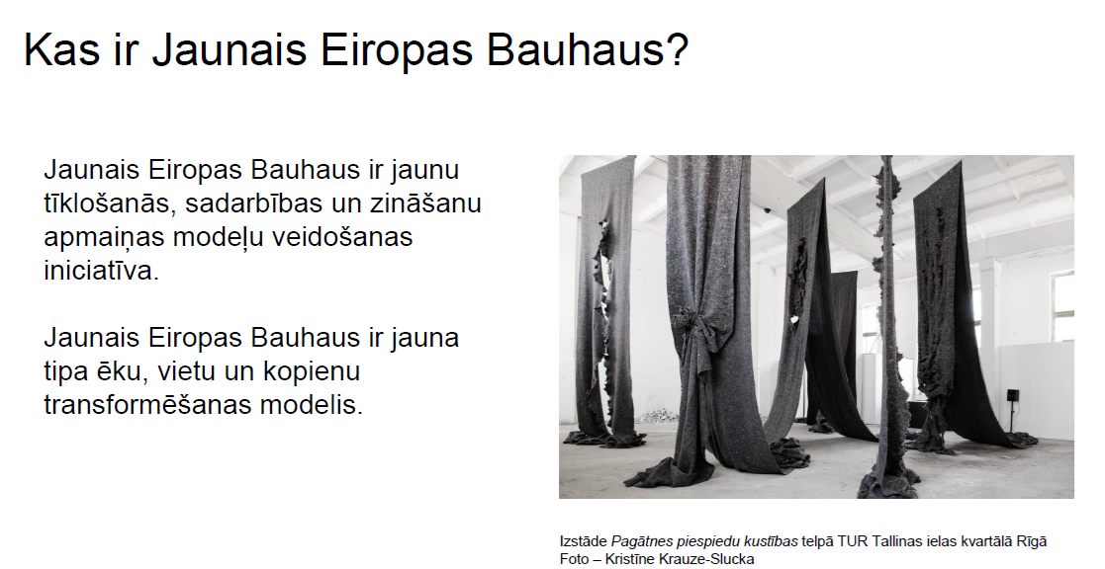
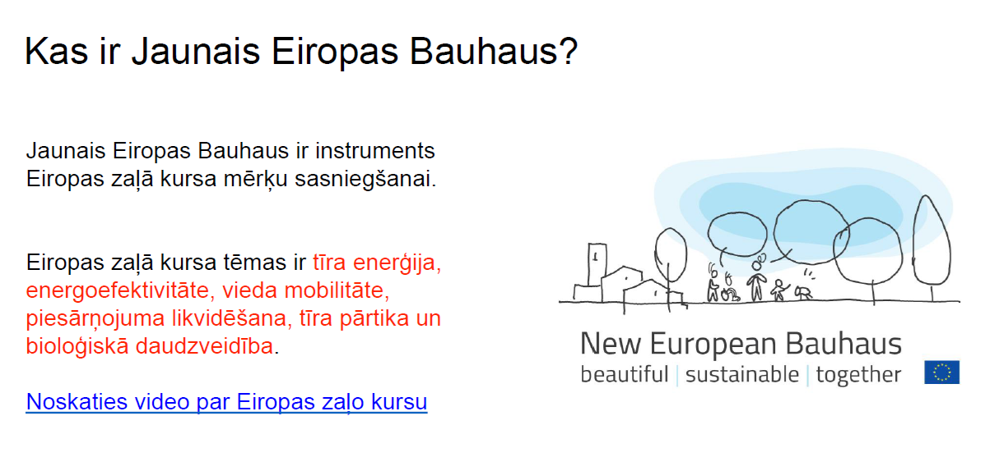
HORIZON-CL2-2024-HERITAGE-01
explaine where your research stands with regard to fundamental research vs. practical application
TRL are not needed!

Slide 16
D3: Innovative Research on Social and Economic Transformations
https://youtube.com/live/OatwXRYEvQg
Opening date: 04 October 2023
Deadline: 07 February 2024
Topic | Type of action, | EU contribution per project | Number of projects to be funded
 | TRL | (EUR million)
HORIZON-CL2-2024-TRANSFORMATIONS-01-01: Policy recommendations from socio-economic impacts of loneliness in Europe | CSA | 3 mln | 1
HORIZON-CL2-2024-TRANSFORMATIONS-01-02: Strengthen economic fairness and resilience of active labour market policies and address high unemployment | RIA | 2-3 mln | 3
HORIZON-CL2-2024-TRANSFORMATIONS-01-03: Minimise costs and maximise benefits of job creation and job destruction | RIA | 2-3 mln | 3
HORIZON-CL2-2024-TRANSFORMATIONS-01-04: Social services: economic and social returns and value added | RIA | 2-3 mln | 3
HORIZON-CL2-2024-TRANSFORMATIONS-01-05: Social dialogue in the new world of work | RIA | 2-3 mln | 3
HORIZON-CL2-2024-TRANSFORMATIONS-01-06: Beyond the horizon: A humanfriendly deployment of artificial intelligence and related technologies | CSA | 3 mln | 1
HORIZON-CL2-2024-TRANSFORMATIONS-01-07: Methodologies for teamworking of researchers – reinforcing transversal collaborative skills, behavioural and implementation sciences | RIA | 2-3 mln | 3
HORIZON-CL2-2024-TRANSFORMATIONS-01-08: Arts and cultural awareness and expression in education and training | RIA | 2-3 mln | 3
HORIZON-CL2-2024-TRANSFORMATIONS-01-09: The role of social economy in addressing social exclusion, providing quality jobs and greater sustainability | RIA | 2-3 mln | 3
HORIZON-CL2-2024-TRANSFORMATIONS-01-10: Effective education and labour market transitions of young people | RIA | 2-3 mln | 3
HORIZON-CL2-2024-TRANSFORMATIONS-01-11: Assessing and strengthening the complementarity between new technologies and human skills | RIA | 2-3 mln | 3

Slide 17
Transformations
Previous projects:
Transforming European Work and Social Protection: A New Proactive Welfare State Fit for the Future World of Work
REmote-working Multiple impacts in the Age of disruptions: socioeconomic transformations, territorial rethinKING, and policy actions

Slide 18
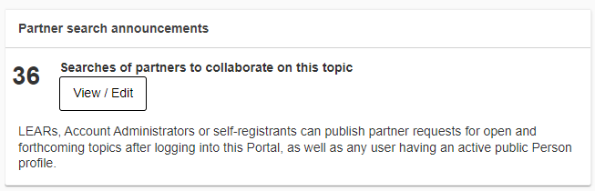
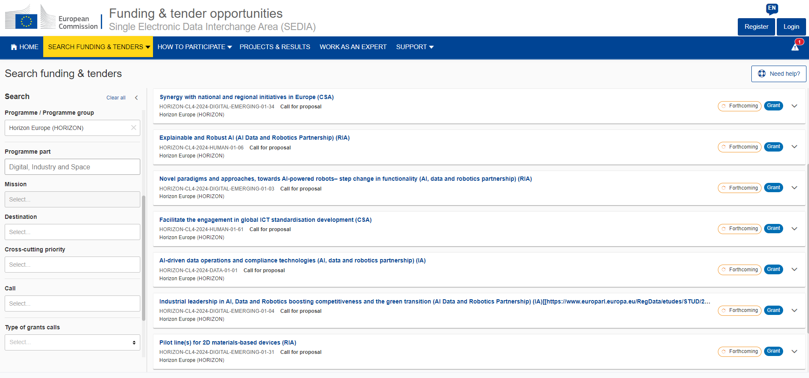
Funding&tender opportunities

Slide 19
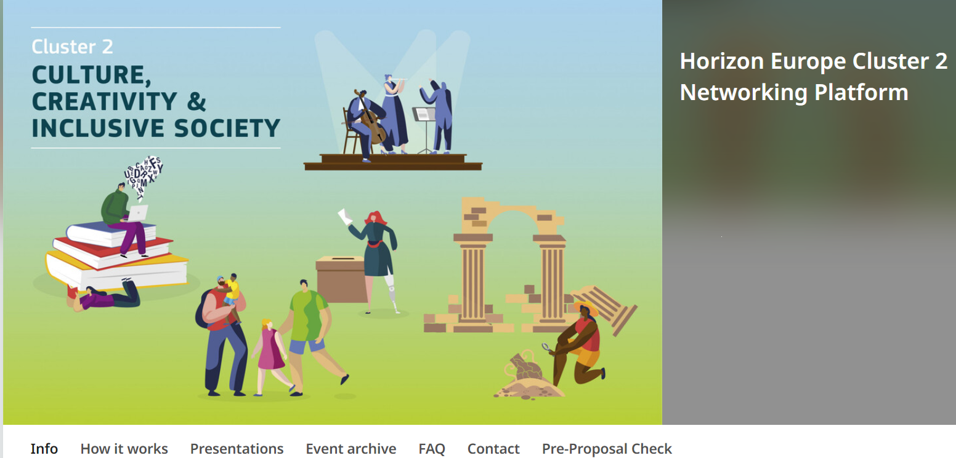
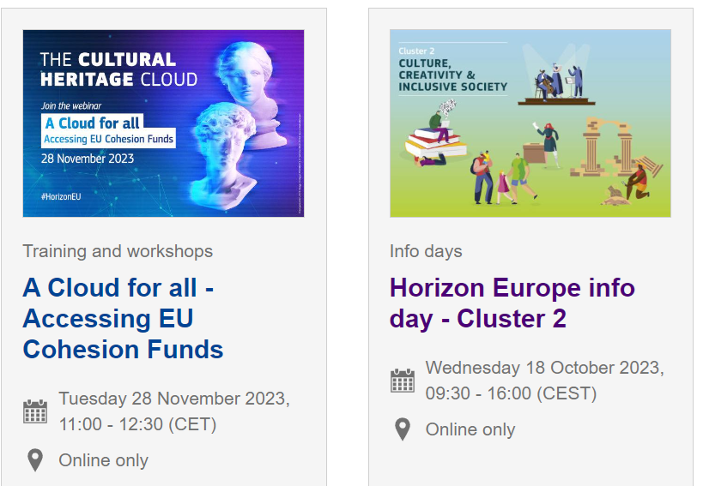
Pasākumi
Horizon Europe Cluster 2 Networking Platform - Info (b2match.io)
Cluster 2: Culture, Creativity and Inclusive society (europa.eu)

Slide 20
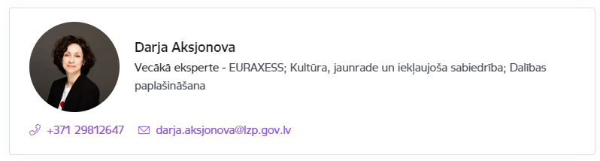

Atbalsts ceļošanas izdevumu segšanai
Apvārsnis Eiropa Nacionālais kontaktpunkts aicina pieteikties saņemt atbalstu ceļošanas izdevumu segšanai uz Apvārsnis Eiropa 2.pilāra tīklošanas pasākumiem.
Atbalsts ceļošanas izdevumu segšanai pieejams visiem Zinātniskajā reģistrā reģistrētiem dalībniekiem, kuri vēlas atrast partnerus un/vai prezentēt sava projekta ideju, piedaloties klātienes tīklošanās pasākumos.
Papildus informācija: https://www.lzp.gov.lv/lv/atbalsts-pieteicejiem

Slide 21
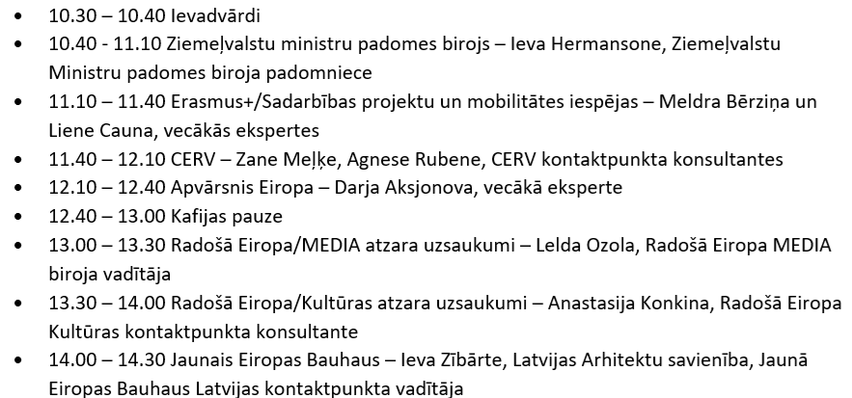
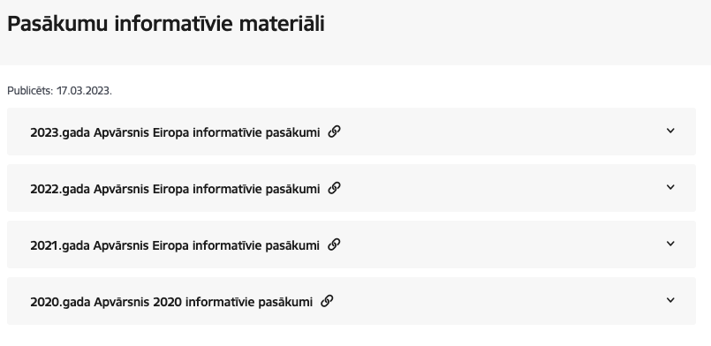
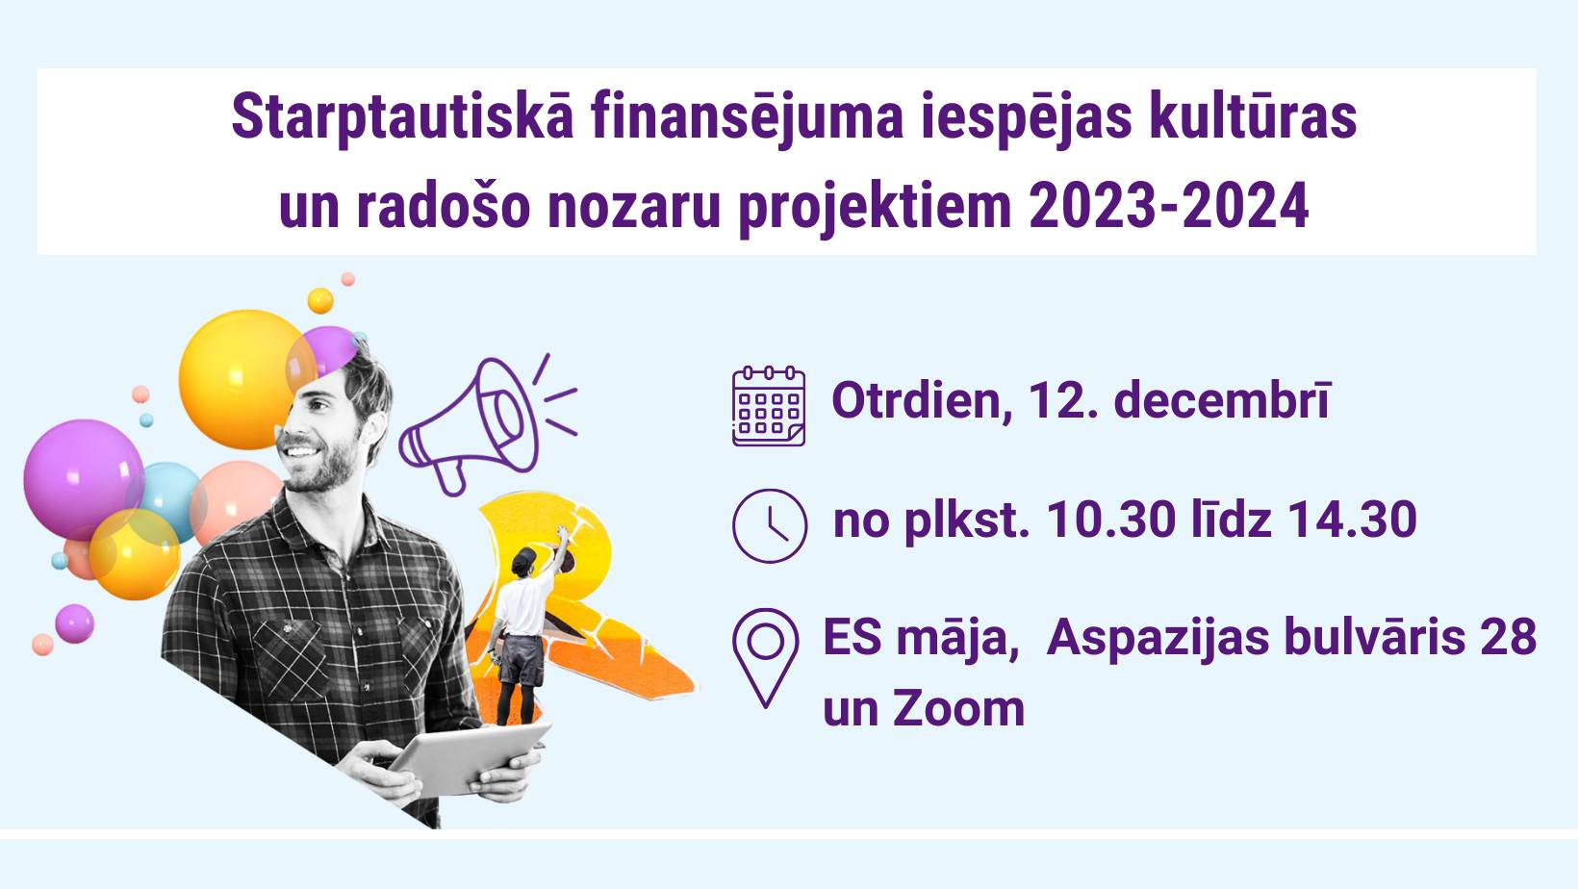
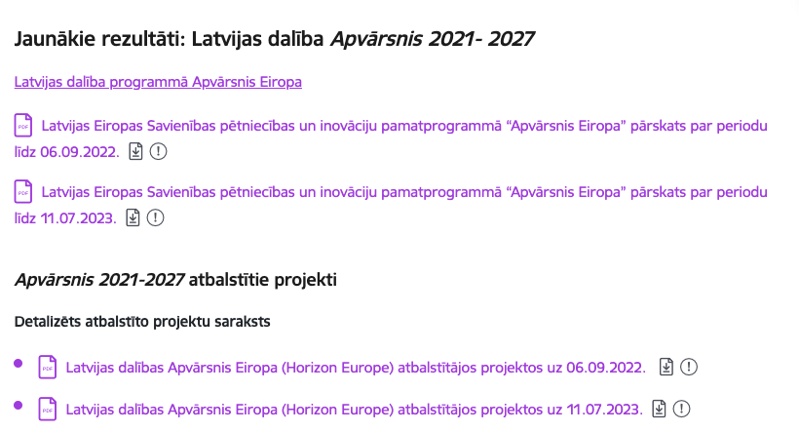
https://www.lzp.gov.lv/lv/notikumu-kalendars
https://www.lzp.gov.lv/lv/pasakumu-informativie-materiali
https://www.lzp.gov.lv/lv/atbalstitie-projekti-2

Slide 22
Statistika: Apvārsnis Eiropa 2. klasteris
European Center for Development of Democracy | 302,573.00
Institute of Literature, Folklore and Art, University of Latvia | 291,325.00
LATVIJAS LAUKU TURISMA ASOCIACIJA LAUKU CELOTAJS | 242,200.00
LATVIJAS PLATFORMA ATTISTIBAS SADARBIBAI | 234,000.00
LATVIJAS UNIVERSITATE | 213,500.00

Slide 23
APVĀRSNIS EIROPA NACIONĀLAIS KONTAKTPUNKTS
Jānis Ancāns
CL1
Marija Plotniece
EIC, EIT, EIE, RI
Inga Šīrante
Legal and Financial issues
Sarmīte Mickeviča
Widening, CL3
Aiga Salmiņa
CL5, CL6, JRC
Liene Ekša
MSCA, ERC, ERA
Jūlija Asmuss
Coordinator, CL4
Darja Aksjonova,
CL2, EURAXESS, Widening
Lāsma Brenča
CL5, CL6
https://www.lzp.gov.lv/lv/apvarsnis-eiropa-2021-2027

Slide 24





Paldies!
@apvarsnis
@Apvārsnis EU Latvijas Nacionālais kontaktpunkts - HE NCP LV
https://www.lzp.gov.lv/lv/apvarsnis-eiropa
Informācijas avots:

