Slide 1
Project- dedicated to Missions

Slide 2
Objectives of the project
The projects’ activities pursue the following objectives:
• Improving and professionalizing NCP support services for the EU Mission Calls • Lowering entry barriers for applicants and raising the quality of proposals • Enhancing the visibility of the Mission NCPs and the cooperation with other relevant stakeholders and networks

Slide 3
Information about the project
Name: HORIZON-MISS-2022-NCP-01-01: Creating a transnational network of National Contact Points (NCPs) for EU Missions
Project type: CSA
Start date: 1st of September 2023
Project Duration: 54 months (4,5 years)
GA no. 101121092
EU co-financing: 1.814.338 EUR
Coordinator: FZJ (DE)
Partners: 19

Slide 4
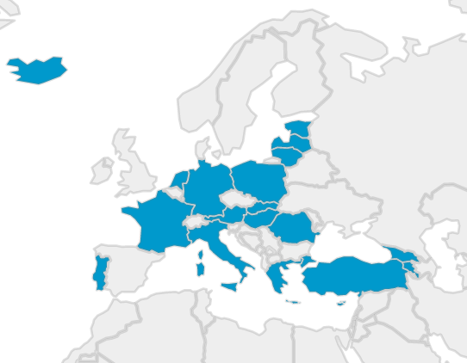
Partner countries
4 associated countries
AM, GE, IS, TR
8 EU-13 countries
CY, EE, HU, LV, LT, PL, RO, SK
7 EU-15 countries
AT, FR, DE, EL, IT, NL, PT
AM, CY, EE, GE, EL, HU, LV, LT, PL, PT, RO, SK, TR

Slide 5
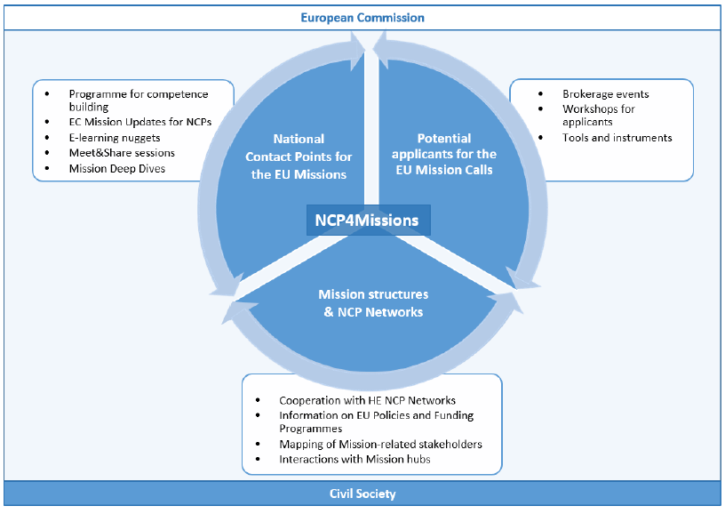
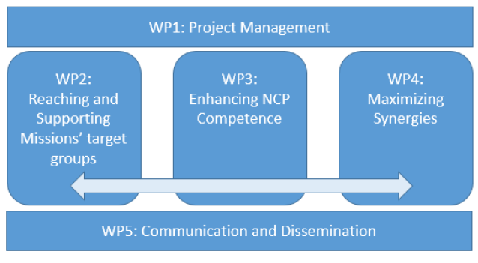
Target groups and activities
Structure of work packages

Slide 6
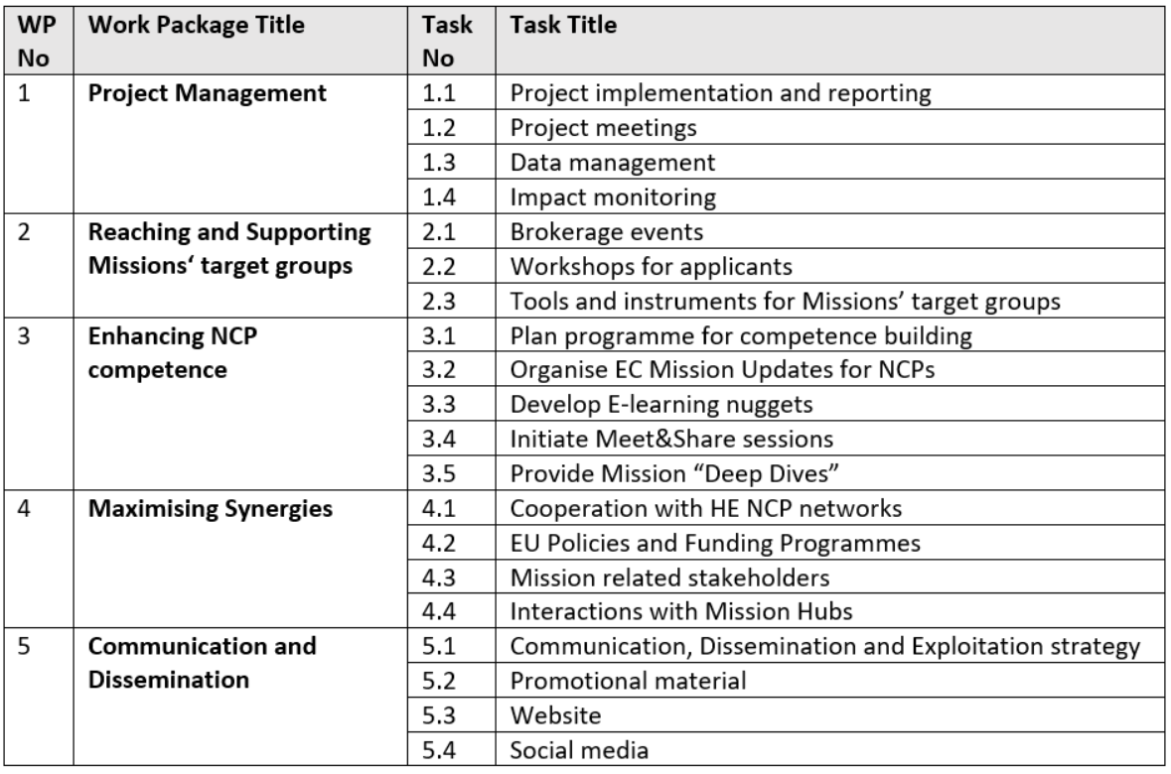
Task structure

Slide 7
Thank you for your attention!
Lāsma Brenča un Aiga Salmiņa
Latvijas Zinātnes padomes
Starptautiskās sadarbības programmu projektu departamenta
Apvārsnis Eiropa Nacionālā kontaktpunkta vecākā ekspertes
E-pasts: lasma.brenca@lzp.gov.lv
aiga.salmina@lzp.gov.lv
@apvarsnis
@Apvārsnis EU Latvijas Nacionālais kontaktpunkts - HE NCP LV
https://lzp.gov.lv/starptautiskas-sadarbibas-programmas/apvarsnis-eiropa/

