Slide 1
Regions4Climate
17.01.2024
Joint Baltic webinar on Adaptation to Climate Change Mission
Anette Iital, Estonian Environmental Research Centre

Slide 2
Regions4Climate (R4C)
Objectives of the project
Facts about the project
Develop a comprehensive operational framework
Scale up and deploy innovative socio-technological climate resilience solutions
Generate and validate suitable solutions for just societal transformation
The European Commission's research and innovation program “Horizon Europe”
5 years (01.01.2023 – 31.12.2027)
44 partners from 13 European countries
12 demo regions
3 clusters
Demo region from Estonia – Pärnumaa

Slide 3
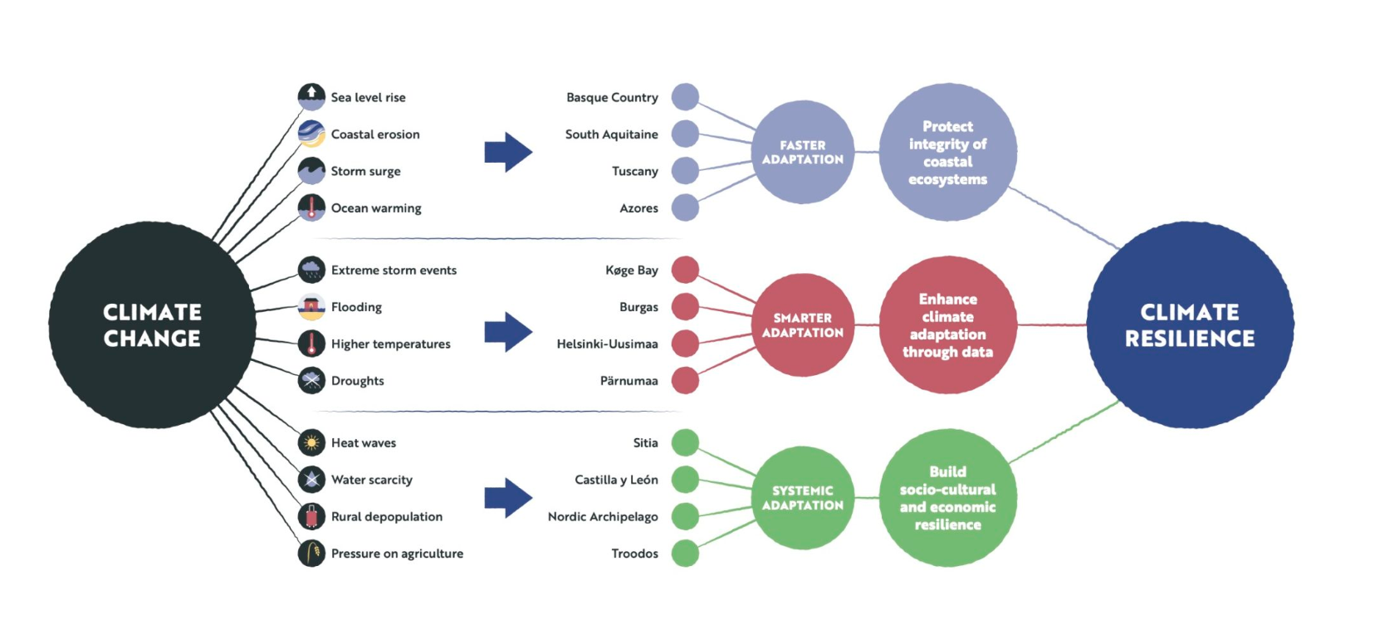
Clusters:

Slide 4
Faster adaption:
Demo regions:
Protect and restore the coasts ​
Examine opportunities for Blue Carbon Credits​
Educate and engage citizens towards resilience building​
Engage in cross-border actions
Basque Country​ (Spain)
South Aquitaine (France)
Azores (Portugal)
Tuscany (Italy)

Slide 5
Systemic adaption:
Demo regions:
Develop and validate green social business models​
Collaboratively devise locally-attuned resilience strategies​
Engage local communities in resilience building activities​
Apply models and frameworks in support of the sustainable use of local resources
Sitia (Greece)​
Castilla y Léon (Spain)
Nordic Archipelago (Sweden)
Troodos ​(Cyprus)

Slide 6
Smarter adaption:
Demo regions:
Improve the use of existing data
Bridge science and policy using digital tools
Support evidence-based and collaborative decision-making
Increase citizens' awareness of climate issues, adaptation solutions and possible trade-offs
Køge Bay (Denmark)
Burgas (Bulgaria)
Helsingi-Uusimaa (Finland)
Pärnumaa (Estonia)

Slide 7
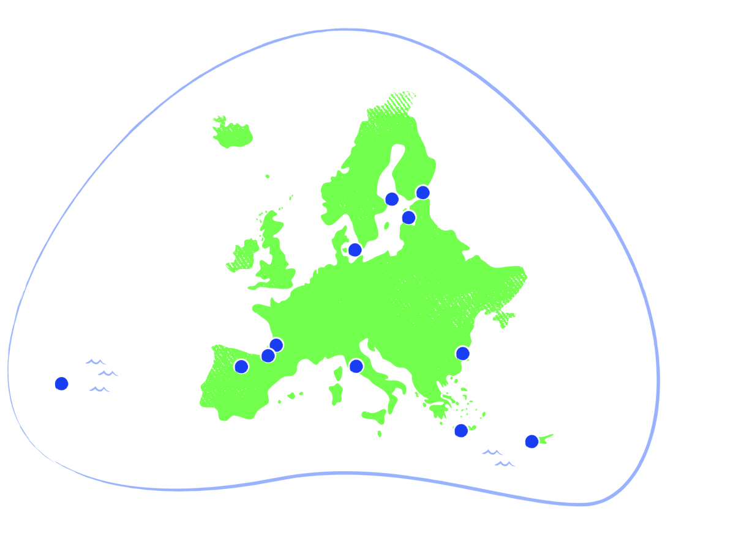
Becoming a demo region, partner(s) and successful application
Coordinated by VTT Technical Research Centre of Finland
Good (previous) connections
Re-writing and supplementing the application
Strong and experienced coordinator
Project partners from Estonia:
City of Pärnu
Pärnu County Development Centre
Stockholm Environment Institute of Tallinn
Estonian Environmental Research Centre

Slide 8
Activities planned in Pärnumaa:
map and study heat islands - map heat islands in the City of Pärnu and the surrounding area, study the possibilities of mitigating and preventing heat islands (modelling);
study and map landslide-prone areas - a study will be carried out, to update knowledge regarding landslide-prone areas in the City of Pärnu, corresponding map layers will be prepared;
start developing a digital tool in the City of Pärnu with the aim of making (planning) decision-making faster, easier and more science-based.

Slide 9
Project activities done in the first year (2023):
A weather sensor network was set up in the City of Pärnu and its surrounding:
  01.06.2023 – 30.09.2026;
  50 weather sensors;
  temperature and relative humidity;
  analysis on data from the summer of 2023 done and presented
Landslide study in the City of Pärnu:
  by scientist from the University of Tartu;
  update data on landslide prone and potentially landslide prone areas;
  climate change impact on landslides in Pärnu County

Slide 10
Lessons learned so far:
Needs of the region
Application/Grant Agreement wording
Motivated partners
Communication
Clear task distribution and documentation

Slide 11
Thank you!
For more information about the project visit https://regions4climate.eu/

