Slide 1

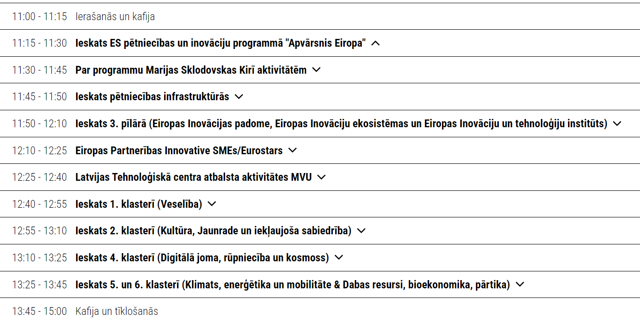
DAŽĀDĪBA KĀ EIROPAS SPĒKS: "APVĀRSNIS EIROPA" PERSPEKTĪVĀS

Slide 2

Apvārsnis Eiropa
Jūlija Asmuss, Dr.sc.ing.
Nacionālā kontaktpunkta
vadītāja
julija.asmuss@lzp.gov.lv
1.1.1. specifiskā atbalsta mērķa “Pētniecības un inovāciju kapacitātes stiprināšana un progresīvu tehnoloģiju ieviešana kopējā P&A sistēmā” 1.1.1.5. pasākuma “Latvijas pilnvērtīga dalība Apvārsnis Eiropa programmā, tajā skaitā nodrošinot kompleksu atbalsta instrumentu klāstu un sasaisti ar RIS3 specializācijas jomu attīstīšanu” projekts “Atbalsts Latvijas dalībai starptautiskās pētniecības un inovācijas programmās”. ietvaros

Slide 3
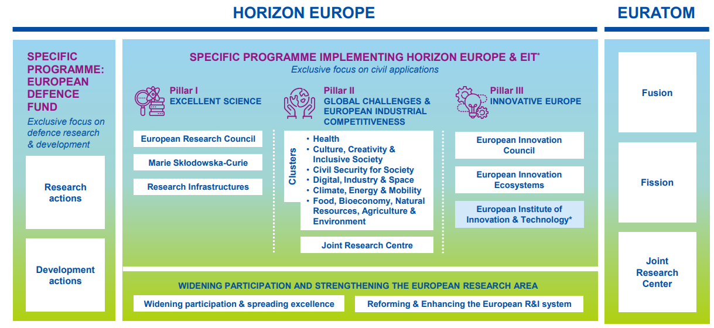
APVĀRSNIS EIROPA
WORK PROGRAMMES 2023-2024

Slide 4
PILLAR I EXCELLENT SCIENCE
STARTING GRANT
TBC
ADVANCED GRANT
29.05.2024
Frontier research by the best researchers and their teams
EUROPEAN RESEARCH COUNCIL
CONSOLIDATOR GRANT
TBC
SYNERGY GRANT
PROOF OF CONCEPT
Equipping researchers
with new knowledge
and skills through mobility
and training
MSCA DOCTORAL NETWORKS
29.05.2024
28.05.2025
MSCA POSTDOCTORAL FELLOWSHIPS
10.04.2024
09.04.2025
MARIE SKŁODOWSKA - CURIE ACTIONS
MSCA STAFF EXCHANGES
19.09.2024
27.03.2025
MSCA & CITIZENS
17.06.2025
MSCA COFUND
03.04.2024
23.01.2025
Integrated and interconnected world-class research infrastructures
RESEARCH INFRASTRUCTURES
INFRANET, INFRADEV, INFRAEOSC
12.03.2024.

Slide 5
PILLAR II
GLOBAL CHALLENGES & EUROPEAN INDUSTRIAL COMPETITIVENESS
HEALTH
11.04.2024.
25.09.2024.
26.11.2024.
CIVIL SECURITY FOR SOCIETY
20.11.2024.
DIGITAL, INDUSTRY & SPACE
19.03.2024.
21.03.2024.
18.09.2024.
CLIMATE, ENERGY & MOBILITY
5.03.2024.
18.04.2024.
5.09.2024.
21.01.2025
FOOD, BIOECONOMY, NATURAL RESOURCES, AGRICULTURE & ENVIROMENT
CULTURE, CREATIVITY
& INCLUSIVE SOCIETIES

Slide 6
PILLAR III INNOVATIVE EUROPE
Support to innovations
with breakthrough and
market creating potential
EIC PATHFINDER (OPEN 07.03.2024.,
CHALLENGES 16.10.2024.)
EIC ACCELERATOR
13.03.2024.
03.10.2024.
EUROPEAN INNOVATION
COUNCIL
EIC TRANSITION
18.09.2024.
INTERCONNECTED INNOVATION ECOSYSTEMS
25.04.2024.
19.09.2024.
Connecting with regional
and national innovation
actors
EUROPEAN
INNOVATION ECOSYSTEMS
EIT MANUFACTURING
EIT HEALTH
Bringing key actors together around a common
goal for nurturing innovation
EUROPEAN INSTITUTE
OF INNOVATION AND
TECHNOLOGY
EIT FOOD
EIT RAW MATERIALS
EIT CLIMATE
EIT URBAN MOBILITY
EIT DIGITAL

Slide 7
WIDENING PARTICIPATION & STRENGTHENING THE EUROPEAN RESEARCH AREA (ERA)
TEAMING FOR EXCELLENCE
EXCELLENCE HUBS
7.03.2024.
Contribute to building research and innovation capacity for countries lagging behind
HOP-ON FACILITY
26.09.2024.
TWINNING
Widening Participation & Spreading Excellence
ERA FELLOWSHIPS
11.09.2024.
ERA CHAIRS
7.03.2024.
PATHWAYS TO SYNERGIES
ERA TALENTS
27.09.2024.
DISSEMINATION AND EXPLOITATION SUPPORT FACILITY
EUROPEAN EXCELLENCE INITIATIVE

Slide 8
WIDENING PARTICIPATION & STRENGTHENING THE EUROPEAN RESEARCH AREA (ERA)
To maximize the impact of the European Union's research and innovation funding for European science, the economy and the wider society.
ENHANCING THE EUROPEAN R&I SYSTEM
12.03.2024.
15.05.2024.
Reforming and enhancing the EU R&I system

Slide 9
APVĀRSNIS EIROPA NACIONĀLAIS KONTAKTPUNKTS
Jānis Ancāns
CL1
Marija Plotniece
EIC, EIT, EIE, RI
Inga Šīrante
Legal and Financial issues
Aiga Salmiņa
CL5, CL6, JRC
Liene Kairiša
MSCA, ERC, ERA
Jūlija Asmuss
Coordinator, CL4
Darja Aksjonova,
CL2, EURAXESS, Widening
Lāsma Brenča
CL5, CL6
https://www.lzp.gov.lv/lv/strukturvieniba/apvarsnis-eiropa-nacionalais-kontaktpunkts

Slide 10

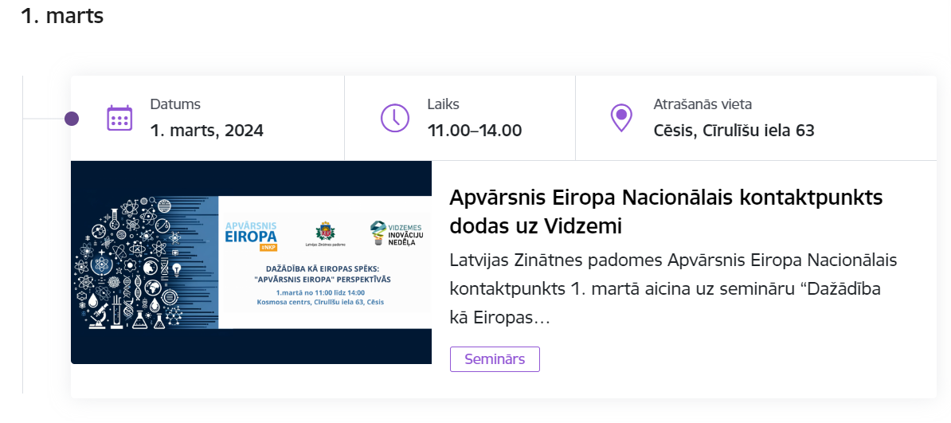
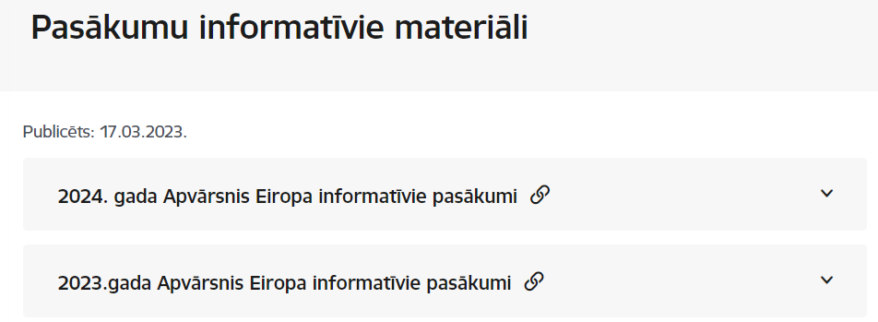
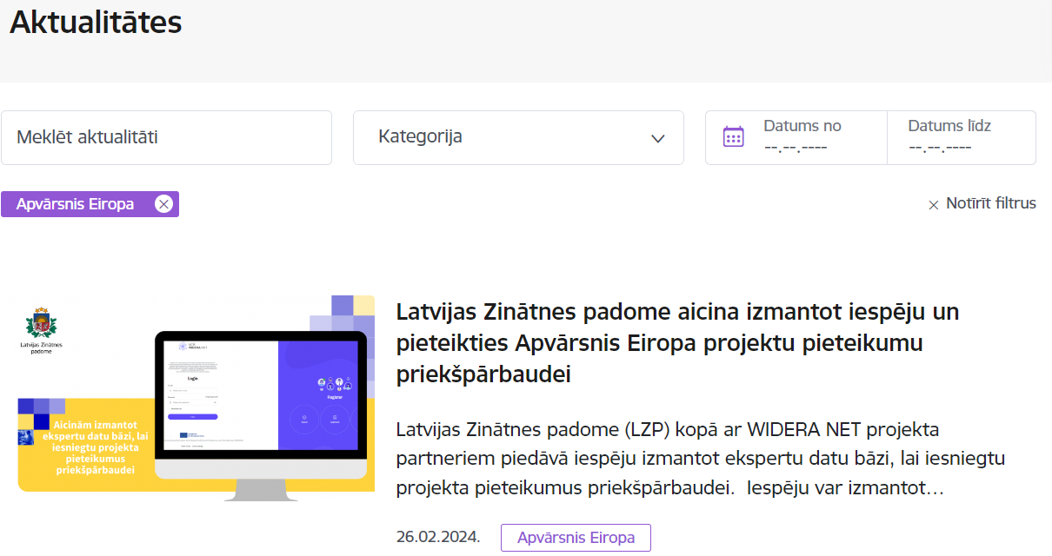
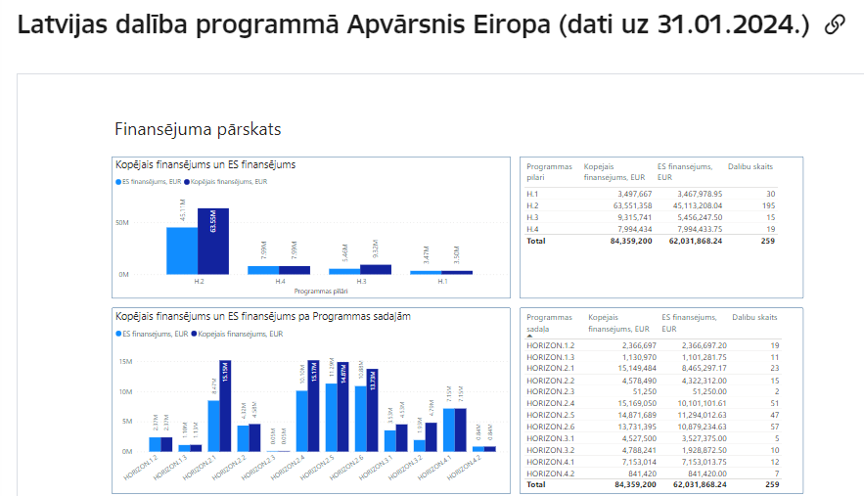
https://www.lzp.gov.lv/lv/notikumu-kalendars
https://www.lzp.gov.lv/lv/pasakumu-informativie-materiali
https://www.lzp.gov.lv/lv/jaunumi?category%5B67%5D=67
https://www.lzp.gov.lv/lv/atbalstitie-projekti-2

Slide 11
Statistika
Pirmās 10 Latvijas institūcijas pēc EK piešķirtā finansējuma apjoma
Nr.p.k. | Organizācijas nosaukums | EK piešķirtā finansējuma apjoms, EUR
1. | LATVIJAS ZINĀTNES PADOME | 6,166,165
2. | LATVIJAS UNIVERSITĀTE | 6,042,660
3. | RIGAS TEHNISKĀ UNIVERSITĀTE | 5,923,476
4. | LATVIJAS ORGANISKĀS SINTĒZES INSTITŪTS | 4,938,929
5. | LATVIJAS UNIVERSITĀTES CIETVIELU FIZIKAS INSTITŪTS | 3,628,140
6. | ELEKTRONIKAS UN DATORZINĀTŅU INSTITŪTS | 3,385,497
7. | NACO TECHNOLOGIES, SIA | 2,633,625
8. | NODIBINĀJUMS BALTIC STUDIES CENTRE | 2,028,763
9. | LATVIJAS VALSTS MEŽZINŽTNES INSTITŪTS SILAVA | 1,483,296
10. | SMARTSOL SIA | 1,480,020
Iesniegti 955 projektu pieteikumi
Finansēti 208 projekti kopā par 62,03 milj. €
Dalību skaits finansētajos projektos – 259.
*dati uz 31.01.2024.

Slide 12
Statistika
Organizācijas nosaukums | EK piešķirtā finansējuma apjoms, EUR | Projektu skaits
VIDZEMES AUGSTSKOLA | € 991 107,75 | 4
BALTICFLOC SIA | € 355 606,50 | 1
VIDES RISINAJUMU INSTITUTS NODIBINAJUMS | € 280 358,75 | 1
VALMIERAS TEHNIKUMS | € 199 522,00 | 1
VIDZEMES PLANOSANAS REGIONS | € 146 250,00 | 1

Slide 13

Projektu tipi
Type | Activities | Financing rate
RIA (Research and Innovation Actions) | Activities to establish new knowledge or to explore the feasibility of a new or improved technology, product, process, service or solution. | Up to 100%
IA (Innovation Actions) | Activities to produce plans and arrangements or designs for new, altered or improved products, processes or services. | *Up to 70%
CSA (Coordination and Support Actions) | Activities that contribute to the objectives of Horizon Europe. This excludes R&I activities, except for ‘Widening participation and spreading excellence’. | Up to 100%
* the rate is 70 percent for profit-making legal entities and 100 percent for non-profit legal entities

Slide 14
Tehnoloģiju gatavības līmenis
Technology Readiness Levels (TRLs) are indicators of the maturity level of particular technologies.
TRL 1 – basic principles observed
TRL 2 – technology concept formulated
TRL 3 – experimental proof of concept
TRL 4 – technology validated in lab
TRL 5 – technology validated in relevant environment (industrially relevant environment in the case of key enabling technologies)
TRL 6 – technology demonstrated in relevant environment (industrially relevant environment in the case of key enabling technologies)
TRL 7 – system prototype demonstration in operational environment
TRL 8 – system complete and qualified
TRL 9 – actual system proven in operational environment (competitive manufacturing in the case of key enabling technologies; or in space)

Slide 15
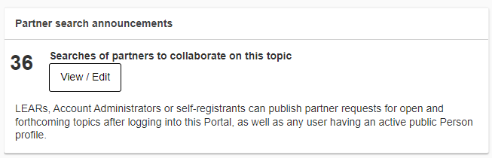
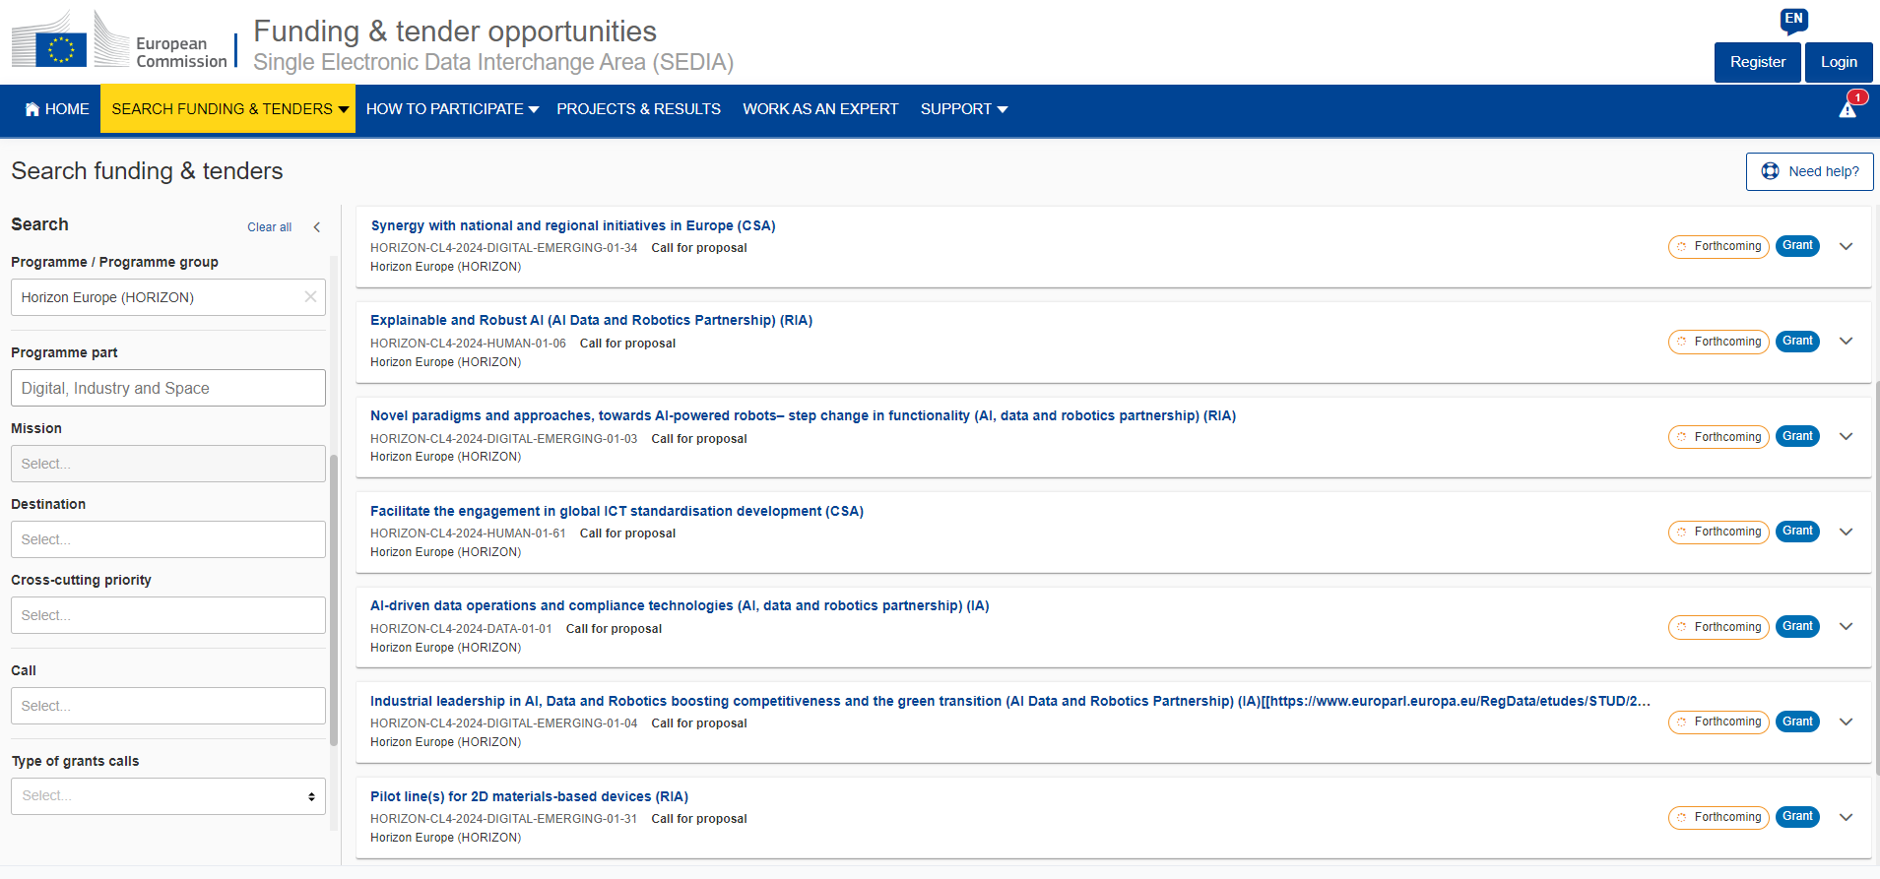
Funding&tender opportunities

Slide 16




Paldies!
@apvarsnis
@Apvārsnis EU Latvijas Nacionālais kontaktpunkts - HE NCP LV
https://www.lzp.gov.lv/lv/apvarsnis-eiropa

