Slide 1
Apvārsnis Eiropa veselības jomas projektu konkursi
Jānis Ancāns, dr.biol.
Apvārsnis Eiropa Nacionālais kontaktpunkts
tematiskā kopa «Veselība» un
uzdevumu joma «Vēzis»
janis.ancans@lzp.gov.lv

Slide 2
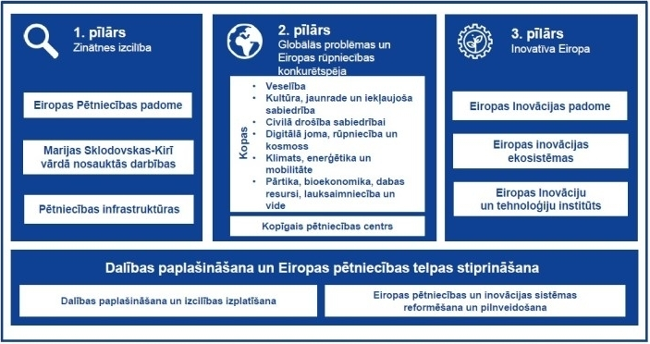
Apvārsnis Eiropa

Slide 3
Apvārsnis Eiropa tematiskās kopas «Veselība» intervences jomas

Slide 4
Apvārsnis Eiropa 1. tematiskās kopas «Veselība» darba programma 2024. gadam
Darba programma: https://research-and-innovation.ec.europa.eu/funding/funding-opportunities/funding-programmes-and-open-calls/horizon-europe/cluster-1-health_en
Programmas ceļvedis:
https://ec.europa.eu/info/funding-tenders/opportunities/docs/2021-2027/horizon/guidance/programme-guide_horizon_en.pdf

Slide 5
Klastera «Veselība» 2024.g. vienpakāpes konkursi
Publicēts: 2023.g. 26.oktobris
Iesniegšanas termiņš: 2024.g. 11.aprīlis
Topic | Type of action | EU contribution per project (EUR million) | Number of projects to be funded
Developing EU methodological frameworks for clinical/performance evaluation and post-market clinical/performance follow-up of medical devices and in vitro diagnostic medical devices (IVDs) HORIZON-HLTH-2024-IND-06-08 | RIA | 8-10 | 1
Gaining experience and confidence in New Approach Methodologies (NAM) for regulatory safety and efficacy testing – coordinated training and experience exchange for regulators HORIZON-HLTH-2024-IND-06-09 | CSA | 2 | 1
Bio-printing of living cells for regenerative medicine HORIZON-HLTH-2024-TOOL-11-02 | RIA | 6-8 | 4
Pandemic preparedness and response: Host-pathogen interactions of infectious diseases with epidemic potential HORIZON-HLTH-2024-DISEASE-08-20 | RIA | 7-8 | 5

Slide 6
Klastera «Veselība» 2024.g. papildus konkursi
Publicēts: 11. aprīlis
Iesniegšanas termiņš: 26. novembris
Topic | Type of action | EU contribution per project (EUR million) | Number of projects to be funded
Implementation research for management of multiple long-term conditions in the context of non-communicable diseases (Global Alliance for Chronic Diseases) HORIZON-HLTH-2024-DISEASE-13-01 | RIA | 3-4 | 5
Pre-commercial procurement for environmentally sustainable, climate neutral and circular health and care systems HORIZON-HLTH-2024-CARE-14-01 | PCP | 3-5 | 3
European Partnership: One Health Anti-Microbial Resistance HORIZON-HLTH-2024-DISEASE-09-01 (iesniegšana - 25. septembris) | HORIZON-COFUND | 100 | 1

Slide 7
Destination 3. Tackling diseases and
reducing disease burden
Presentation of Destination 3
https://www.youtube.com/watch?v=-Hh23q2M5GE
Q/A: https://www.youtube.com/watch?v=yAgSqnFBDVc#t=2m33s

Slide 8
Destination 5. Unlocking the full potential of
new tools, technologies and digital
solutions for a healthy society
Presentation of Destination 5 :
https://www.youtube.com/watch?v=bLicsNQaHP4
Q/A: https://www.youtube.com/watch?v=A4CEaR4c_Cc#t=2m27s

Slide 9
Destination 6. Maintaining an innovative,
sustainable and globally competitive
health industry
Presentation of Destination 6
https://www.youtube.com/watch?v=8atgwd1FMqs
Q.A: https://www.youtube.com/watch?v=DVzrFB84WTQ#t=9m46s

Slide 10
Destination 6. Maintaining an innovative,
sustainable and globally competitive
health industry
Presentation of Destination 6
https://www.youtube.com/watch?v=8atgwd1FMqs

Slide 11
Vispārīgi un horizontālie jautājumi
Q.A: https://www.youtube.com/watch?v=ngF27Fw1E34#t=3m32s

Slide 12
Tematiskā kopa «Veselība» 2024.-2025.
11.04.
25.09.
26.11.
2025
Iesniegšanas termiņš vienpakāpes 2024.g. konkursiem
Iesniegšanas termiņš partnerības One Health Anti-Microbial Resistance konkursam
Iesniegšanas termiņš diviem papildus 2024.g. konkursiem
Jaunā darba programma un 2025.g. konkursi

Slide 13
2025.g. konkursu tēmas (projekts)

Slide 14
2025.g. konkursu tēmas (projekts)

Slide 15
Misijas «Vēzis» plānotie konkursi 2024.g.

Slide 16
Atbalsts projektu iesniedzējiem
Event webpage, including the draft agenda.
Registration is free but mandatory and open until 11 March 14:00
Semināru organizē Veselības kopas kontaktpunktu tīkla projekts HNN3.0

Slide 17
Jānis Ancāns
Apvārsnis Eiropa Nacionālais kontaktpunkts
mob. 26494422
janis.ancans@lzp.gov.lv
@apvarsnis
@Apvārsnis EU Latvijas Nacionālais kontaktpunkts - HE NCP LV
https://www.lzp.gov.lv/lv/apvarsnis-eiropa

