Slide 1
Apvārsnis Eiropa 4. klastera «Digitālā joma, rūpniecība un kosmoss» aktualitātes
Jūlija Asmuss, Dr.sc.ing.
Nacionālā kontaktpunkta
vadītāja
julija.asmuss@lzp.gov.lv
1.1.1. specifiskā atbalsta mērķa “Pētniecības un inovāciju kapacitātes stiprināšana un progresīvu tehnoloģiju ieviešana kopējā P&A sistēmā” 1.1.1.5. pasākuma “Latvijas pilnvērtīga dalība Apvārsnis Eiropa programmā, tajā skaitā nodrošinot kompleksu atbalsta instrumentu klāstu un sasaisti ar RIS3 specializācijas jomu attīstīšanu” projekts “Atbalsts Latvijas dalībai starptautiskās pētniecības un inovācijas programmās”. ietvaros

Slide 2
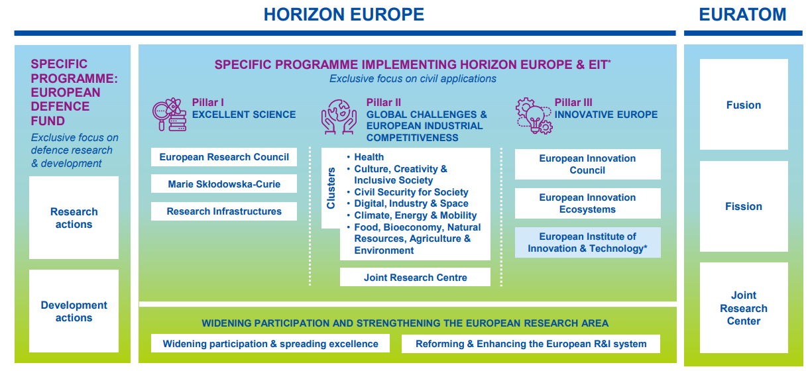
APVĀRSNIS EIROPA
WORK PROGRAMMES 2023-2024

Slide 3
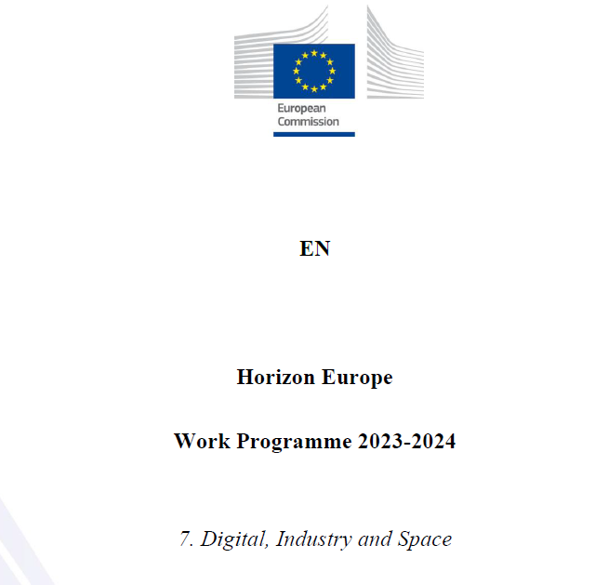
Apvārsnis Eiropa 4. klastera darba programma
informācija: https://ec.europa.eu/info/horizon-europe/cluster-4-digital-industry-and-space_en
darba programma: https://ec.europa.eu/info/funding-tenders/opportunities/docs/2021-2027/horizon/wp-call/2023-2024/wp-7-digital-industry-and-space_horizon-2023-2024_en.pdf
programmas ceļvedis:
https://ec.europa.eu/info/funding-tenders/opportunities/docs/2021-2027/horizon/guidance/programme-guide_horizon_en.pdf

Slide 4
DESTINATION 1
CLIMATE NEUTRAL, CIRCULAR AND DIGITISED PRODUCTION
DESTINATION 2
INCREASED AUTONOMY IN KEY STRATEGIC VALUE CHAINS FOR RESILIENT INDUSTRY
DESTINATION 3
WORLD LEADING DATA AND COMPUTING TECHNOLOGIES
DESTINATION 4
DIGITAL AND EMERGING TECHNOLOGIES FOR COMPETITIVENESS AND FIT FOR THE GREEN DEAL
DESTINATION 5
OPEN STRATEGIC AUTONOMY IN DEVELOPING, DEPLOYING AND USING GLOBAL SPACE-BASED INFRASTRUCTURE, SERVICES, APPLICATIONS AND DATA
DESTINATION 6
A HUMAN-CENTRED AND ETHICAL DEVELOPMENT OF DIGITAL AND INDUSTRIAL TECHNOLOGIES

Slide 5
Apvārsnis Eiropa 4. klastera darba programma
2023./2024. WP
top 2025. WP
WP 2025. nopublicēta
2024. gada rudens
https://www.youtube.com/watch?v=PgXf-jbRE80&t=7s

Slide 6
D3: World Leading Data and Computing Technologies
https://www.youtube.com/watch?v=tCMzmVa3QcA
Opening date: 15 November 2023
Deadline: 19 March 2024
Topic | Type of action, TRL | EU contribution per project (EUR million) | Number of projects to be funded
HORIZON-CL4-2024-DATA-01-01: AI-driven data operations and compliance technologies (AI, data and robotics partnership) | IA TRL 4-5/TRL 6-7 | 8-10 | 4
HORIZON-CL4-2024-DATA-01-03: Piloting emerging Smart IoT Platforms and decentralized intelligence | IA TRL 3-4/TRL 6-7 | 20-25 | 2
HORIZON-CL4-2024-DATA-01-05: Platform Building, standardization and Up-scaling of the ‘Cloud-Edge-IoT’ Solutions | CSA | 2 | 1

Slide 7
D4: Digital and Emerging Technologies for Competitiveness and Fit for the Green Deal
https://www.youtube.com/live/PEmPitl3cLU
Opening date: 15 November 2023
Deadline: 19 March 2024
Topic | Type of action, TRL | EU contribution per project (EUR million) | Number of projects to be funded
HORIZON-CL4-2024-DIGITAL-EMERGING-01-03: Novel paradigms and approaches, towards AI-driven autonomous robots (AI, data and robotics partnership) | RIA TRL 2-3/TRL 4-5 | 8 | 4
HORIZON-CL4-2024-DIGITAL-EMERGING-01-04: Industrial leadership in AI, Data and Robotics boosting competitiveness and the green transition (AI, data and robotics partnership) | IA TRL 3-5/TRL 6-7 | 10 | 5
HORIZON-CL4-2024-DIGITAL-EMERGING-01-21: Open Source for Cloud/Edge to support European Digital Autonomy | RIA TRL 4/TRL 6 | 4-6 | 4
HORIZON-CL4-2024-DIGITAL-EMERGING-01-22: Fundamentals of Software Engineering | RIA TRL 2/TRL 5 | 4-6 | 4
HORIZON-CL4-2024-DIGITAL-EMERGING-01-23: Public recognition scheme for Open Source | CSA | 2 | 1
HORIZON-CL4-2024-DIGITAL-EMERGING-01-31: Pilot line(s) for 2D materials-based devices | RIA TRL 3-4/TRL 5-6 | 33 | 1

Slide 8
D4: Digital and Emerging Technologies for Competitiveness and Fit for the Green Deal
https://www.youtube.com/live/PEmPitl3cLU
Opening date: 15 November 2023
Deadline: 19 March 2024
Topic | Type of action, TRL | EU contribution per project (EUR million) | Number of projects to be funded
HORIZON-CL4-2024-DIGITAL-EMERGING-01-45: Fundamentals of Software Engineering | IA TRL 4-5/TRL 6-7 | 4-5 | 3
HORIZON-CL4-2024-DIGITAL-EMERGING-01-54: Public recognition scheme for Open Source | RIA TRL 2/TRL 5 | 3-5 | 4
HORIZON-CL4-2024-DIGITAL-EMERGING-01-55: Photonics Innovation Factory for Europe (Photonics Partnership) | IA TRL 2-5/TRL 4-7 | 15 | 1

Slide 9
D5: Open strategic autonomy in developing, deploying and using global space-based infrastructures, services, applications and data
Opening date: 21 November 2023
Deadline: 21 March 2024
https://www.youtube.com/live/Y7sDJJlyYSE
Topic | Type of action, TRL | EU contribution per project (EUR million) | Number of projects to be funded
HORIZON-CL4-2024-SPACE-01-35: Copernicus for Land and Water | RIA /TRL 5-6 | 1,5-2 | 4
HORIZON-CL4-2024-SPACE-01-36: Copernicus for Security | RIA /TRL 5-6 | 4 | 2
HORIZON-CL4-2024-SPACE-01-64: Quantum Space Gravimetry Phase-B study & Technology Maturation | RIA /TRL 6-7 | 14 | 1
HORIZON-CL4-2024-SPACE-01-73: Space technologies for European non-dependence and competitiveness | RIA /TRL 5-8 | 2-3 | 7

Slide 10
D4: Digital and Emerging Technologies for Competitiveness and Fit for the Green Deal
Opening date: 16 April 2024
Deadline: 18 September 2024
Topic | Type of action, TRL | EU contribution per project (EUR million) | Number of projects to be funded
HORIZON-CL4-2024-DIGITAL-EMERGING-02-01: Developing and deploying a network of quantum gravimeters in Europe | IA TRL 6/TRL 8 | 25 | 1
HORIZON-CL4-2024-DIGITAL-EMERGING-02-02: Stimulating transnational research and development of next generation quantum technologies, including basic theories and components | RIA TRL 1-4/TRL 6 | 15 | 1

Slide 11
D6: A human-centred and ethical development and industrial technologies
Opening date: 16 April 2024
Deadline: 18 September 2024
Topic | Type of action, TRL | EU contribution per project (EUR million) | Number of projects to be funded
HORIZON-CL4-2024-HUMAN-03-01: Advancing Large AI Models: Integration of New Data Modalities and Expansion of Capabilities (AI, Data and Robotics Partnership) | RIA TRL 2-3/TRL 4-5 | 25 | 2
HORIZON-CL4-2024-HUMAN-03-02: Explainable and Robust AI (AI Data and Robotics Partnership) | RIA TRL 2-3/TRL 4-5 | 7,5 | 2
HORIZON-CL4-2024-HUMAN-03-03: Digital Humanism - Putting people at the centre of the digital transformation | CSA | 1,5 | 1
HORIZON-CL4-2024-HUMAN-03-04: Facilitate the engagement in global ICT standardisation development | CSA | 6 | 1
HORIZON-CL4-2024-HUMAN-02-35: Intellectual asset management support for public research organisations, academic institutions and their spin-offs | CSA | 2 | 1
HORIZON-CL4-2024-HUMAN-02-36: Synergy with national and regional initiatives in Europe on Innovative Materials | CSA | 4 | 1

Slide 12
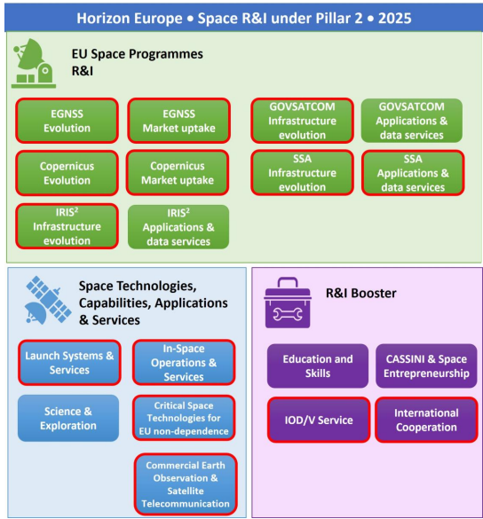
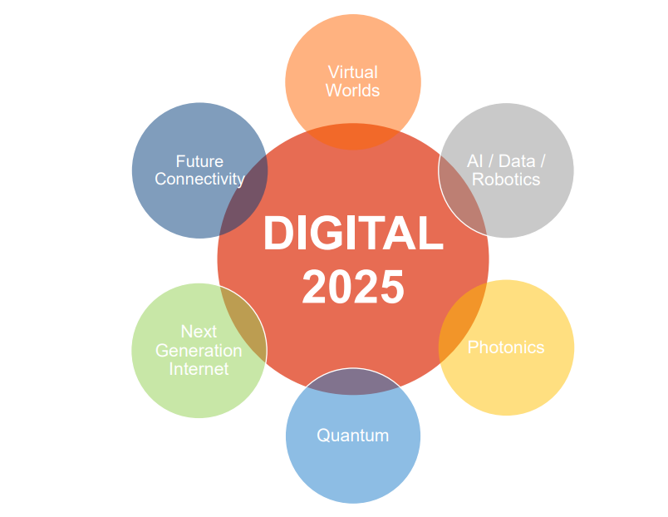
WP 2025 Orientations

Slide 13
Pasākumi
https://digital-strategy.ec.europa.eu/en/events/info-session-alliance-language-technologies-and-open-source-foundation-model
https://www.eurohpcsummit.eu
https://www.lzp.gov.lv/lv/notikums/informativais-pasakums-explore-horizon-europe-european-commissions-perspective-opportunities-latvian-participants?date=0
https://projects.research-and-innovation.ec.europa.eu/en/events/upcoming-events/research-innovation-days
https://erf2024.eu/

Slide 14
Statistika
Statistika: Apvārsnis Eiropa 4. klasteris
Nr.p.k. | Organizācijas nosaukums | EK piešķirtā finansējuma apjoms, EUR
1. | ELEKTRONIKAS UN DATORZINATNU INSTITUTS | 2 321 972
2. | RIGAS TEHNISKA UNIVERSITATE | 972 219
3. | LATVIJAS UNIVERSITATES CIETVIELU FIZIKAS INSTITUTS | 936 595
4. | SMARTSOL SIA | 663 770
5. | LATVIJAS UNIVERSITATE | 511 968
6. | WIT BERRY | 433 443
7. | LATVIJAS VALSTS KOKSNES KIMIJAS INSTITUTS | 421 375
8. | TILDE SIA | 408 538
9. | LATVIJAS TEHNOLOGISKAIS CENTRS NODIBINAJUMS | 385 888
10. | ZALA BRIVIBA BIEDRIBA | 305 000
Finansēti 43 projekti kopā par 10,1 milj. €
Dalību skaits finansētajos projektos – 51.
*dati uz 31.01.2024.

Slide 15
Paldies!
@apvarsnis
@Apvārsnis EU Latvijas Nacionālais kontaktpunkts - HE NCP LV
https://www.lzp.gov.lv/lv/apvarsnis-eiropa

