Slide 1
Horizon NCP info day
07.05.2024.

Slide 2
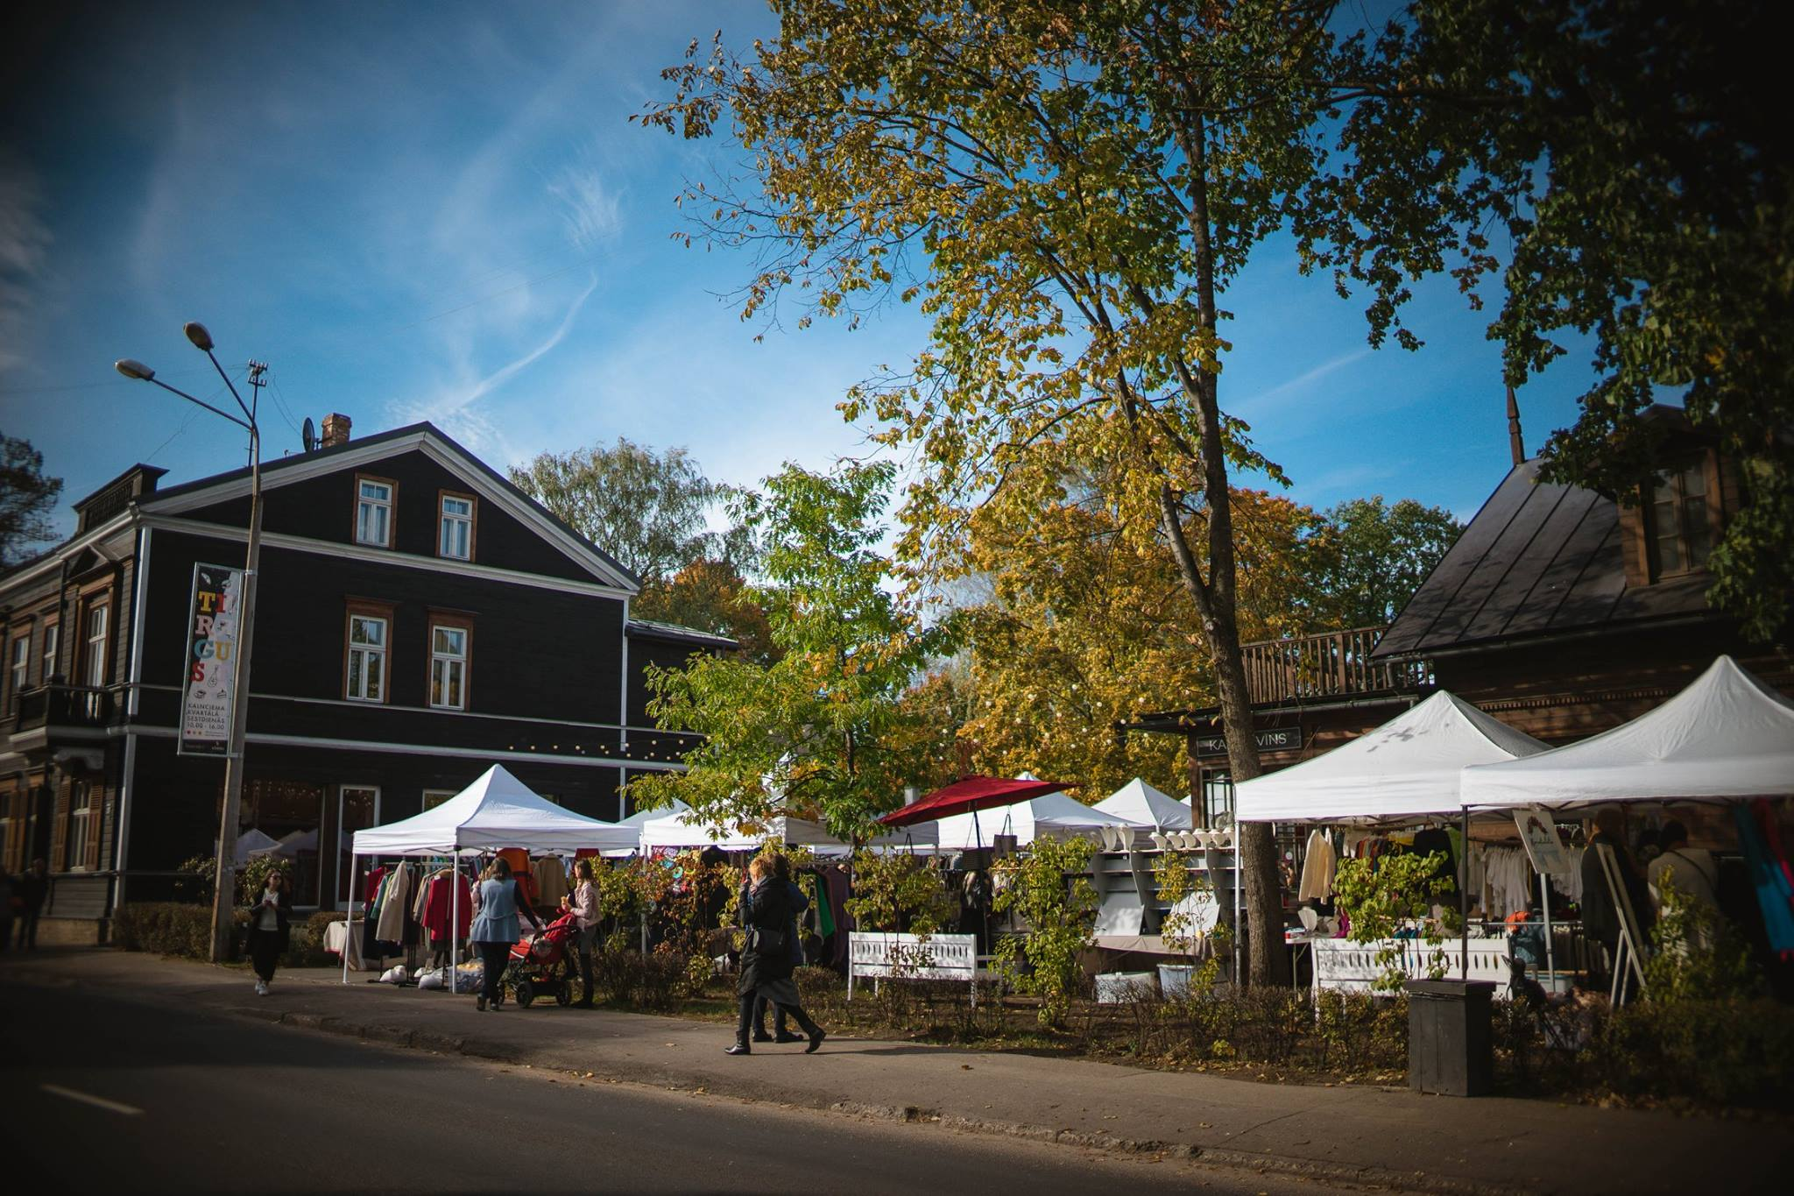
Experienced PLACEMAKERS from Latvia:
developers and managers of 2 multifunctional markets - food and culture hubs in Riga: Kalnciema Quarter & Āgenskalns market.
In line with NEB principles: BEAUTIFUL, SUSTAINABLE, TOGETHER

Slide 3
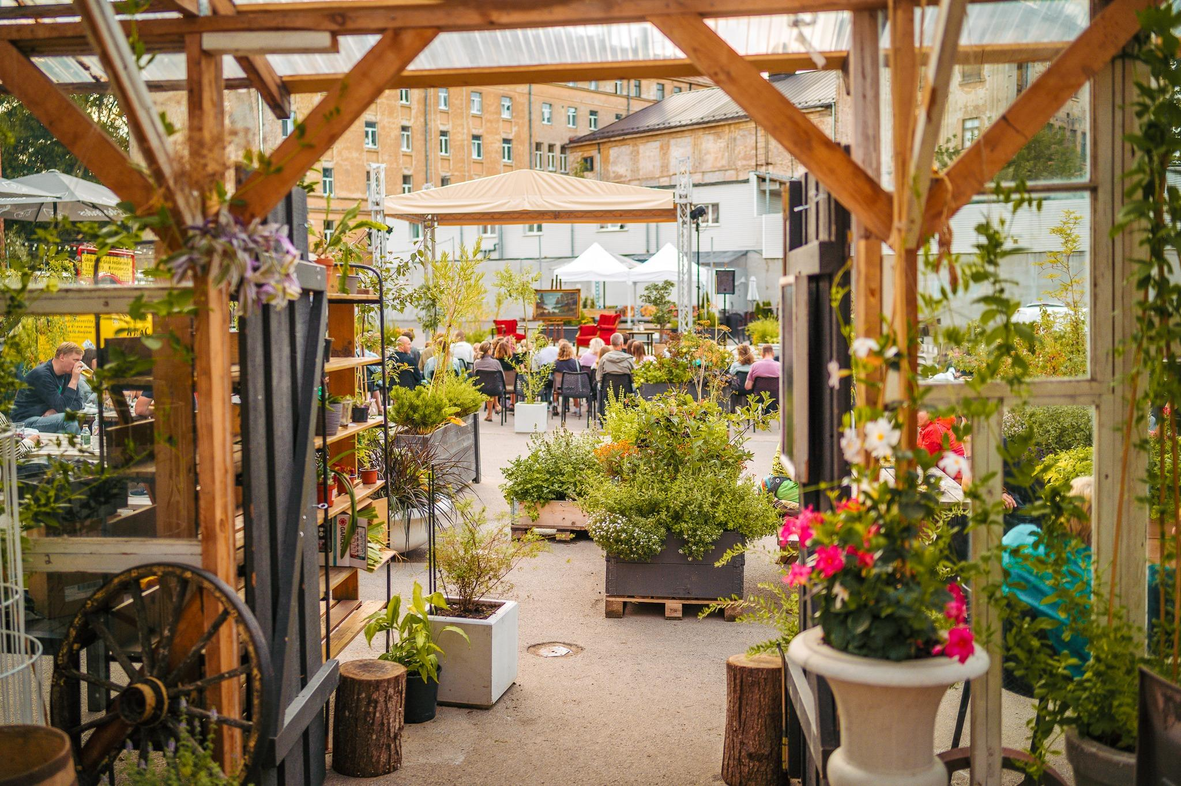
Kalnciema Quarter – reconstructed wooden architecture heritage site. Privately owned, open for public since 2008.
Āgenskalns market – reconstructed from 2018-2022, built 1914. National monument of architecture, owned by city of Riga.

Slide 4
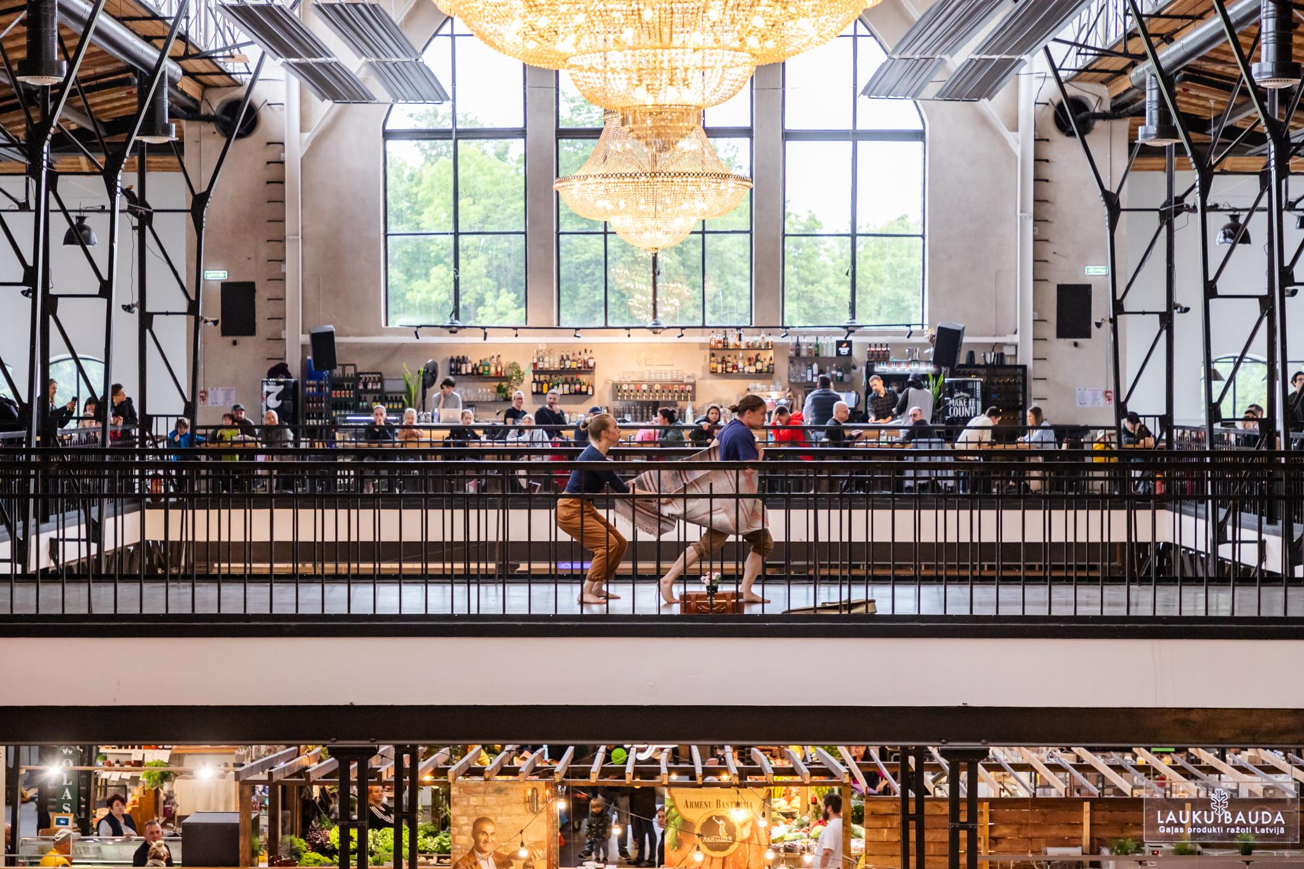
Riga-based organization Kalnciema Quarter, working for 15 years in placemaking, urban revitalization, and interdisciplinary culture projects.
Our themes encompass cultural heritage transformation, community engagement, local food, art, and wellbeing.

Slide 5
Interested in forming new partnerships under Horizon CL2, CL5, NEB, Creative Europe, and other calls.
Usually participate as practice partners in projects. As NGO or SME/entity.

Slide 6
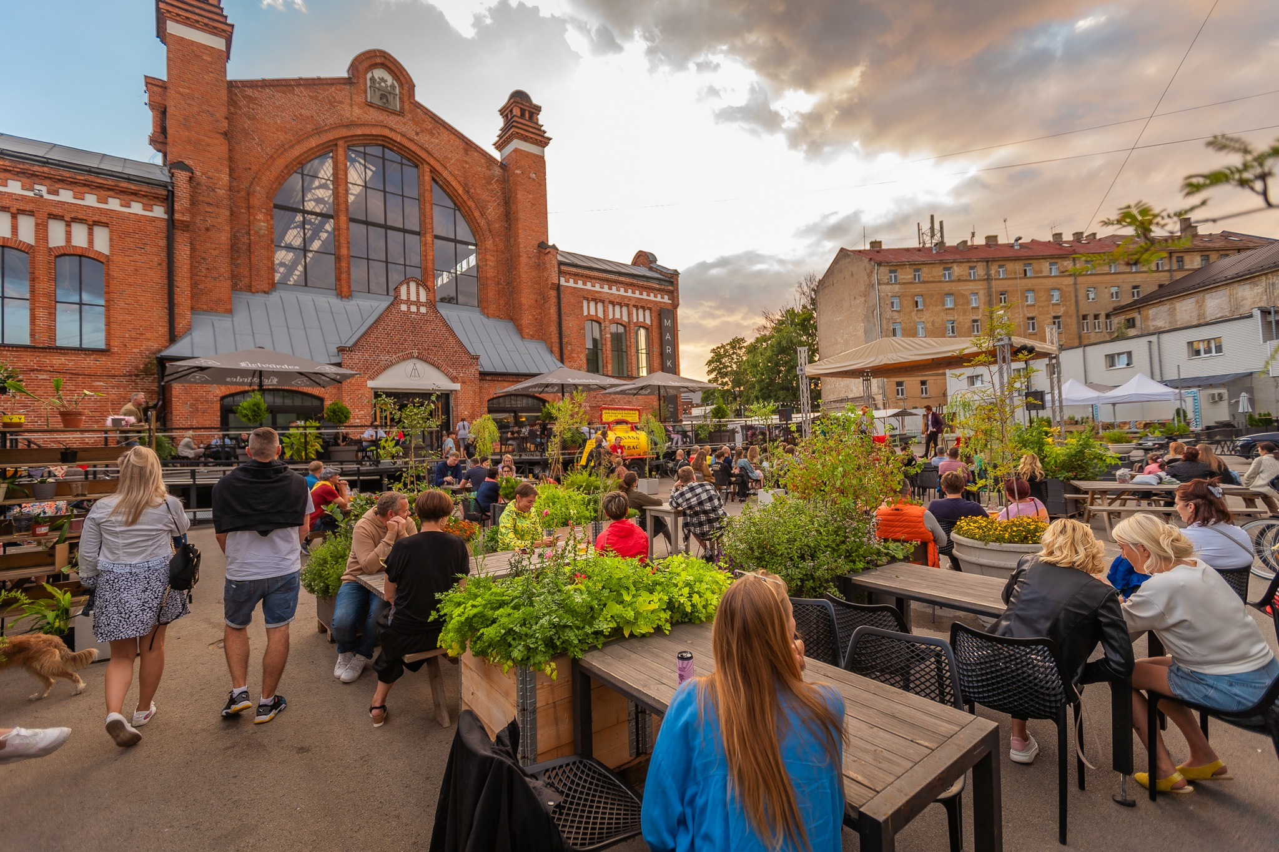
Looking for partners for current projects:
HORIZON-CL2-2024-HERITAGE-ECCCH-01-05: A European Collaborative Cloud for Cultural Heritage – Innovative tools for the study, conservation and restoration of heritage objects HORIZON-MISS-2024-NEB-01-02: New governance models for the co-design and co-construction of public spaces in neighbourhoods by communities

Slide 7
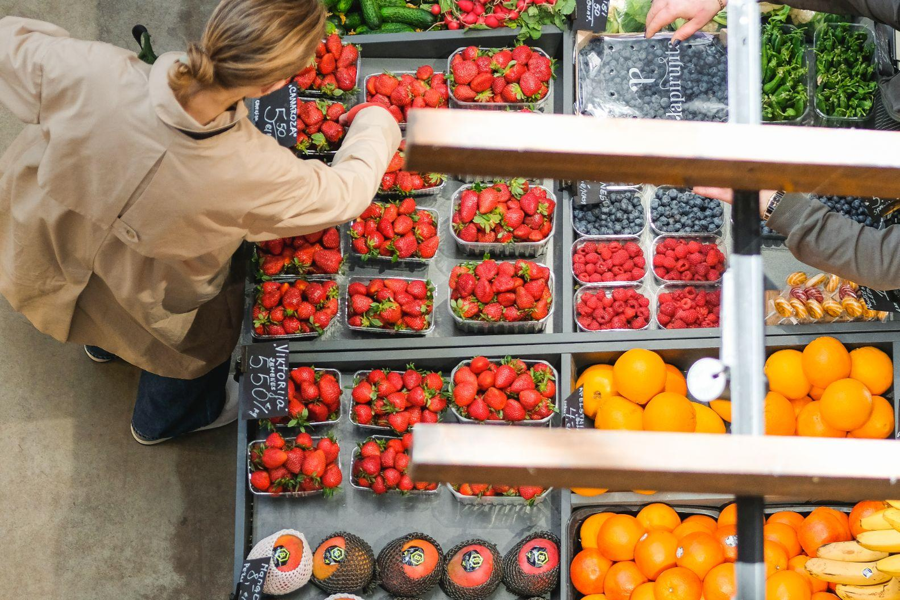
FOODCITYBOOST (2024-2028), Horizon Project
Integrated assessment of urban farming impacts and policies for boosting sustainable urban agricultural development linking urban, peri-urban and rural areas.
IN-HABIT (2020-2025), HORIZON 2020 Project
Objective: Enhance inclusive health and wellbeing in four peripheral small and medium-sized cities. Āgenskalns market actively participates as a multifunctional food hub.
SUSPLACE Project (2015-2019), Supported by Horizon 2020 (Marie Curie Actions):
Focus: Sustainable place shaping
SUPURBFOOD (2012-2015) Horizon Project:
Aim: Enhance sustainability of agriculture and food delivery in city-regions across Europe and the global South. Kalnciema Quarter Food market collaboration: Develop innovative approaches and shorten food chains.
Current and past projects:
Notes:
Submitted in 2024: HORIZON-CL6-2024-COMMUNITIES-01 HORIZON-IA 101181963 CROSSROADS HORIZON-CL6-2024-COMMUNITIES-01 HORIZON-IA 101182061 FULLNEB HORIZON-CL2-2024-HERITAGE-01 HORIZON-IA 101177343 HERITcote HORIZON CL5 Energy effiency Vehoren

Slide 8
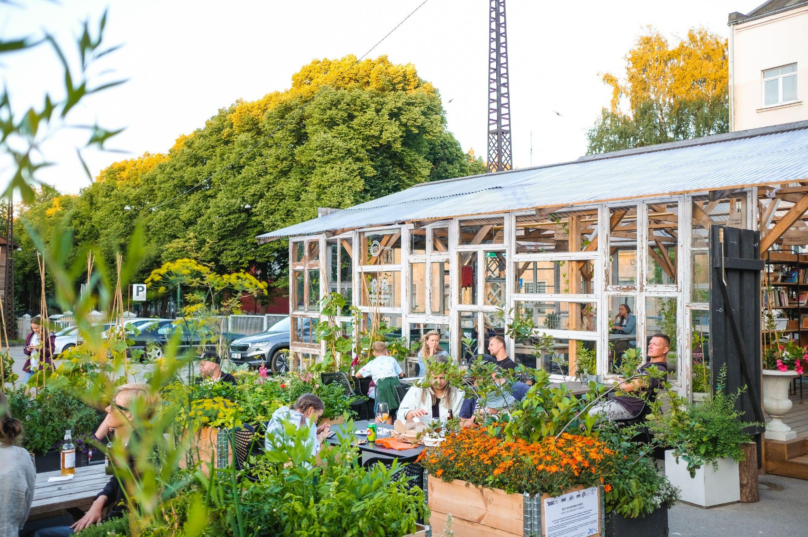
Do-it-yourself garden / Community garden
in Āgenskalns market since 2023 (IN-HABIT project)

Slide 9
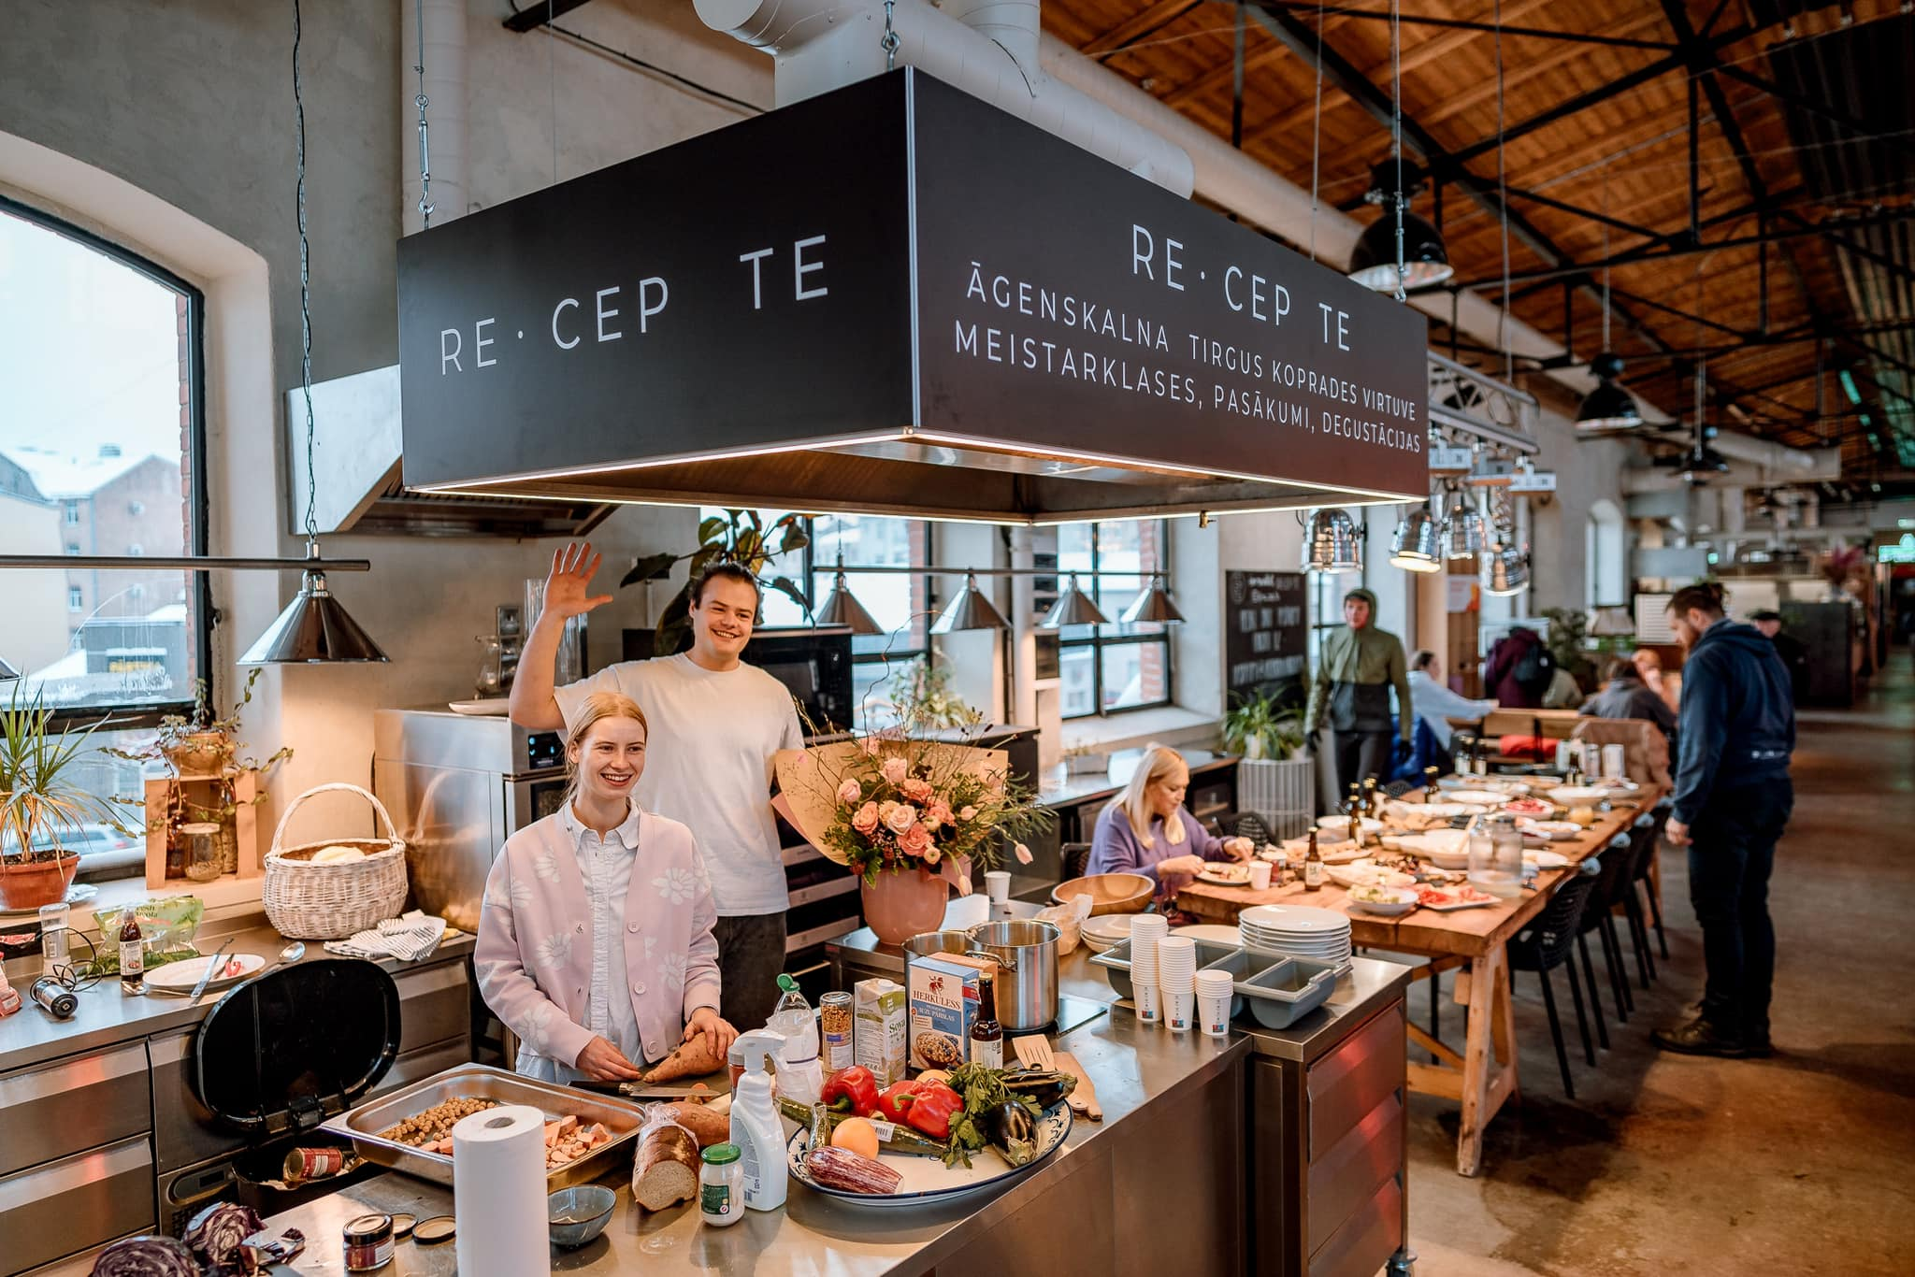
Co-creation kitchen RE CEP TE
in Āgenskalns market since 2023 (IN-HABIT project)

Slide 10
Follow our activities:
Kalnciema Quarter
@kalnciemaiela, kalnciemaiela.lv
Āgenskalns market
@atirgus, agenskalnatirgus.lv

Slide 11
Paldies!
Una Meiberga
senior project manager
+37129402027
una.meiberga@gmail.com
www.linkedin.com/in/una-meiberga

