Slide 1

Horizon Europe Vision 24-25:
EIC, EIT & EIE Announcements
Updates for Late 2024 and Early Insights into 2025
Marija Plotniece
Horizon Europe National Contact Point
Senior expert (EIC, EIT, EIE & RI)
marija.plotniece@lzp.gov.lv
1.1.1. specifiskā atbalsta mērķa “Pētniecības un inovāciju kapacitātes stiprināšana un progresīvu tehnoloģiju ieviešana kopējā P&A sistēmā” 1.1.1.5. pasākuma “Latvijas pilnvērtīga dalība Apvārsnis Eiropa programmā, tajā skaitā nodrošinot kompleksu atbalsta instrumentu klāstu un sasaisti ar RIS3 specializācijas jomu attīstīšanu” projekts “Atbalsts Latvijas dalībai starptautiskās pētniecības un inovācijas programmās”. ietvaros

Slide 2
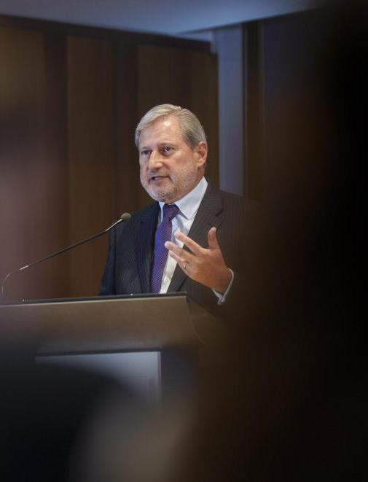
VISION 24-25
2024
Climate Action and Green Deal
Digital Transformation and Industry
Health and Life Sciences
2025
Climate Action and Energy Independence
Food Security and Agriculture
Digital Innovation and Strategic Technologies
Health and Wellbeing
Notes:
The strategic agenda for 2024-2029 (June 2024)

Slide 3



















EIC PRIZES
Women innovators
Capital of innovation
Innovation procurement
Social innovation
Humanitarian Innovation
SEAL OF EXCELLENCE
Fast track to other funding
EIC ACCELERATOR
SERVICES
Mentors, coaches
Global partners
Innovation ecosystems
EIC Community Platform
EIC ACCELERATOR
For single companies
Grants up to €2.5 million
Equity up to €15 million
or above
To enter the market &
scale-up (TRL 6-9)
EIC TRANSITION
For consortia &
single companies
Grants up to
€2.5 million
To develop
business cases
(TRL 4-6)
EIC PATHFINDER
For consortia
Grants up to €4 million
To research technology
breakthroughs (TRL 1-4)

Slide 4


EIC
WHO CAN APPLY & WHAT FOR?
PATHFINDER
Consortia of at least 3 different independent legal entities established in at least 3 different eligible countries. Additionally, single applicants or small consortia (2 partners) for EIC Pathfinder Challenges only.
Grants of up to €3 million (open) or €4 million (challenges, or more if duly justified, to achieve the proof of principle and validate the scientific basis of breakthrough technology (Technology Readiness Levels 1-4)

Slide 5



TRANSITION
Single applicants (SMEs, spin-offs,
start-ups, research organisations, universities) or small consortia
(2 partners) or consortia of 3 to 5 different independent legal entities established in at least 3 different eligible countries. Proposals must build on eligible EU-funded project results.
Grants of up to €2.5 million to validate and demonstrate technology in application-relevant environment (Technology Readiness Levels 4 to 5/6) and develop market readiness.

Slide 6





EIC ACCELERATOR
Grants for up to €2.5 million for developing your innovation (TRL 5/6 to 8)
Investments of €0.5 up to €15 million in the form of direct equity or convertible loans for scaling up your innovation and attracting co-investors
Single start-ups and SMEs (including spin-outs), individuals (intending to launch a start-up/SME) and in exceptional cases small mid-caps (fewer than 499 employees)
The technology component of the innovation is at least TRL 5 (technology validated in relevant environment)
The applicants must be establishes in a Member State or Horizon Europe Associated country

Slide 7



EIC BUSINESS
ACCELERATOR
PROCESS
Step 3
PITCH
Step 2
Successful Step 2 applicants will pitch their innovation in front of EIC Jury Members. If selected, applicants will be awarded funding.
If not selected, applicants will be awarded a Seal of Excellence to help you secure funding from other sources as well as get support from EIC Business Acceleration Services.
  SoE
SUBMISSION
Step 1
Successful step 1 applicants submit their full proposal to regular cut-off deadlines, to be assessed by remote evaluators.
To help you draft your full proposal, you will be entitled to receive 3 days of remote coaching from the EIC Business Acceleration Services.
  Next step: 3 GOs
IDEA PRESENTATION
Applicants have a disruptive / deep tech idea with a potential to scale up. Submissions of short proposals are possible at any time. Evaluation by remote evaluators within 4 -6 weeks.
Proposal template of 12 pages, 3 min video, 10 pitch ppt

Slide 8



EIC OPEN & CHALLENGES OVERVIEW 2023
EIC PATHFINDER
EIC TRANSITION
EIC ACCELERATOR
OPEN
DEADLINES
7 March 2024
18 September 2024
Short Applications: Continuous
Full Applications 2024: 3 October 2024
INDICATIVE BUDGET
€ 136 MILLION
€ 94 MILLION
€ 375 MILLION
CHALLENGES
DEADLINES/CUT-OFFS
16 October 2024
Short Applications: Continuous
Full Applications 2024: 3 October 2024
INDICATIVE BUDGET
€ 120 MILLION
€ 300 MILLION
CHALLENGES
Solar-to-X” devices Towards cement and
concrete as a carbon sink
Nature inspired alternatives for food
packaging and films.
Nanoelectronics for energy-efficient smart
edge devices
Protecting EU space infrastructure
Human Centric Generative AI
Virtual worlds and augmented interaction, including support to Industry 5.0
Enabling the smart edge & quantum technology components
Food from precision fermentation and algae
Monoclonal antibody-based therapeutics for
emerging viruses
Renewable energy sources and their whole
value chain

Slide 9

EIC (European Innovation Council) 2025
Main differences
Budget adjustments: increased focus on biotechnology, AI, and STEP Scale Up
Strategic priorities: enhanced focus on scaling deep tech and EU strategic autonomy
STEP Scale Up call: new initiative for larger investments in critical technologies.
Evaluation process updates: streamlined approach for STEP Scale Up, modified investment criteria

Slide 10
EIC (European Innovation Council) 2025
Pathfinder Challenge calls:
Biotech for Climate Resilient Crops and Plant-Based Biomanufacturing
Generative-AI based Agents to Revolutionize Medical Diagnosis and Treatment of Cancer
Towards autonomous robot collectives delivering collaborative tasks in dynamic unstructured construction environments
Waste-to-value devices - circular production of renewable fuels, chemicals and materials
Accelerator Challenge calls:
Acceleration of advanced materials development and upscaling along the value chain
Biotechnology driven low emission food production systems
GenAI4EU: Creating European Champions in Generative AI
Innovative in-space servicing, operations, space-based robotics and technologies for resilient EU space infrastructure
Breakthrough innovations for future mobility

Slide 11
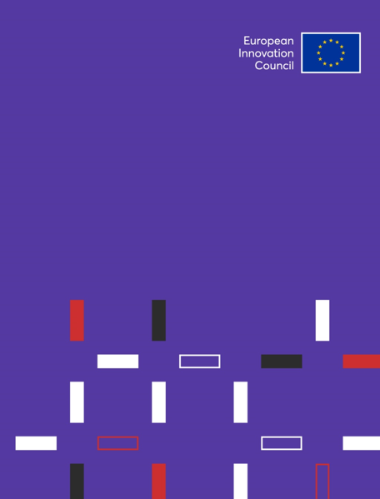


If you have any further questions about the EIC programme,
please contact us based on your country:
FOR LATVIA:
Egita Aizsilniece-Ibema
LIAA representative, NCP EIC & EIT
Latvian office for Innovation & Technology in Brussels – Lat.tech
Mob. +32 (0)455 10 12 74, +371 29331162, e-mail: egita.aizsilniece-ibema@liaa.gov
Marija Plotniece
Senior expert | Horizon Europe RI, EIC, EIE, EIT
Latvian Council of Science, Smilsu street 8, Riga, LV-1050
phone: +371 29966535, e-mail: marija.plotniece@lzp.gov.lv

Slide 12

EIT (European Institute of Innovation & Technology)
Programmes currently open
Event in October with EIT Campus and UK EIC/EIE NCP and Eurostars
/
2025 HIGHLIGHTS:
Manufacturing: focus on the Industrial Metaverse, AI, Circular Economy, and Net-Zero Industry
Urban Mobility: emphasis on sustainable urban logistics, public transport, and electrification
Culture & Creativity: supporting innovation in the cultural and creative sectors, fostering European identity
Water Innovation: launch of a new community addressing water scarcity, droughts, and ecosystem protection
https://www.eiturbanmobility.eu/main-innovation-open-call-2025/

Slide 13
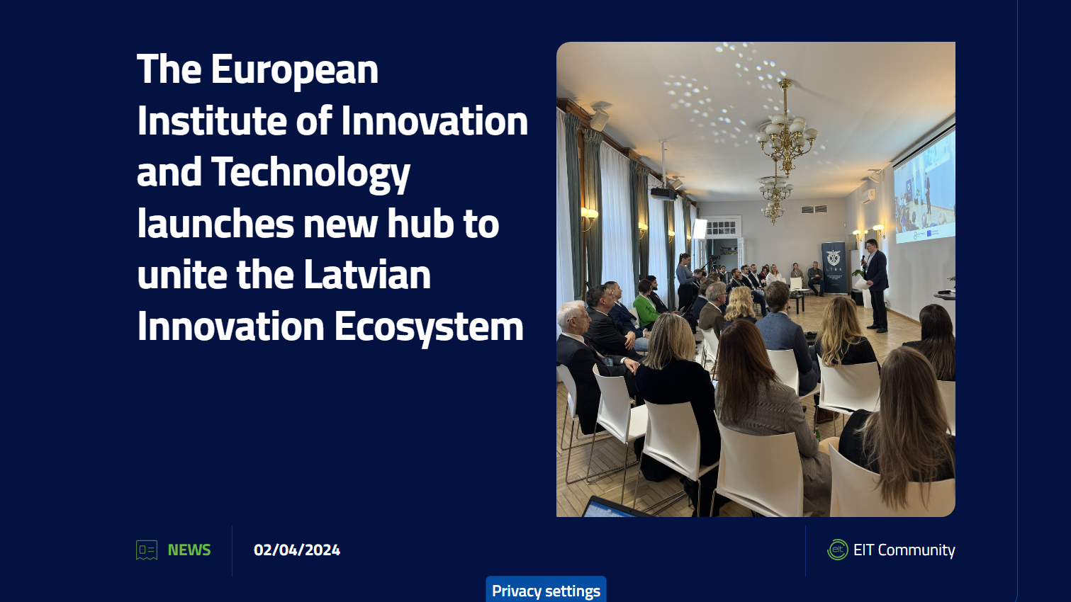
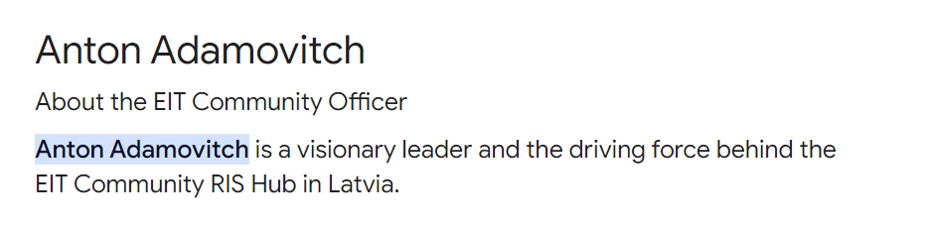

Slide 14
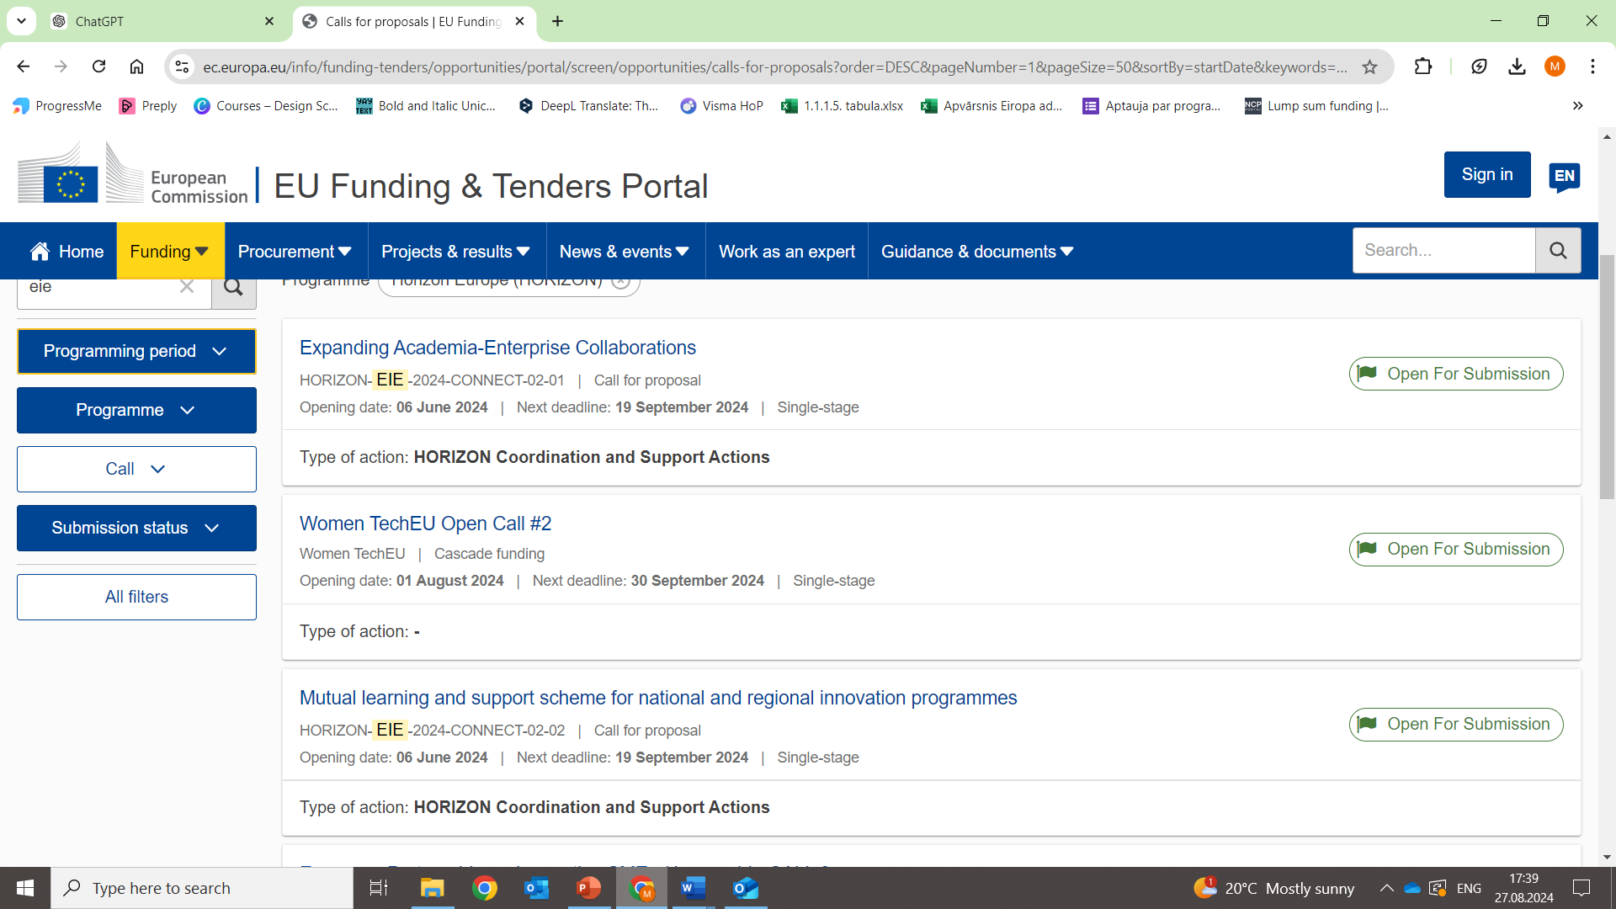

EIE (European Innovation Ecosystems) 2024
STILL OPEN

Slide 15
EIE (European Innovation Ecosystems) 2025
Increased Focus on Regional Innovation Hubs:
Strengthening Regional Innovation Valleys (RIVs) with co-funded action plans
Two Call Destinations (CONNECT & INNOVSMES):
Continuation of these call destinations with enhanced focus areas
Expanded Role of Innovation Procurement:
Launch of the European Network of National Competence Centers for Innovation Procurement
Greater Emphasis on Inclusiveness and Diversity:
Targeting less represented regions and fostering gender and social innovation
Strategic Alignment with European Priorities:
Stronger alignment with the Green Deal, digital transformation, and net-zero objectives
Enhanced Synergies with Other EU Programs:
Integration with Cohesion Policy, Recovery and Resilience Facility, and other funding sources

Slide 16

THANK YOU!

